Slide 1
Designing a Course Template for a Large Institution
Sophie Gahan
Inclusive UCC
University College Cork

Slide 2
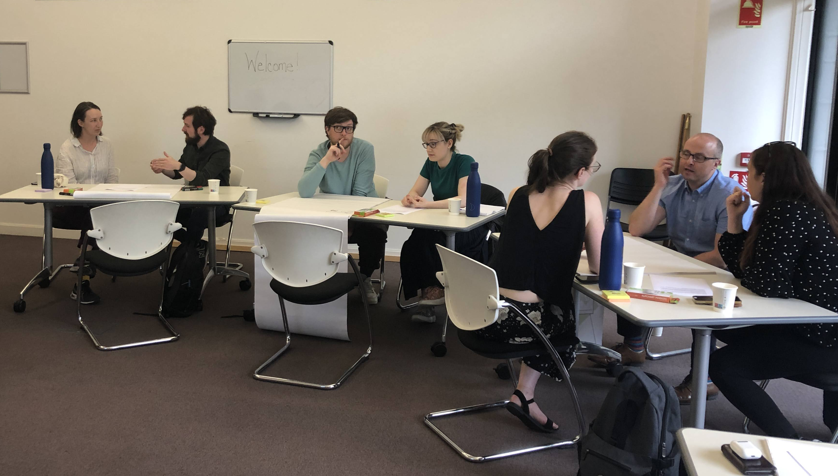
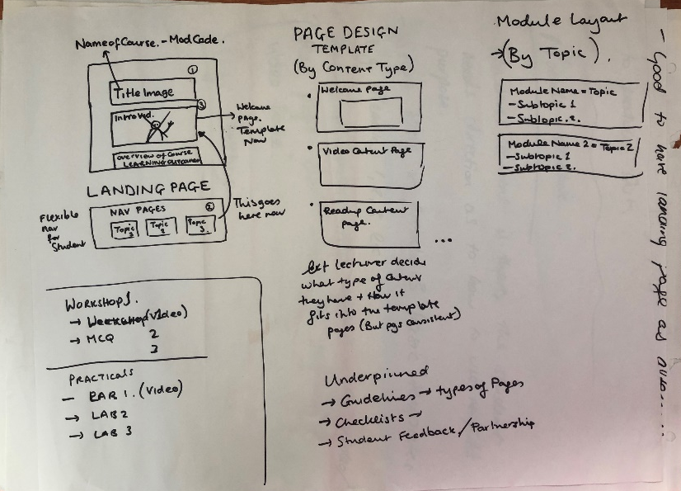
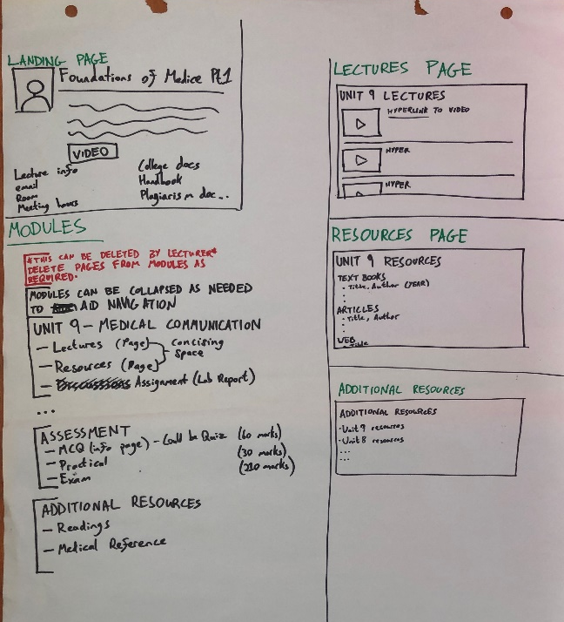
Getting Started
The first step was a workshop involving Instructional Designers, academic staff, and students.
Styled using tasks and scenarios.
The students brought a unique lens of experience e.g. what features are helpful/unhelpful on a landing page.
Built in Canvas after the workshop. Reviewed with group.

Slide 3
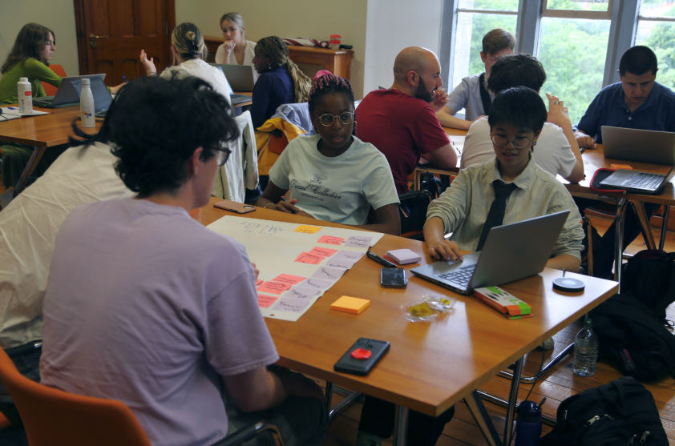
Trialling
“I was delighted that we could be a part of this pilot this year - while there was a little more work involved it was so worth it because it made my life a lot easier in terms of accessing and using Canvas without drowning in information.”
Dr Helen Lynch, Occupational Science
The first trial was with modules in Occupational Science.
There was positive feedback from lecturers and students, despite some initial extra work from the former.
Further feedback was collected from our student interns the following summer.

Slide 4
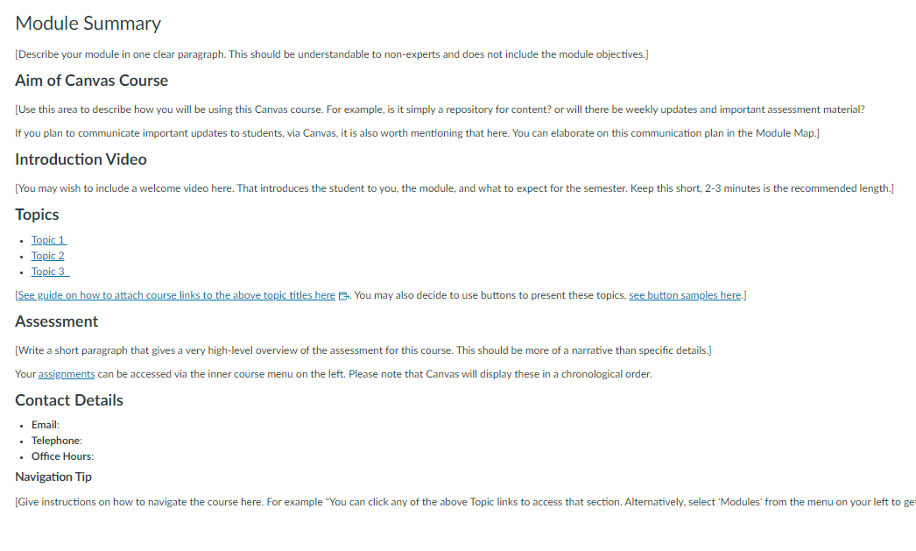
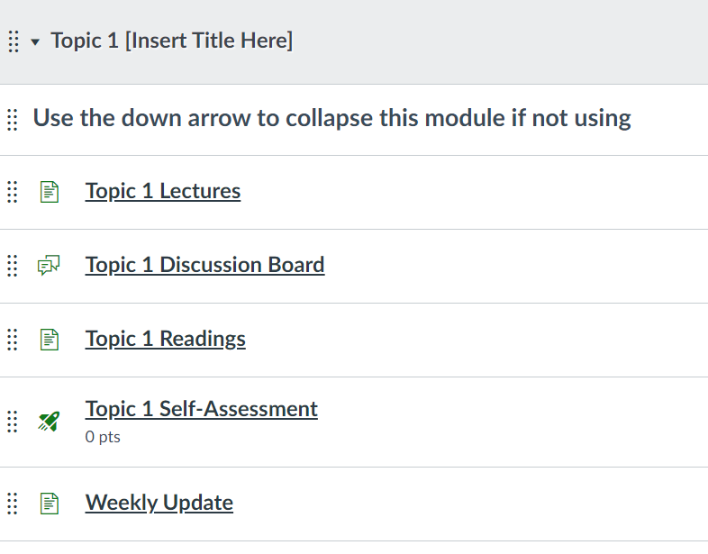
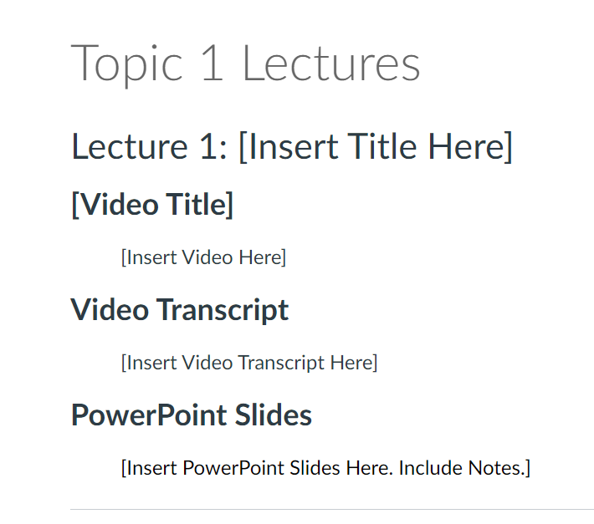
Features
The template provided pre-formatted layouts for the landing page, the sections within the course, and the layout of each page of content.
Instructions on how to use the template were also a necessity.
We opted for a more text-based layout to avoid issues with image adjustments and screen resizing.

Slide 5
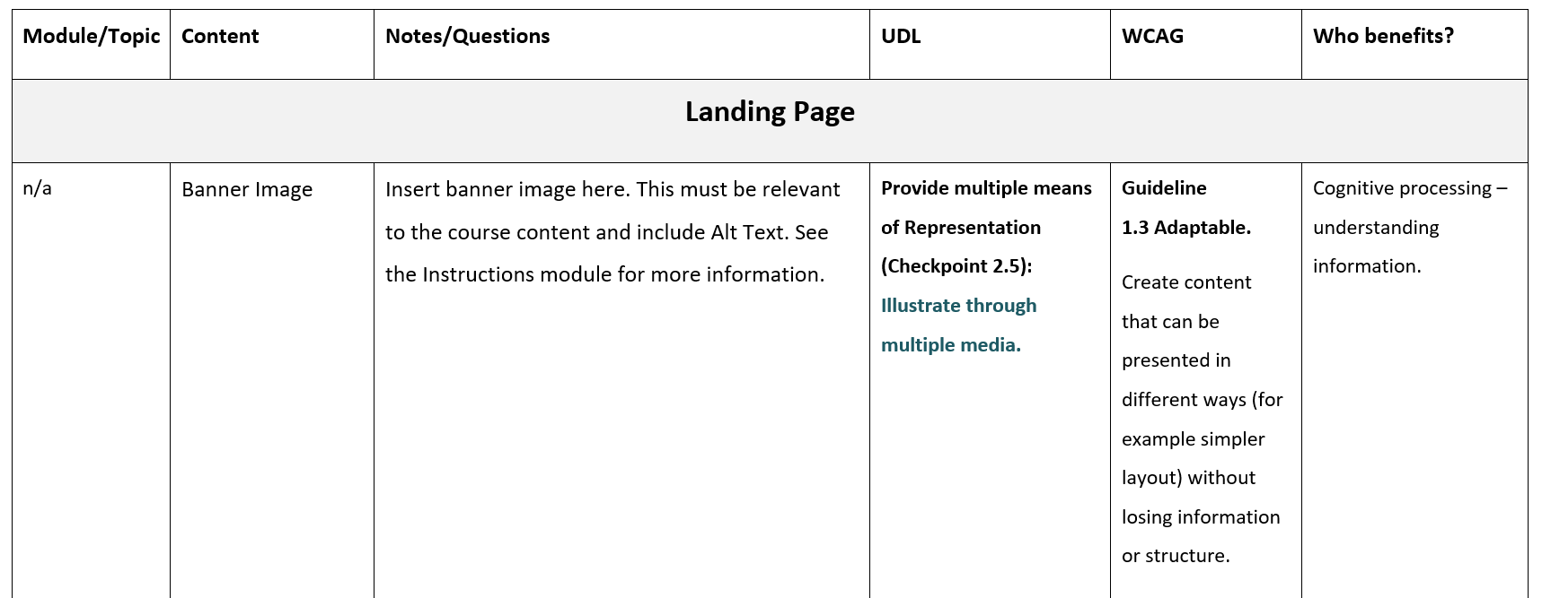
Rationale
We incorporated UDL and WCAG standards throughout and provided a rationale for each layout to the staff.

Slide 6
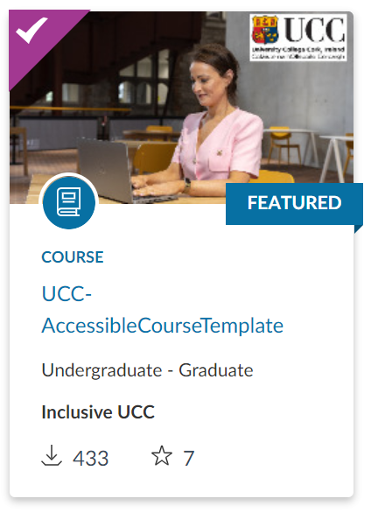
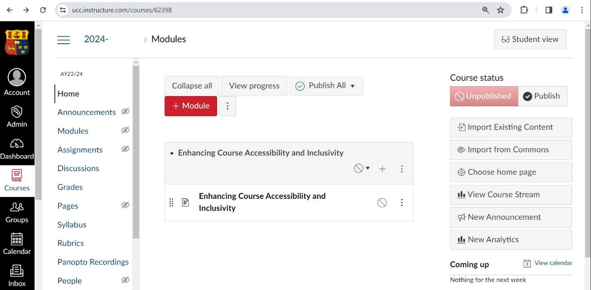
Rollout
We spent time researching whether to make the template a default setting for all users or optional.
Default templates are rarer, and we chose optional in the end, with a recommendation included on all new course shells.
Since the 2024 rollover there has been over 400 downloads.

Slide 7
Analysis
To gather feedback we ran a focus group with staff.
Students were surveyed via live VeVox sessions in class.
Staff were generally positive about the formatting but negative about the workload involved.
Students’ favourite part was the structuring into clear topics.

Slide 8
Learnings
Training for staff is essential (include demos and drop-ins),
Templates can be misused. Especially when using images and buttons. We decided to use text, but instructions to lecturers were often published,
It is easier to apply to a new courses than to retrofit,
Student and staff feedback can differ. What staff find time-consuming; students love e.g. one page to summarise all readings for the module.

Slide 9
Thank you for engaging
inclusive@ucc.ie

