Slide 1


Career Development Power of Disability | 13th February 2024
Alice Hartigan | WAM Project Officer
Banba Fitzgerald | GetAHEAD Officer

Slide 2
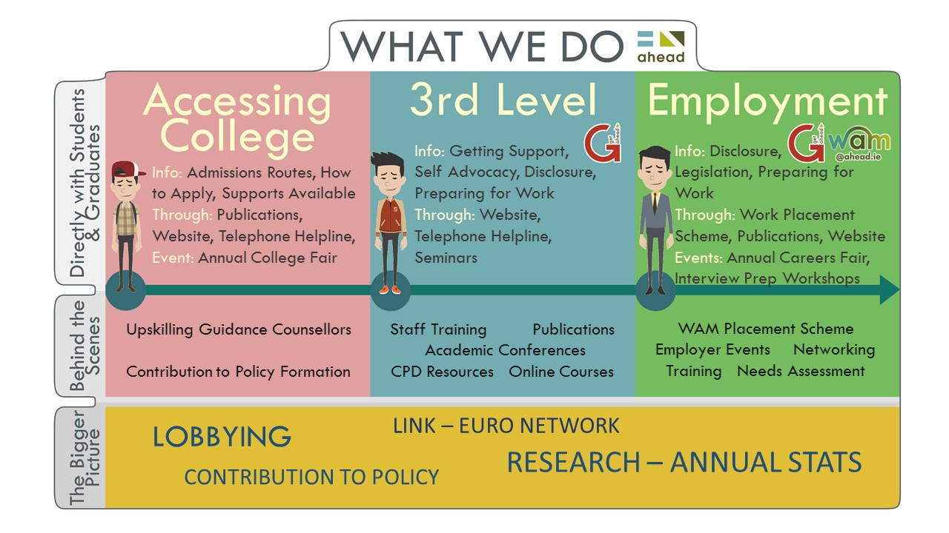
What do AHEAD do?

Slide 3

What is The WAM Programme?
Widen access to mainstream employment while working and supporting employers to become more inclusive
Employers offer ring-fenced roles at graduate level
Comprehensive training prior to recruitment and placement
Workplace needs assessment conducted with all graduates
Ongoing support from WAM Team throughout
Graduates get paid work opportunities and experience the world of work in a supported way
Notes:
The WAM programme is helping to bridge the disconnect with employers and the recruitment of people with disabilities.
What is the WAM programme and how do we do this?

Slide 4

Benefits of WAM
Employers receive disability awareness training
Paid work experience
A safe space to disclose
Career development
A comprehensive Needs Assessment to identify supports
Support of a company mentor on site
Enrolment into WAM’s online course
Support from WAM Team
Improved confidence!!

Slide 5
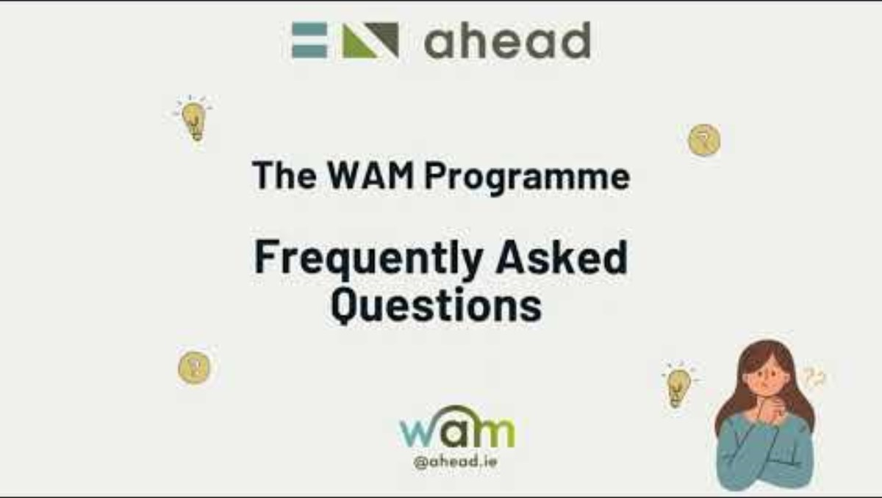
WAM Programme - FAQs

Slide 6

Steps involved in a WAM placement
Recruitment & Selection
WAM Needs Assessment
The WAM Mentoring Model
Pre-Placement Training
The WAM Placement
Evaluation
Notes:
Recruitment & Selection
WAM advertise roles on our website, graduates apply through their WAMworks account, Interviews and shortlisting conducted by company
WAM Needs Assessment
Once successful in securing a placement, we conduct needs assessment. A report is given to employer with recommended supports for the graduate
The WAM Mentoring Model
Every candidate is assigned an in-house mentor during their placement, for extra support.
Pre-Placement Training
WAM team conduct pre-placement training with the line manager and mentor before the placement begins.
The WAM Placement
Graduates start in their new role, WAM check in with Graduate, Manager and Mentor to support the placement
Evaluation
End of the placement, WAM send an evaluation survey to gain feedback and learning

Slide 7
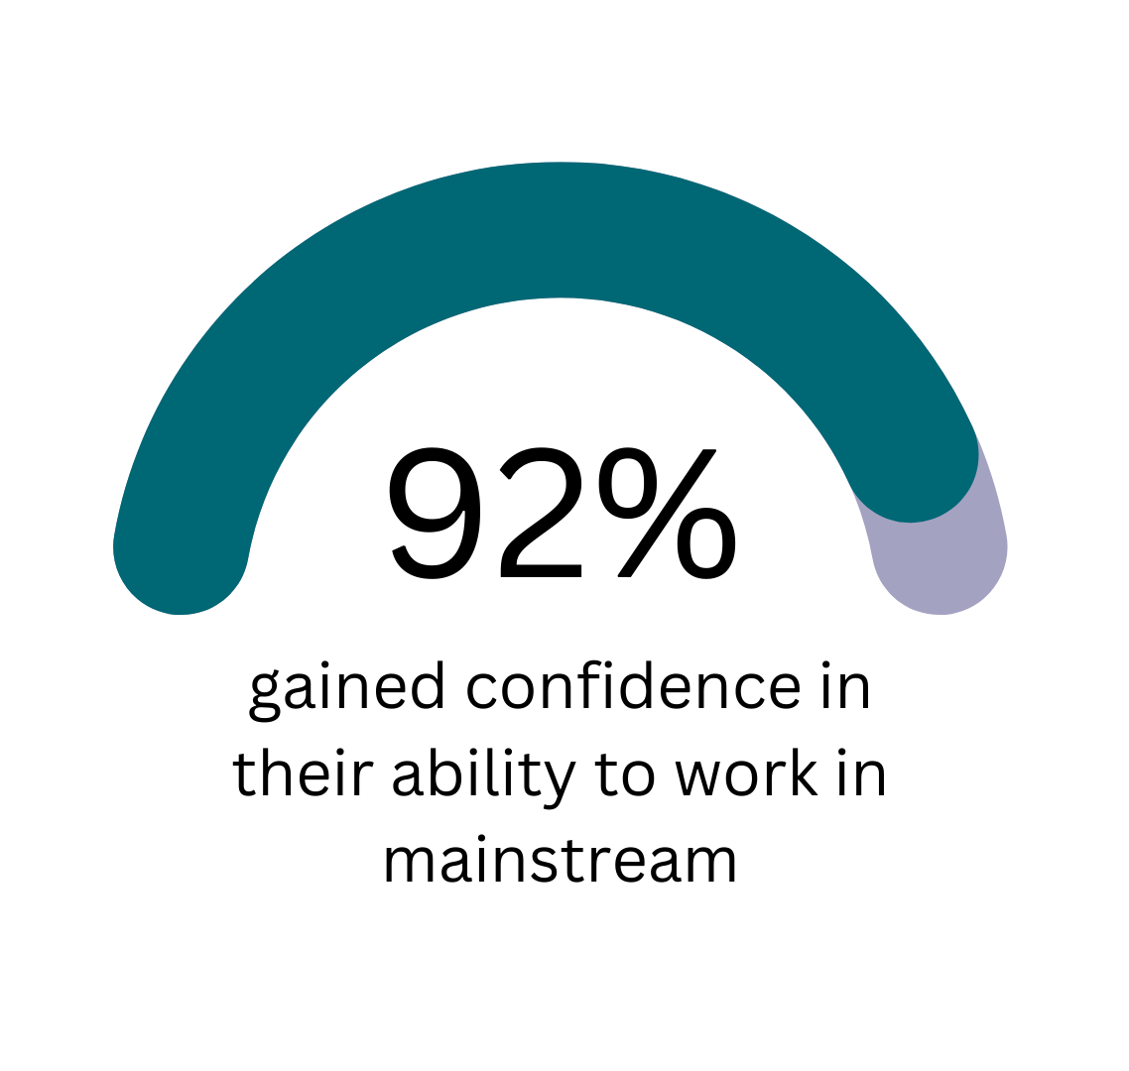
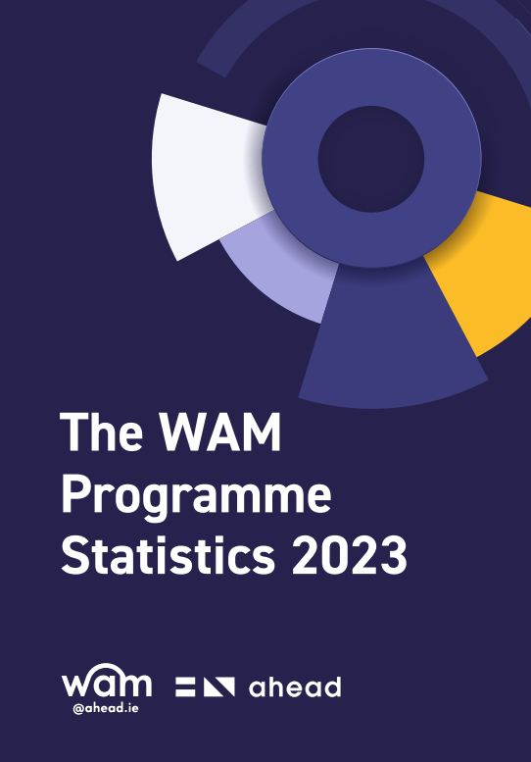
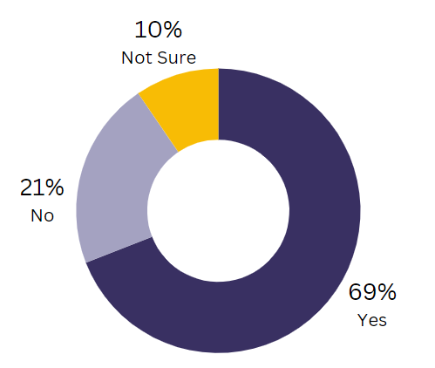

WAM Key Statistics
69% of graduates are more confident in disclosing their disability to mainstream employers after their WAM placement.
Full Report on AHEAD’s Website
Notes:
Each chart is separate – choose what you wish.

Slide 8
We know WAM works!
“
From this placement, I had the confidence to apply for a traineeship in a legal law firm. I am one off until I am a trained solicitor. Thanks for everything.
81% of WAM graduates secured employment as a direct result of their WAM placement
“
“
I can safely say that I would not be nearly as successful without the support of AHEAD……I am now a full-time, permanent Civil Servant and I literally could not be happier!
“

Slide 9
Profile of WAM Placements
Company | Location | Educational Requirements | Duration
Civil Service - Executive Officer Permanency Pathway x 25 | Nationwide | All disciplines, QQI Level 6 | 10 months
Local Authorities - Assistant Staff Officer | Nationwide | All disciplines, QQI Level 6 | 6- 12 months
Graduate Programmes Bank of Ireland NTMA Pfizer Allianz Enterprise Ireland ESB | Dublin | All disciplines, QQI Level 7,8,9 | 1– 2 years
Various other roles with Bord na Móna, MTU Kerry, Abbvie, Mental Health Commission, Boston Scientific and more!

Slide 10
WAM Graduate Video – not yet released

Slide 11

What is GetAHEAD?
Initiative of AHEAD working to up-skill students and graduates with disabilities by providing training events, blogs, resources and other valuable information covering a wide range of topics. Find out more here.

Slide 12

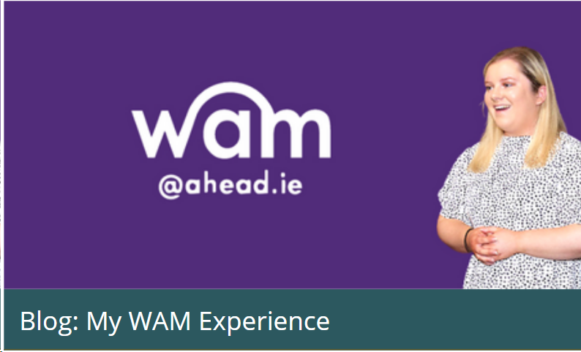



GetAHEAD Blogs – Tips & personal stories
Personal experiences
Tips
Event insights
Explore the GetAHEAD Blogs here!
Submit your own story here

Slide 13


GetAHEAD Events Free Training!
Think Twice Workshops
GetAHEAD Boot-Camps
Transferable Skills
CV Writing
Interview Preparation
Disclosure
Assistive Technology
Working Remotely
Getting Ready to Start Work
Growing your LinkedIn

Slide 14


Think Twice Workshops
Building your Employability Skills on Campus!
Revenue, Set, GO! Your Tax Starter Kit

Slide 15


GetAHEAD Resources
Disclosure
Legislation
Accommodations at work
Grants available
Resources – AHEAD
Job Search – AHEAD

Slide 16

Building the Future
Hosted by Citi in Dublin
Mock Interviews
CV clinic
Headshot station
Employer Exhibition Space
Workshops
date to be confirmed – June 2025

Slide 17





Building the future images

Slide 18



Useful Publications
Download Links
Maximising Your Job Application Going to College Guide Disclosure Guide

Slide 19

What is Disclosure?
Disclosure can be perceived as a negative term
May not necessarily align with how you feel
Term ‘disclosure’ has a particular connotation in legal frameworks

Slide 20
An Approach to Disclosure
Personal Factors
Systemic Factors
Environmental Factors
Type of Disability
Self-identity
Personality
Previous Experiences
Colleagues and managers
Organisational culture
Physical or hybrid
Legalisation
Company Policies
Infrastructure
Supports and Grants
Awareness of Disability

Slide 21

Action Plan for Disclosing
Why
What
When
Who
How

Slide 22

5 reasons to register on our WAMWorks Database!

Slide 23


Upcoming WAM Job Opportunities
Opening 19th February 2025
Pfizer Newbridge – 3 positions available for 6-month contracts. NFQ level 7 required in Science/Engineering
Open now – Closing 19th February 2025
20 roles across 12 Local Authorities
Placement durations vary, 6-month, 9-month and 12-month placements
NFQ Level 6 required

Slide 24

Register on our WAMWorks Database!
Students and graduates with disabilities should firstly register on our WAMWorks Database
www.ahead.ie/wamworks
Get notified and attend workshops and events on upskilling in the workplace
Get notified and apply for paid graduate level jobs exclusively for people with disabilities

Slide 25

Any questions? WAM: WAM@ahead.ie GetAHEAD: banba.fitzgerald@ahead.ie
aheadireland
www.ahead.ie

