Slide 1


AHEAD & NDPAC Partnership
Creating a Community of Disabled Postgraduates
Dr Vivian Rath – Research & Policy Officer
Aoife Price – Co-Chair of National Disabled Postgraduate Advisory Committee
Vivian.rath@ahead.ie
disabledpostgradgroup@gmail.com

Slide 2
Under-Representation
3% postgrad
Vs
8.1% undergrads
Postgraduates in HE
Lack of Community
Lack of Knowledge & Awareness of the Barriers
Challenges Accessing Funding
Lack of Transition Pathways
Notes:
Add in figures from Disabled Students UK on STEM Postdocs -

Slide 3
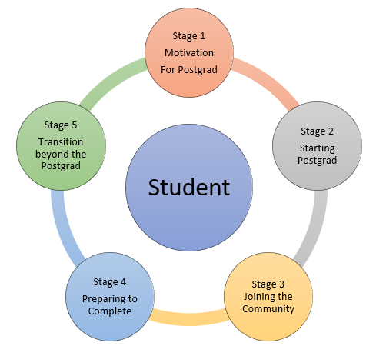
Barriers to Postgraduate
Pathways to Postgraduate
Funding
Professional development on postgraduate
Attending conferences, writing journals
Balancing impairment and workload
Flexible Learning/Research Opportunities
Progression from Postgraduate to Early Career Research

Slide 4

Tackling Under-Representation
Student Experience & Success
Notes:
Student Experience & Success – making contribution to addressing these issues

Slide 5
What is NDPAC
Campaign to increase awareness of disabled postgrads began in 2019
NDPAC established to hear the voice of a group who were not at the decision making table
Group organised, led and comprised of disabled people
Postgrads & Early Career Researchers from colleges across Ireland, and growing

Slide 6
Achievements
KPI on Postgraduate Study in the National Access Plan
HEA/NDPAC Disabled Postgraduate Conference
Ahead Conference Workshop
AHEAD/NDPAC Partnership

Slide 7
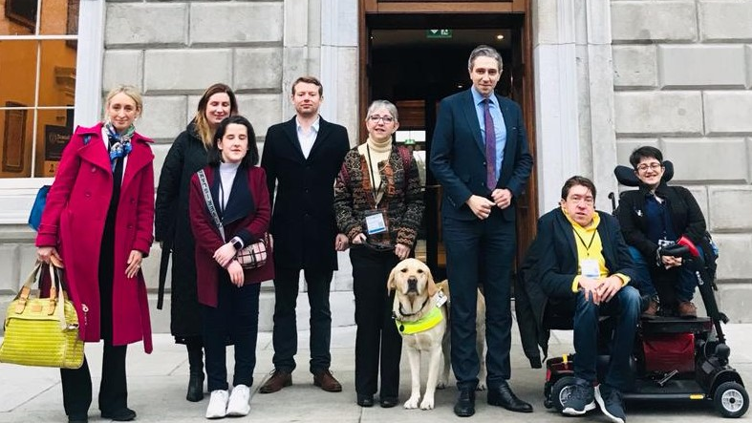
Photograph

Slide 8

Peer Group Communities
Role Models
Identity
NDPAC
Voice
Belonging
Community
Empowerment
Notes:
Harness the voice – hearing lived experience – influence change
Thriving groups create spaces to foster social connections and communication that in turn nurture creativity, innovation, and success (West, 2022).
Central to creating a sense of belonging and connection is developing an identity and voice as a postgraduate and ECR.
Supporting activities that present opportunities for connection and foster a sense of community and belonging, can act to fight against social isolation and loneliness (McNamara et al., 2021) , support positive mental health (Dingle et al., 2022), and reduce disengagement (Pedler et al., 2022).

Slide 9

Creating a Partnership
Between AHEAD (NGO) & NDPAC (DPO)
What needed to be done?
Identify if there was alignment of Values between the groups
Develop a Memorandum of Understanding between the two groups to work together
Create a three-year project plan & funding proposal

Slide 10
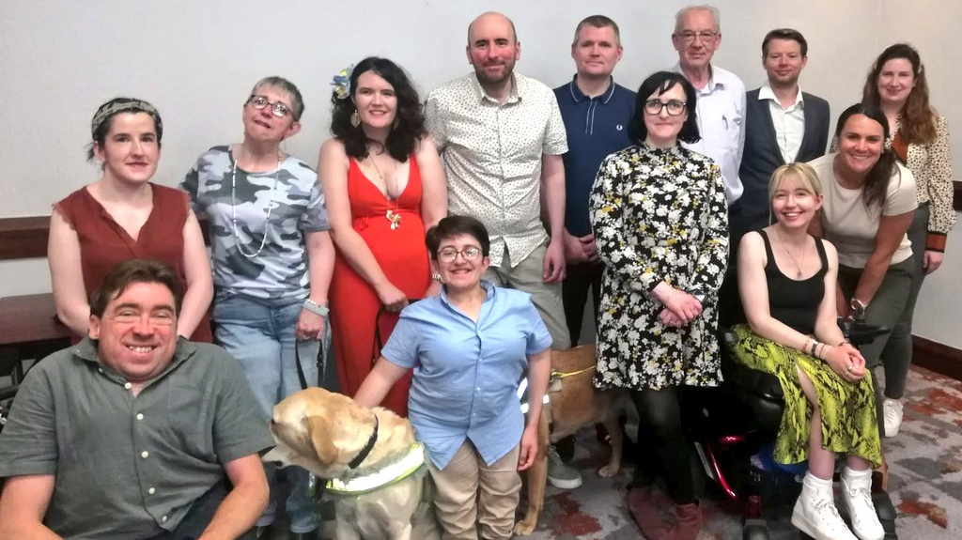
NDPAC & AHEAD – Building a Community of Disabled Postgrads

Slide 11

3 Year Partnership Plan
This partnership will see AHEAD roll out of several targeted initiatives to tackle the underrepresentation of disabled postgraduates and ECRs in HE in Ireland with the support and guidance of NDPAC
While operating separate and distinct mandates, the Parties will be guided by a three-year project plan and the following objectives:
Year one – Foster a Sense of Belonging by Establishing the NDPAC / AHEAD Partnership and Community
Year two – Influence Policy Development by Amplifying the Lived Experience of the Diverse Voices in the Community
Year three – Sustaining the Community to Make a Lasting Impact Through Engagement in HE Decision-Making

Slide 12

What should that Disabled Postgraduate Community Look Like?

Slide 13
What should the NDPAC / AHEAD Partnership be focusing on?
What events should it consider running?
What supports do you want to see for disabled postgraduates in colleges?

Slide 14
Resources
National Disabled Postgraduate webpage
NDPAC Membership Form
AHEAD Postgraduate webpage
HEA / NDPAC Report on Barriers to Postgraduate
The National Disabled Postgraduate Advisory Committee: Working for Change in Higher Education

Slide 15

Thank You!
Visit ahead.ie for more information about our work
Email: vivian.rath@ahead.ie

