Slide 1

Hello
Trevor Boland
Assistive Technology Officer
Dublin City University
(Dog fantanatic, Song: California Soul, Game:Zelda)

Slide 2

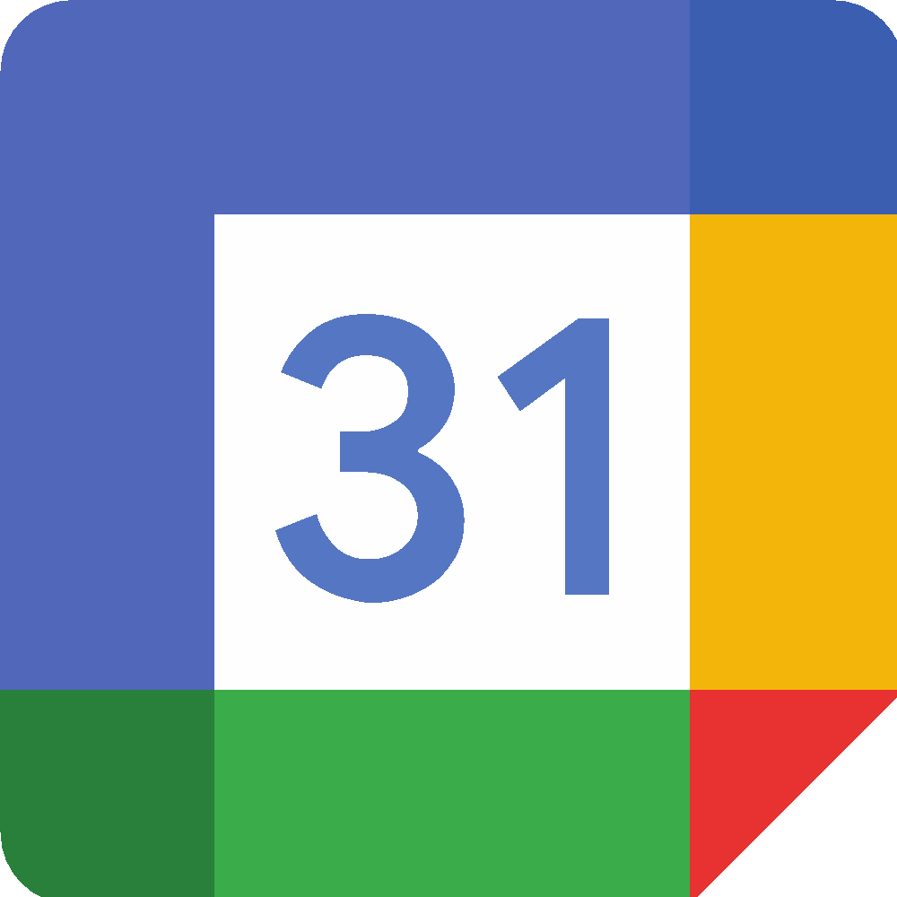







Tech is everywhere

Slide 3









Social

Slide 4

















Lifestyle

Slide 5


Technology expectations
for College?

Slide 6

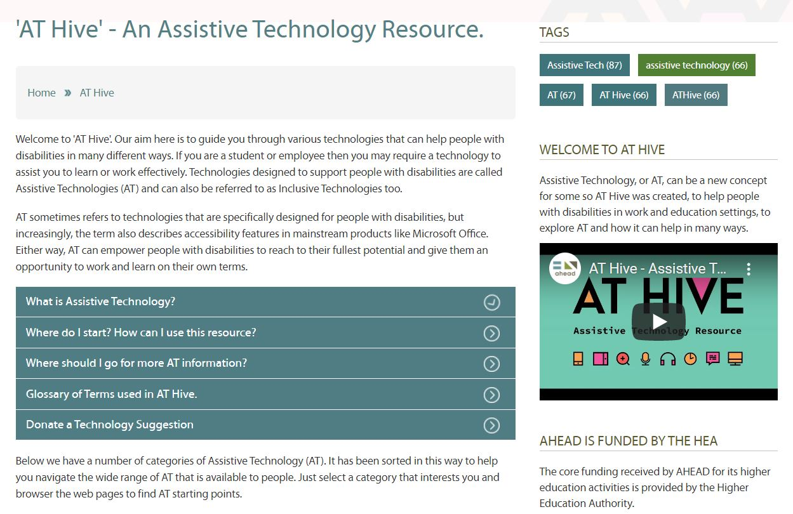
AT Hive – Raise AT awareness
AT Hive is an Assistive Technology Resource, in the AHEAD website, that aims to raise awareness and where to find AT and how to use it.
To date a collection of 50 technologies (websites, apps, browser plugins…) about reading, writing, organisation, communication and more.
Go to www.ahead.ie/ATHive

Slide 7
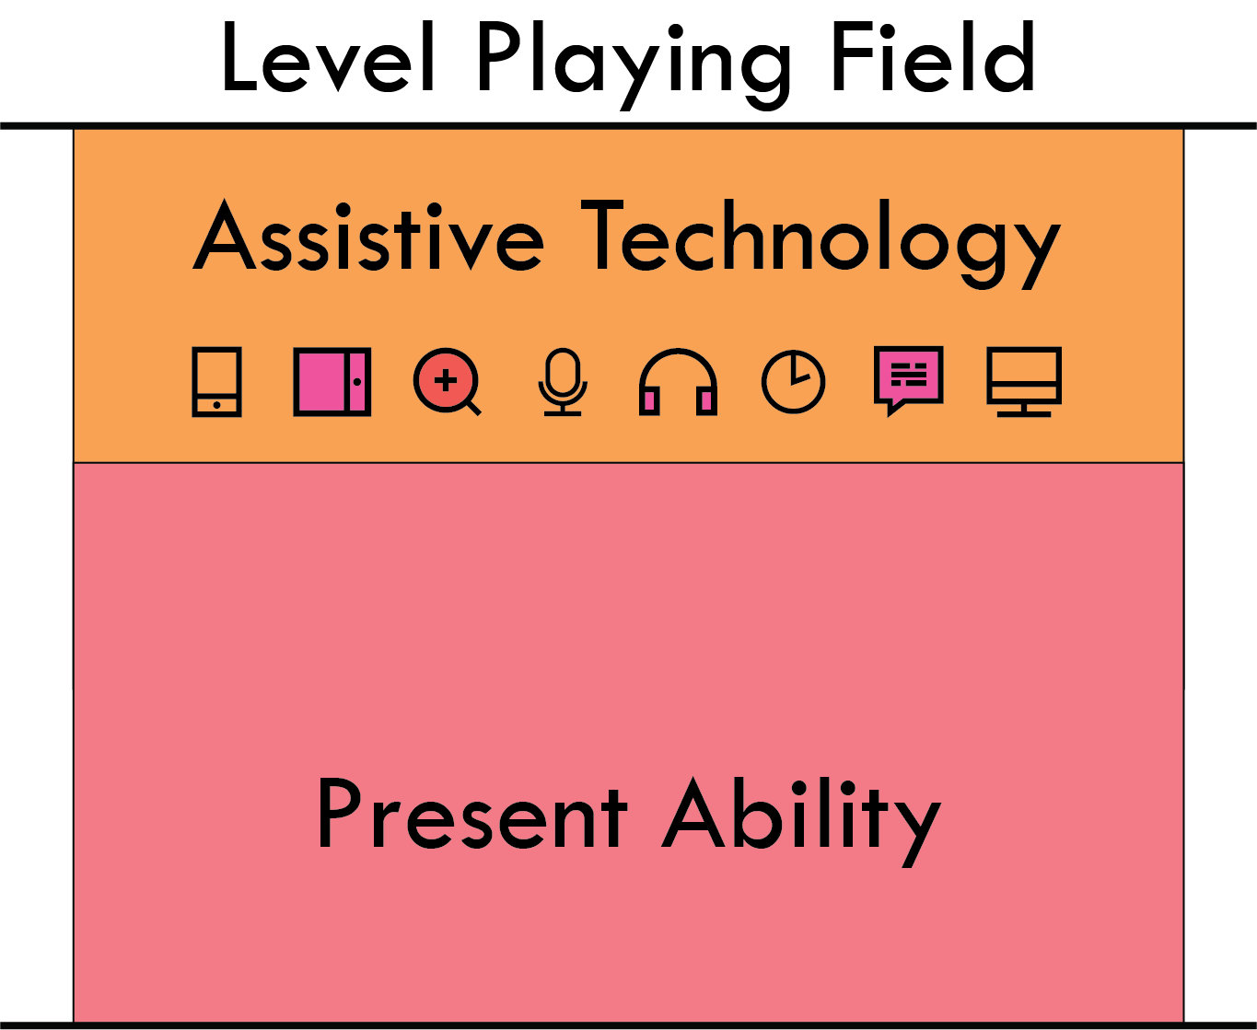
AT – Levels the Playing Field
Literature highlights many benefits which can include ... heightened self-worth and improved academic outcomes
(Chambers & Berlach, 2015).

Slide 8
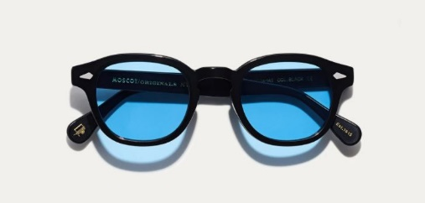
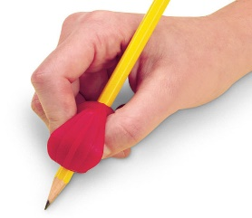
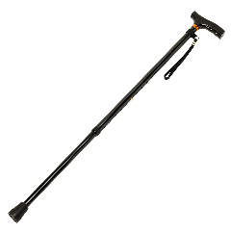

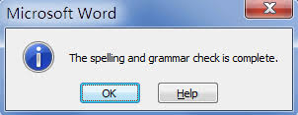
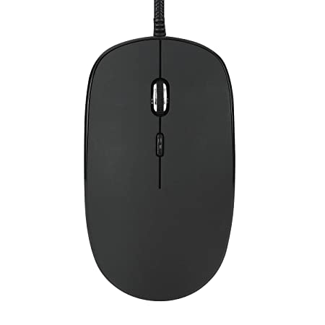

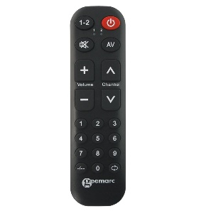
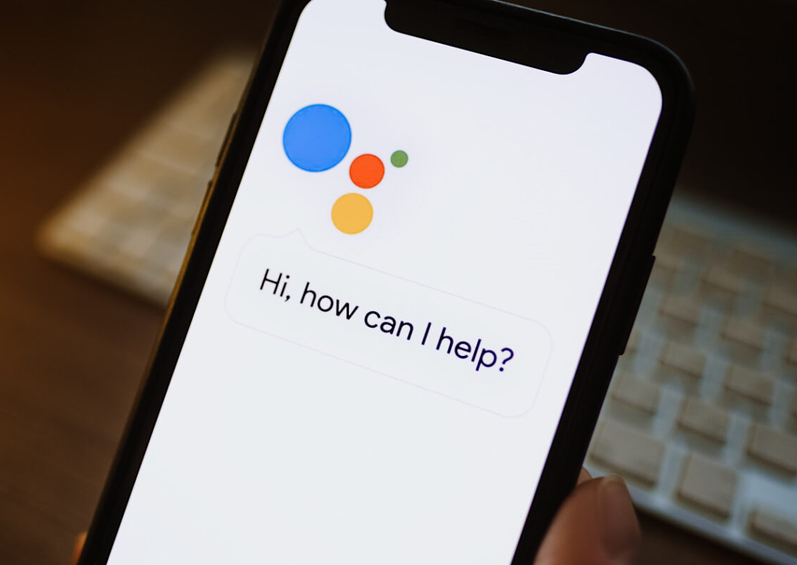
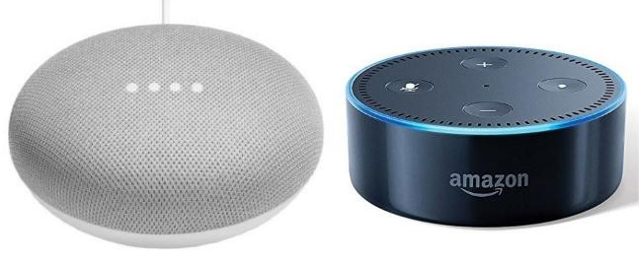
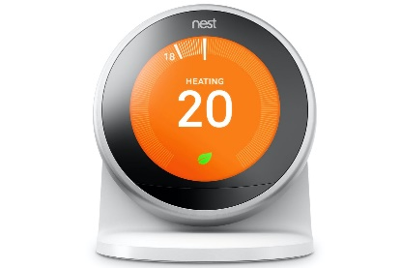
Types of Assistive Technology
Non –Tech
Eyeglasses
Pencil Grip
Walking Stick
Post-its
Low-Tech
Spellcheck in Word
Mouse
Calculator
Remote Control
High-Tech
Google Home / Amazon Echo
Siri / Google Assistant / Cortana
Nest Thermostat
Notes:
Right now, AT is being used by all of us, in one way or another, we have been users of AT throughout our whole lives.
AT involves everything from non-tech, like eyeglasses and pencil grips, walking sticks, post its
to low tech, like spelling supports in word and remote controls,
to high tech, like Google assistant on your phone and Google home devices, so needless to say AT is everywhere.
So, AT is already our business, but maybe we just didn’t realise it.

Slide 9

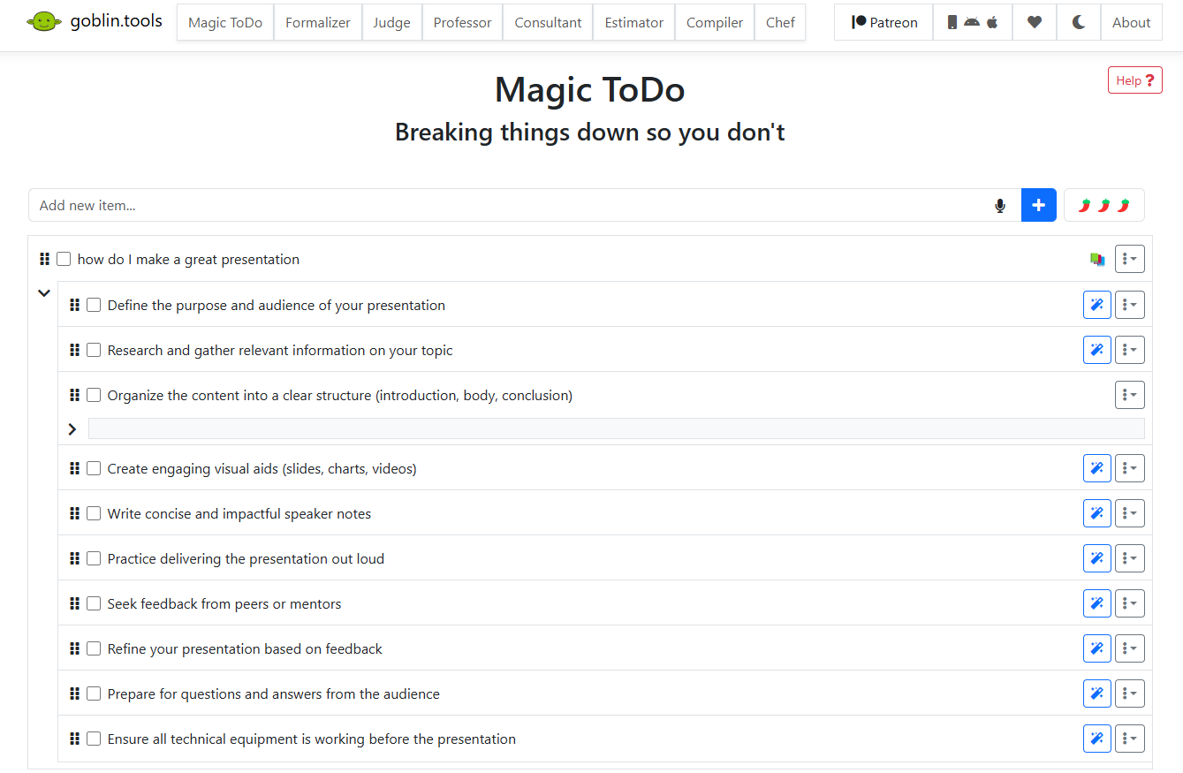
Goblin.Tools - free website-task breakdown
goblin.tools is a collection of small, simple, single-task tools, mostly designed to help neurodivergent people with tasks they find overwhelming or difficult.

Slide 10


Find out more
www.dcu.ie/disability/assistive-technology

Slide 11
Curiosity …
Curiosity about yourself
  What type of learner are you?
  What Technology skills you have/ need?
  What are your strengths and challenges?
Curiosity about your College / University
  What services do they have?
  How do you access them?
  Do you engage with them?
  Attendance is key to success

Slide 12

Curiosity… and Assistive Tech
Why even think about Assistive Tech:
Note-taking - OneNote / Google Docs
Read Aloud - Immersive Reader / iPhone
Writing - Write with your Voice
Organisation - Bookmark on Browser
Procrastination - What makes you work?

Slide 13

Curiosity… about your Disability Service
Talk to your Disability Service:
Email / meet up - ask the Team
Disability Officer / Occupational Therapist
Assistive Technology - types?
Other services - Library…
Student Union

