Slide 1


Student Services
let us help you succeed
Presented By:
Carol Neenan
Active Inclusion Officer
Carol.Neenan@corketb.ie

Slide 2



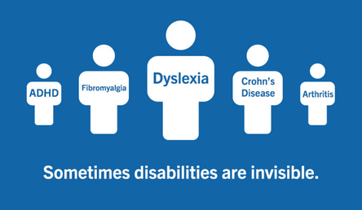

Learner Diversity is vast
  Obvious Physical differences
  Chronic/Acute - Medical conditions e.g. Diabetes or Arthritis,
  learning differences e.g., dyslexia or dyscalculia
  Other neurodiverse profiles like ADHD/ASD
  Mental health concerns e.g. trauma
anxiety, depression, and more

Slide 3
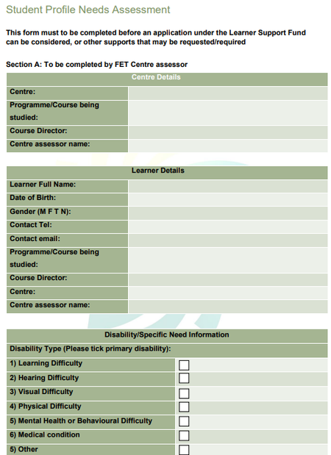

Why It Works
PREVIOUS SUPPORT:
  RESOURCE /SET
  ASSISTIVE TECHNOLOGY
  READER/SCRIBE
  SIGN LANGUAGE INTERPRETER
  TRANSPORT
WE ASSESS YOUR NEEDS
BENEFITS FOR INDIVIDUALS
  Specific needs are identified
  Additional needs may also be recognised
  Learner needs are mapped to services available
  Learners often discover supports they need that they were not aware of before disclosing

Slide 4

Exam Accommodations
Positioned for all exams or in emergency situations
  Use of a Laptop
  Extra time
  Smaller room/ separate room
  Rest breaks
  A larger Desk to work from
  A scribe .

Slide 5




Supports
Academic Learning Support
Software & Hardware
Tutorials
This may be 1-2-1 or small group support advising on study skills and assignment skills
All that Office 365 & Moodle have to offer , One note, CANVA, Notebook LM, R&W Gold, Dragon, etc
In person and pre-recorded sessions explaining about briefs, academic writing, how to use one note

Slide 6


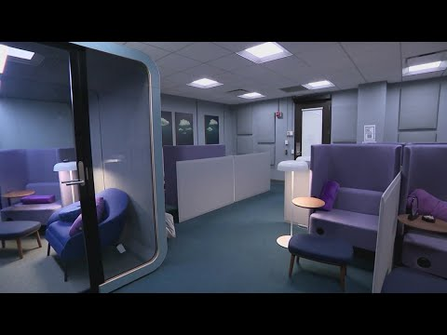
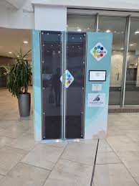

Supports contd.
Why It Really Matters
  Note can be made available ahead of classes
  There are quiet spaces away from the main hustle and bustle
  Personal assistants can support and take notes
  Some centres have pods for having tutorial sessions or taking online tutorials
  In one of our centres we are getting a cubbie

Slide 7


Additional supports
Staff who specialise in advising students on Assistive Technology
AT & AI
The choices available in
Assistive Technology are
mind blowing

Slide 8


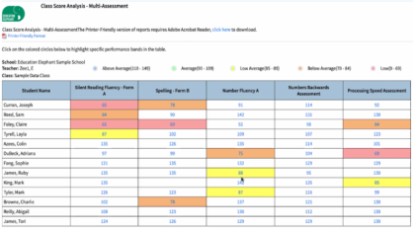
In-house Assessment of need
educationelephant.ie
Five Measures taken
  Reading Speed
  Math/number processing speed
  Spelling
  Working memory
  Processing Speed

Slide 9


Woodcock Johnson V (WJV)
WE ASSESS YOUR SKILLS
BENEFITS FOR INDIVIDUALS
  Up to date scores in five skill areas
  If low scores are flagged a more in-depth assessment may be completed
  This may provide access to academic supports
  It may recommend a referral for a diagnostic assessment

Slide 10
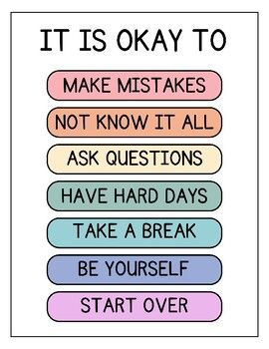
Thank You
Asking for help is a sign of strength !
Carol.Neenan@corketb.ie

