Slide 1



Employment considerations for people with disabilities Power of Disability 2026
Alice Hartigan – WAM Project Officer
11th April 2026

Slide 2
Employment Considerations – Top Tips
Is your CV up to date?
Try to keep your CV to two pages max
Try to keep information clear, concise and with text to a minimum
Is there something that can make you stand out?
Do you need accommodations to apply or interview?
Not every company is pro-active in asking you if you need support, think about what you need and reach out to the recruitment team
Not sure what accommodations would help? Try to re-frame this as ‘what impacts me? Or ‘what support could help me be my best self’

Slide 3
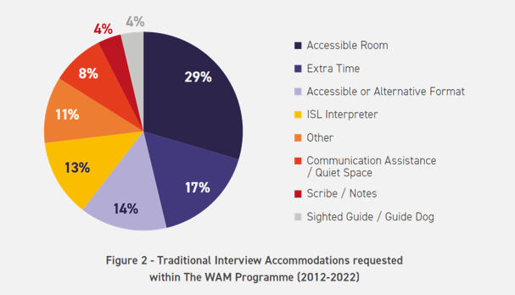
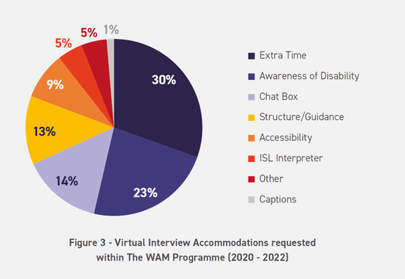
Reasonable Accommodations at Interview
Traditional Interviews
Virtual Interviews

Slide 4
Employment Considerations – Top Tips contd.
Want to stand out from the crowd?
Do some searches online to find out more about the company and their work
Show interest by discussing their projects or main work that interests you
Questions
Don’t forget that you could show interest during an interview, by having your own questions prepared, these could include:
Can you tell me a bit about your company culture?
What is your company doing for diversity and inclusion in the workplace?

Slide 5
Employment Considerations – Top Tips contd
Networking and Career Fairs
Think about what you want to learn & ask questions
Focus on your own value, what makes you special or unique?
Get their contact details if appropriate so you can follow-up
Build an online presence
LinkedIn can be a great tool for virtual networking
Keep your profile up to date and follow industry leaders/organisations

Slide 6

Disclosure
You may need to disclose your disability to ask for and receive accommodations
Disclosure can be perceived as a negative term and may not align with how you feel
Having an action plan for how and when to disclose can help you navigate this conversation

Slide 7
Action Plan for Disclosing
Why
What
When
Who
How
Notes:
Why – I want them to know or I need accommodations
What – be specific – I may need extra time for the interview as I have a processing delay which could affect my ability to answer questions quickly
When – No legal obligation of ‘when’ to disclose but consider H&S and requesting accommodations
Who – Disclose to someone such as HR, or manager who can help support you and provide accommodations
How – How to disclose – application form, in advance of interview, by email or requesting accommodations

Slide 8

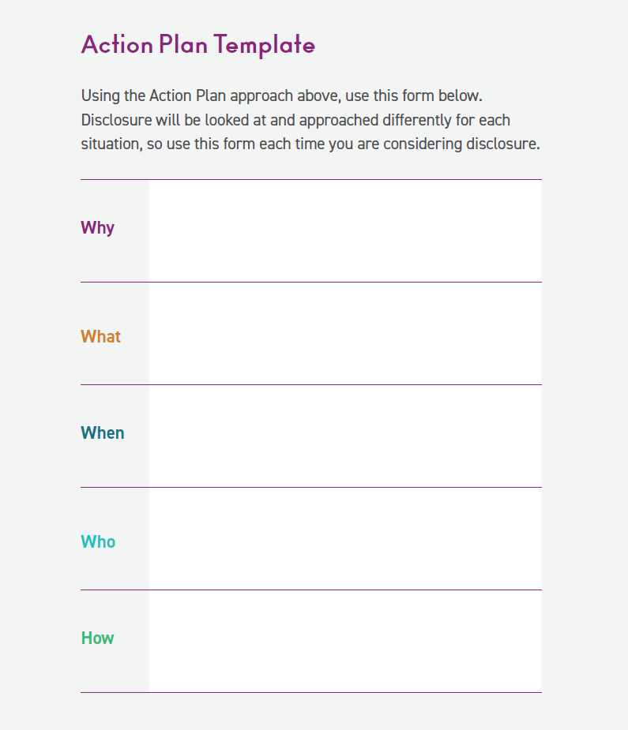


Action Plan
Try out the Action Plan for yourself using our template in our How to Tell Employers about your Disability Guide.

Slide 9


Willing, Able, Mentoring …ensuring employers understand disability
Vision
Shaping an inclusive future where students and learners with disabilities can succeed
The WAM Programme was established in 2005 and is currently funded by the Department of Social Protection. The central objective of WAM is to widen access to employment for graduates with disabilities while working with and supporting employers to create more inclusive workplaces.
We set to achieve this strategically primarily through our work placement programme; over 800 placements secured to date in both the public and private sector.
Notes:
Caroline McGrotty

Slide 10
What is The WAM Programme?
Widen access to mainstream employment while working and supporting employers to become more inclusive
Employers offer ring-fenced roles at graduate level
Comprehensive training prior to recruitment and placement
Workplace needs assessment conducted with all graduates
Ongoing support from WAM Team throughout
Graduates get paid work opportunities and experience the world of work in a supported way
Notes:
The WAM programme is helping to bridge the disconnect with employers and the recruitment of people with disabilities.
What is the WAM programme and how do we do this?

Slide 11
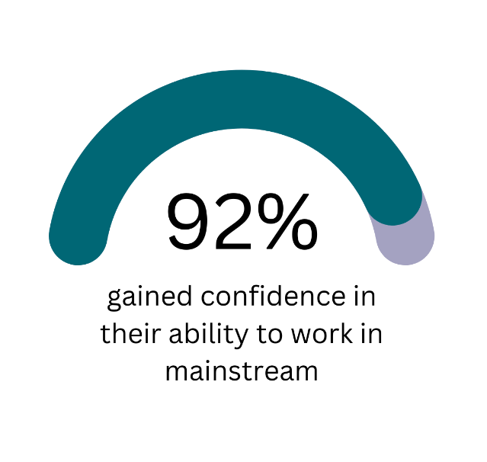


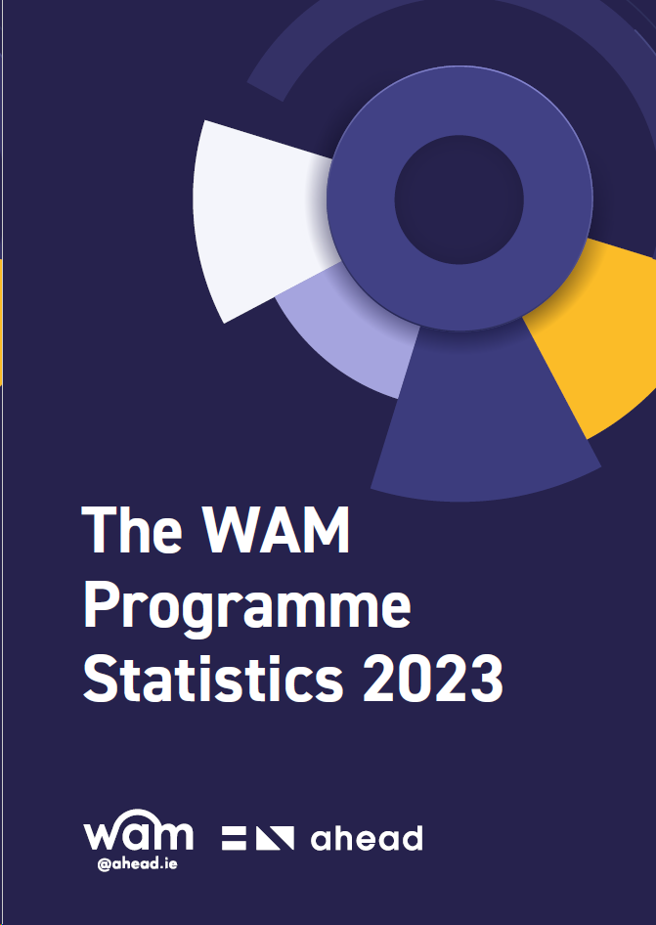
Graduate Benefits
81% of WAM graduates secured employment as a direct result of their placement
Download Full Report!
Notes:
3,665 applications for WAM placements and 460 needs assessments carried out by AHEAD
81% of WAM graduates secured employment as a direct result of their WAM placement.
1 in 5 applicants required accommodations for a traditional interview.
1 in 7 applicants required accommodations for a virtual interview.
1 in 3 required accommodations for testing and screening recruitment processes.
Two-thirds of workplace accommodations do not incur any cost to the employer and are in relation to work tasks.
42% of graduates require time off to attend disability related medical appointments
92% of WAM graduates gained confidence in their ability to work in a mainstream environment
69% of WAM graduates were no longer in receipt of any disability or illness payments.

Slide 12

What is GetAHEAD?
Initiative of AHEAD working to up-skill students and graduates with disabilities by providing training events, blogs, resources and other valuable information covering a wide range of topics. Find out more here.

Slide 13
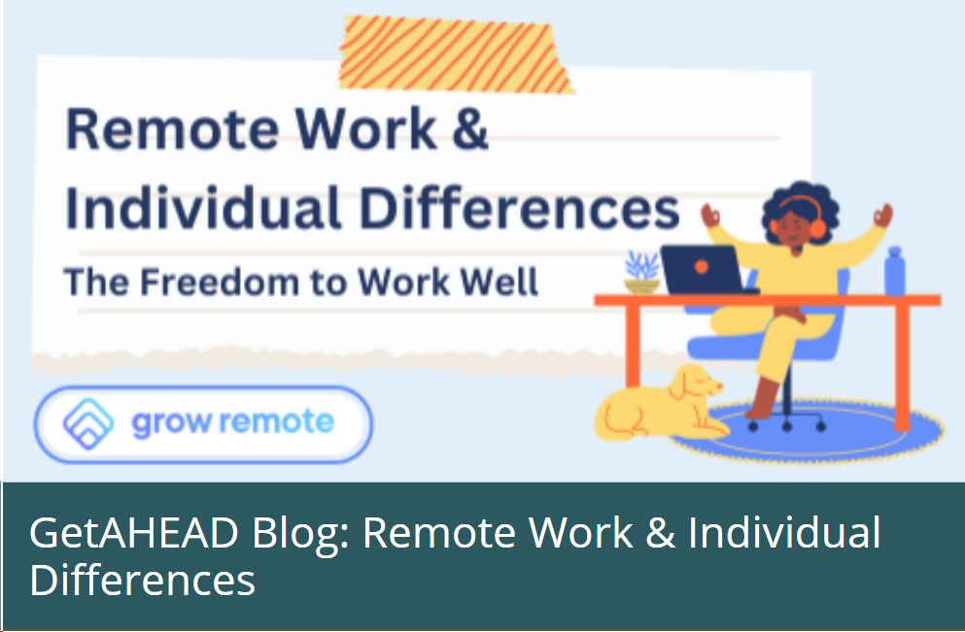
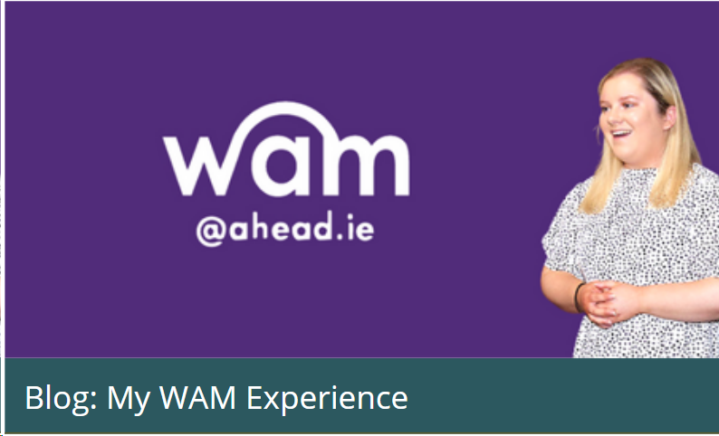
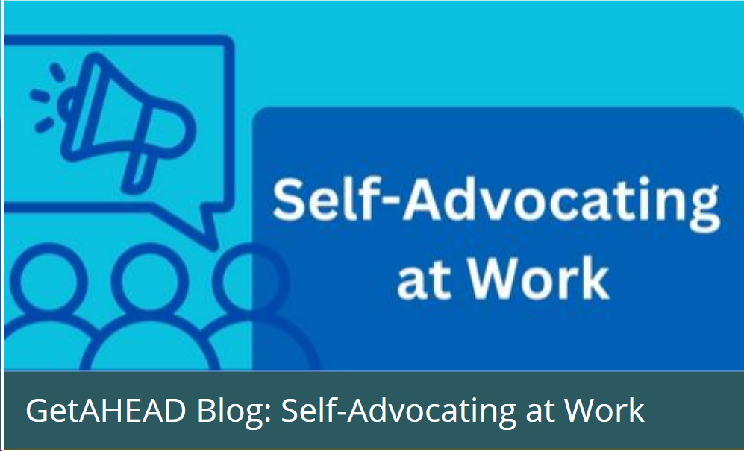
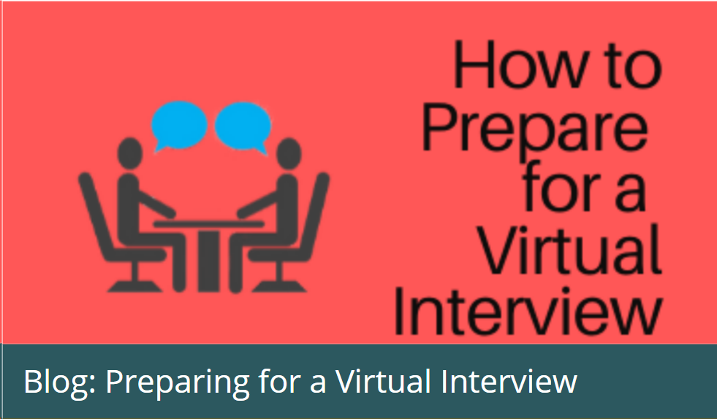
GetAHEAD Blogs – Tips & personal stories
Personal experiences
Tips
Event insights
Explore the GetAHEAD Blogs here!
Submit your own story here

Slide 14
GetAHEAD Events - Free Training!
Think Twice Workshops
GetAHEAD Boot-Camps
Transferable Skills
CV Writing
Interview Preparation
Disclosure
Assistive Technology
Networking
Working Remotely
Getting Ready to Start Work
Growing your LinkedIn

Slide 15
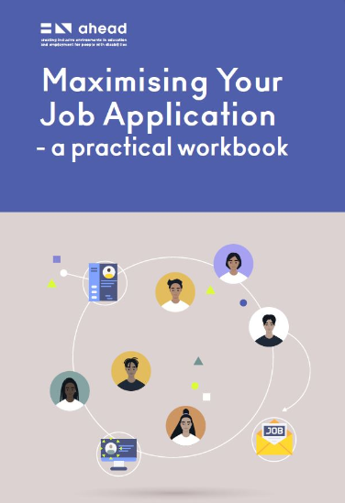


Useful Publications
Download Links
Maximising Your Job Application Workplace Wellness Guide Disclosure Guide

Slide 16

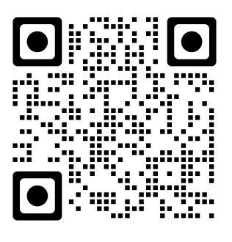
Register on our WAMWorks Database!
Students and graduates with disabilities should firstly register on our WAMWorks Database
www.ahead.ie/wamworks
Get notified and attend workshops and events on upskilling in the workplace
Get notified and apply for paid graduate level jobs exclusively for people with disabilities

Slide 17



WAM Job Opportunities
EirGrid - Opening – April 15th – Closing April 29th
One role available
Two-year Graduate Programme
NFQ level 8 all disciplines
Pfizer Newbridge – Opening April 29th – closing May 13th
Four positions available
6-month contracts.
NFQ level 7 required in Science/Engineering
ESB - Opening – May 27th – Closing June 10th
Number of roles and locations to be confirmed

Slide 18

Building the Future
Hosted by Citi in Dublin
Mock Interviews
CV clinic
Headshot station
Employer Exhibition Space
Workshops
May 27th 2026
Register here

Slide 19

Any questions? WAM: WAM@ahead.ie GetAHEAD: banba.fitzgerald@ahead.ie Our website: www.ahead.ie Instagram: aheadireland X: aheadireland LinkedIn: AHEAD (Ireland) Facebook: AHEADIreland

