Slide 1


Preparing for the Workplace
Power of Disability | 7th February 2024
Philip Carroll | WAM Project Officer
Banba Fitzgerald | GetAHEAD Officer

Slide 2
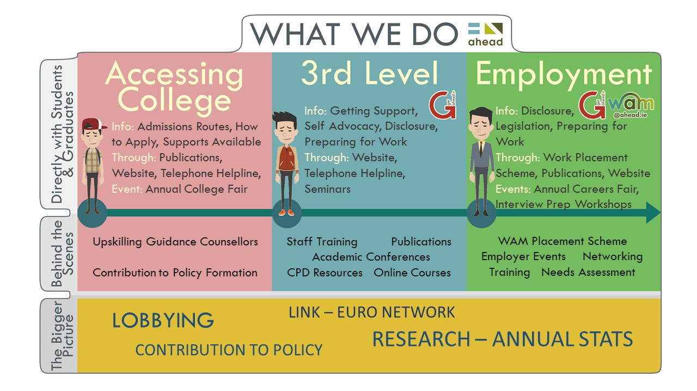
What do AHEAD do?

Slide 3

5 reasons to register on our WAMWorks Database!

Slide 4

What is GetAHEAD?
Initiative of AHEAD working to up-skill students and graduates with disabilities by providing training events, blogs, resources and other valuable information covering a wide range of topics.

Slide 5



GetAHEAD Resources
Disclosure
Legislation
Accommodations at work
Grants available
Resources – AHEAD
Job Search – AHEAD

Slide 6



Useful Publications
Download Links
Maximising Your Job Application Going to College Guide Disclosure Guide

Slide 7

GetAHEAD Events
Free Training!
Think Twice Workshops
GetAHEAD Boot-Camps
Transferable Skills
CV Writing
Interview Preparation
Disclosure
Assistive Technology
Working Remotely
Getting Ready to Start Work
Growing your LinkedIn

Slide 8

Building the Future
Hosted by Citi in Dublin
  Mock Interviews
  CV clinic
  Headshot station
  Employer Exhibition Space
  Workshops
2024 date to be confirmed – likely to be the 29th or 30th of May

Slide 9

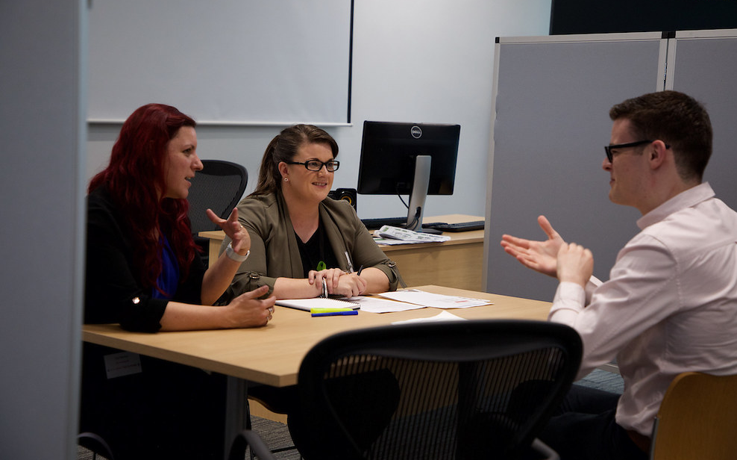


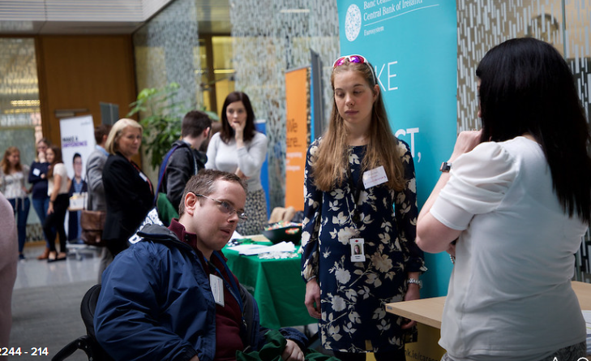
Images of Building the Future

Slide 10

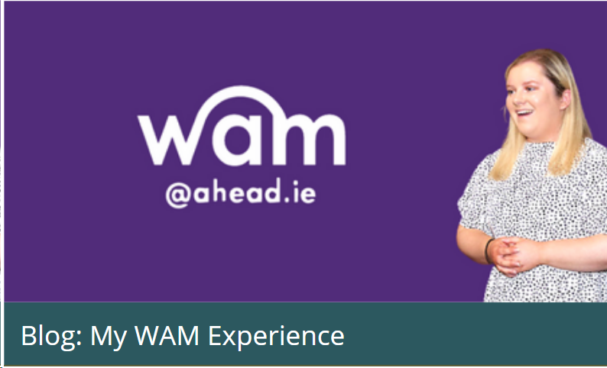



GetAHEAD Blogs – Tips & personal stories
Personal experiences
Tips
Event insights

Slide 11

The WAM Programme
Employers provide WAM with paid, graduate level jobs exclusively for people with disabilities
We provide support and training for employers
All jobs are full time and for a minimum of 6 months – most even longer!

Slide 12

Benefits of WAM
Employers receive disability awareness training
Paid work experience
A safe space to disclose
Career development
A comprehensive Needs Assessment to identify supports
Support of a company mentor on site
Enrolment into WAM’s online course
Support from WAM Team
Improved confidence!!

Slide 13
We know WAM works!
“
From this placement, I had the confidence to apply for a traineeship in a legal law firm. I am one off until I am a trained solicitor. Thanks for everything.
81% of WAM graduates secured employment as a direct result of their WAM placement
“
“
I can safely say that I would not be nearly as successful without the support of AHEAD……I am now a full-time, permanent Civil Servant and I literally could not be happier!
“

Slide 14
How does WAM work?
You must have a disability and meet the educational requirements outlined on the job descriptions
Be work-ready and available for full time graduate level work
Submit a CV or application form
Request any reasonable accommodations you require
Employer shortlists and conducts interviews
If successful, undergo training and needs assessment with WAM
Commence work!

Slide 15
Profile of WAM Placements in last 12 months
Company | Location | Educational Requirements | Duration
Civil Service - Executive Officer Permanency Pathway x 25 | Nationwide | All disciplines, QQI Level 8 | 10 months
Local Authorities - Assistant Staff Officer x 13 | Nationwide | All disciplines, QQI Level 6 | 12 months
Graduate Programmes Bank of Ireland NTMA Pfizer Allianz Enterprise Ireland | Dublin | All disciplines, QQI Level 8 | 1– 2 years
Various other roles with ESB, Architas, Willis Towers Watson, SIG, MTU Kerry, Pfizer, Abbvie

Slide 16
Can I still keep my Disability Allowance?
We have a special agreement with the Department of Social Protection
We contact DSP on your behalf
Depending on how much you earn, your payment may be reduced or suspended for the duration of the contract.
BUT…. You will be automatically reinstated your payment at the end!
You can still keep your Free Travel Pass and Medical Card.

Slide 17
What jobs are available in next few months?
ESB Graduate Programme
  3 Positions in Engineering & IT – Opens 7th February!
Best place to find out about new roles?....

Slide 18

Register on our WAMWorks Database!
Students and graduates with disabilities should firstly register on our WAMWorks Database
www.ahead.ie/wamworks
Get notified and attend workshops and events on upskilling in the workplace
Get notified and apply for paid graduate level jobs exclusively for people with disabilities

Slide 19

Any questions?
WAM@ahead.ie
aheadireland
www.ahead.ie/wamworks

