Slide 1


Evolving Disability Support in Tertiary Education
An Analysis of Changing Trends, Policy and Practices in Disability Support Provision, Tertiary Ed.
Pathways to Possibilities— From Campus to Career April 29th 2025
Presentation 1. Dr Richard Healy

Slide 2


This Presentation aims to explore:
A longitudinal analysis of disability support provision in Further and Higher Education.
Trends, patterns, brief look at legislation, current policy.
AHEAD research examining systemic barriers that can impede progression for disabled learners/students.
What are the legislative obligations conferred upon State actors and are they being realised?
Exploring the numbers of students/learners accessing disability support services in FE/HE.
Unpacking the interaction of disability support provision. Balanced overview underpinned by experiences, expertise and feedback from students/learners/support staff.
Solutions derived from AHEAD’s work and engagement with stakeholders/learners/students.

Slide 3

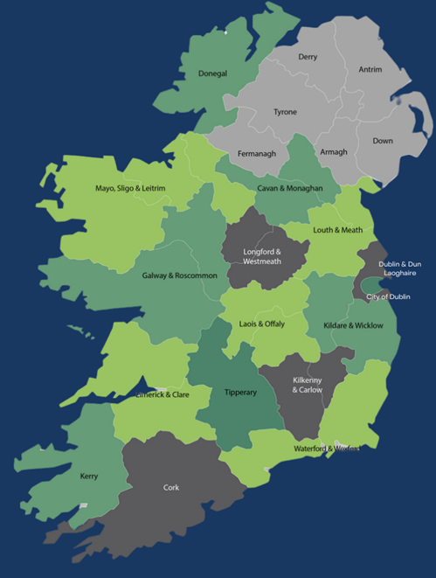
Setting the Scene: Disability and Tertiary Education
The result of the intersection of rights, policy development and a diversifying Irish society.
National Access Plan, (HEA, 2022). Huge increase in DSS engagements
Current and forthcoming FET Strategy. Overall number increase.
Census data demonstrating rising percentage of people disclosing a disability.
UN CRPD Art 24, Equal Status Act 2000-2018, Public Sector Duty
The pivot to a knowledge-based economy that places a renewed emphasis on tertiary education.
The accepted intersection of disability and poverty in contemporary Ireland.

Slide 4
The Rights of Disabled Students and Learners
UN CRPD Article 24
“States Parties recognize the right of persons with disabilities to education. With a view to realizing this right without discrimination and on the basis of equal opportunity, States Parties shall ensure an inclusive education system at all levels and lifelong learning”.
Equal Status Act (2000-2018)
The legislation states that an educational establishment will discriminate against a student with disability if they do not do all that is reasonable to accommodate that student.
Notes:
accessible, inclusive, and future-focused education.

Slide 5

More students with disabilities
20.2% of HE Equal Access Survey Respondents anonymously self-declare a disability (68% increase since 15/16)
(HEA, 2023a)
Number of students in higher education registered with the DSS has risen by over 100% in last 10 years. 8% of all students are now registered with DSS.
(AHEAD, 2024)

Slide 6
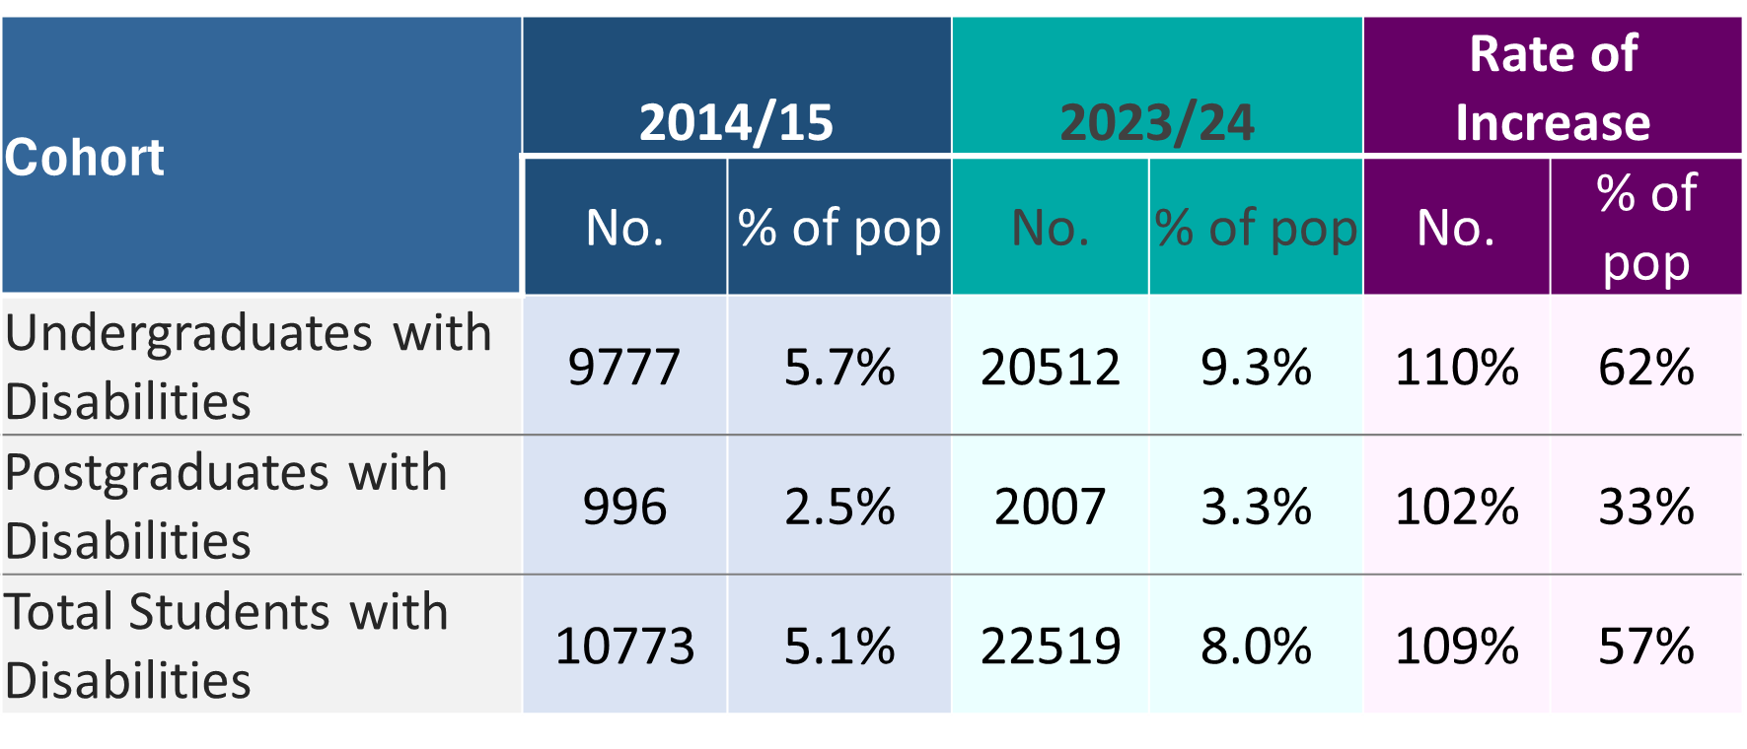
10 Year Overview – Overall Numbers Registering for HE Supports

Slide 7

More pressure on support services
A significant percentage of new entrant students have a disability but do not disclose and register for support.
There has been a 59% rise in the number of students with disabilities per support staff member in the last 10 years.
(AHEAD, 2024)
Notes:
DR

Slide 8


Resources in HE Services – 7 Year View
+18%
-35%
FSD data provided by the HEA
Notes:
DARE
The DARE model is failing HE applicants and is not fit for purpose.
Challenge to register students who have received a reduced points place as they are not engaging with services. A large number of students in HE do not feel the need to register with Disability Services.
Professional Placement
Timeframe is very tight to complete a Placement Needs Assessment
Increase in demands on Disability Services by Professional Programmes and Employers.

Slide 9

On the Ground Challenges for DSS:
Many DSS in publicly funded HEIs are severely under-resourced and over-burdened (AHEAD, 2024). 364% increase in SWDs.
Students availing of the DARE programme often do not register for supports, (AHEAD, forthcoming).
Difficulties working against the backdrop of FSD Guidelines and Framework. The requirement for medical evidence often precludes students from accessing supports.
Dichotomy between legislative obligations and systemic practice, (AHEAD, 2024).
Continuously increasing ratio of students to DSS member, (AHEAD, 2024).
Notes:
Changing support needs—PP RAPP Report
Different approaches in different HEIs

Slide 10
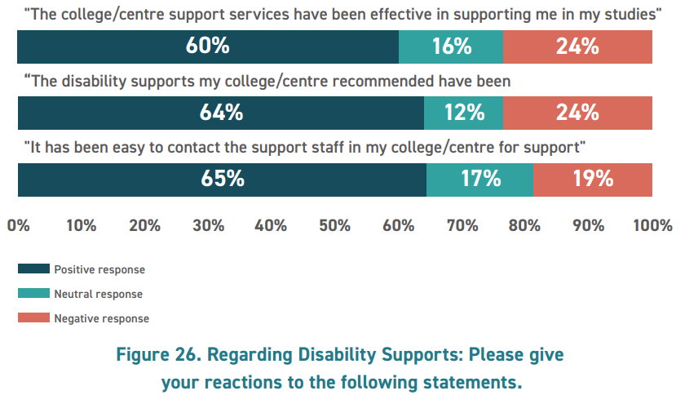
On the Ground Challenges for Students:
Notes:
accessible, inclusive, and future-focused education.

Slide 11

Student and Staff Voices
“..Other staff in the college are receptive to disability office recommendations, but there are still battles at times to get students what they need and are entitled to”.
DSS Staff Member (AHEAD, 2023)
“There is little to no coordination between the access office and the academic staff. Students often have to remind lecturers of their accommodations in a public way in front of other students”.
Student (AHEAD, 2023a)

Slide 12
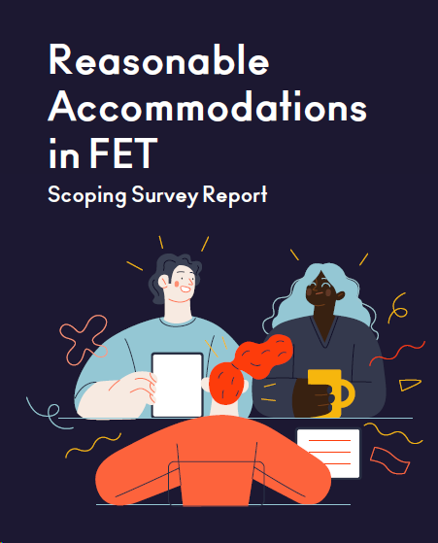
Reasonable Accommodations in FET Research – Why?
Good progress on UDL in FET
Inconsistency in individualised disability supports highlighted in programme reviews.
Research to understand state of play, gaps and areas for improvement in consistency.
Current FET Strategy Review & ALTITUDE—empirical evidence.

Slide 13
Methodology/Sample – Stratified Quota Sampling
Strata/Quotas Set | Sample Collected
75% (12) of ETBs represented by respondents working directly within a regional ETB. | 20 respondents representing 13 (81%) of the 16 ETBs.
50 responses from those representing a local college/centre, with at least one response from a college/centre in 75% (12) of ETBs. | 77 respondents in colleges/centres based in 14 (88%) of the 16 ETBs.

Slide 14
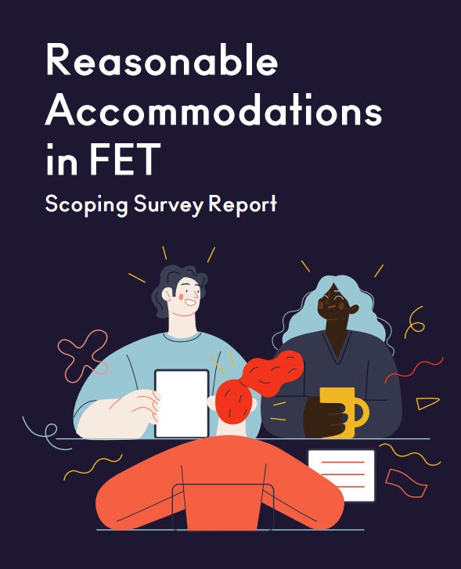
RA in FET Scoping Research Findings
General Culture on Inclusion with pockets of good practice, however:
Gaps/issues identified in:
Staffing and CPD
Communications of Supports
Policy coverage for supports and NA
Funding

Slide 15
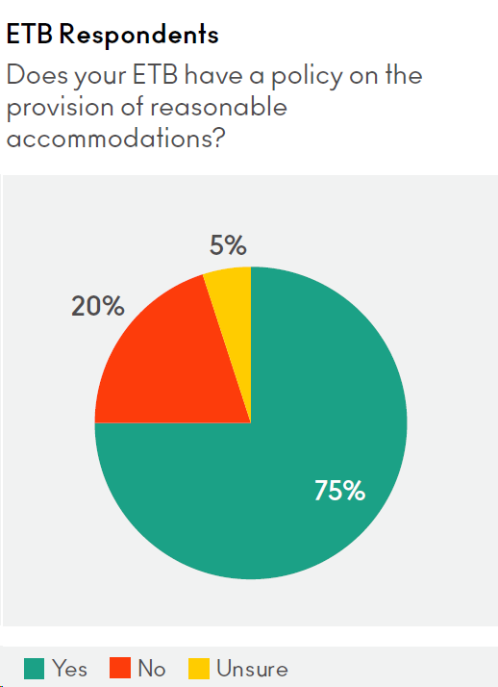

Reasonable Accommodation Policies
Good reach, but gaps significant identified in what policies cover
"There is a policy in development for reasonable accommodations for assessment and examinations. There is a need for a policy on the provision of reasonable accommodations for overall learning." (ETB respondent)

Slide 16
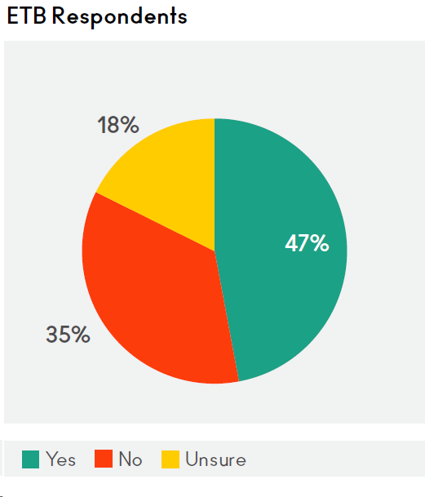
Needs Assessment (NA) Process
Does your ETB/college/centre have a formal needs assessment process?
Minority had formal NA procedure at ETB level – different at college/centre level (74%)
"The PLC colleges would have clearer guidelines as opposed to the rest of the FET provision given their experience delivering the Fund for Students with Disabilities." (ETB respondent)

Slide 17


Funding
Sources very different from centre to centre
“Different for different programmes” (college/centre respondent)
In some cases - lack of awareness if any funding could be accessed.
Funding inconsistency led to outcomes inconsistency.

Slide 18

Other Significant Challenges Raised
Medical evidence burden – out of step with post primary.
Inaccessibility of older centres.
Volume of learners vs. short course length (FSD Stipulation: courses must be “at least 1 year in duration”).
Access to contracted professional supports (e.g. PAs and ISL interpreters)

Slide 19
AHEAD Responses to Rising Disability in Further and Higher Education
Notes:
Strategic, staged, collaborative. Future proofing.
AHEAD responses include LaunchPAD and WIDE; evidence based, amplifying an “inclusion is everyone’s business” rhetoric

Slide 20
RA in FET: Key Recommendations
National
Review disability support staffing (Funding/Staffing Frameworks)
FSD expansion
ETB
Review and update RA policy
Review web communications – clear, consistent, messaging
AHEAD
Develop guidance and on-demand training
Create self-review tools for policies and comms
Reduce barriers -Medical evidence requirement
Develop COPs and foster collaboration
Gather and share good practice case studies

Slide 21

Further Education: RA in FET Feedback Group
Research Output/tools to generate sustainable and tangible change in the Sector. These tools include:
Self-directed on demand short-course on Reasonable Accommodation and Needs Assessment.
Selection of Case Studies of good practice – service and individual level.
A Maturity Model for ETB Disability Support Provision – self review and improvement planning tool.
ETB level Communications and RA Policy Review Checklists.
Notes:
RA in FET Feedback Group—using findings from research to generate

Slide 22


Altitude Charter

Slide 23

The Advantages of UD/L & ALTITUDE Adoption:
Changing demographics – newer flexibilities required
Personal demands on students changing
Cultural shifts in expectations
Can help level the playing field for students with disabilities.
ALTITUDE aims to standardise the implementation of UD/L and embed a whole of institution response across HE/FE.
Notes:
A recent report by the HEA states that the number of mature students (37%), students with children (11%) and disabled students (273% increase) have all increased substantially since 2007.
More students are now employed and there has also been a significant increase in the hours students work, arguably due to the continued rise in the cost of living, (HEA, 2023).
If tertiary education is to respond to this adequately, through the establishing of accessible pathways both into and through education for these students, blended learning should be developed, and its practice retained.
This should be accompanied by UDL. It is imperative that the structure of courses and programmes reflect societal change, thus making the attainment of high demand qualifications accessible for all.

Slide 24
ALTITUDE—early actions
Funded by the HEA under PATH 4, the ALTITUDE Project was an extensive cross sectoral collaboration involving 6 national agencies, 15 HEIs & 6 ETBs.
Launched in Spring 2024. All Learners are Transformatively Included through universal design in education’.
Adoption on April 9th, 2025. SOLAS, HEA, approx. one third of ETBs and HEIs publicly declared adoption.
“Inclusion is everyone’s business!!” –Unified, cross sectoral, all of institution approach.

Slide 25
How ALTITUDE Can Help Institutions
Vehicle to declare your Intent
Anchor a culture of shared responsibility
Strategies, policies and procedures
More Unified Language of and commitment to UD
More effective compliance

Slide 26
Thank You For Listening!
Dr Richard Healy, Research & Policy Officer
AHEAD—Richard.healy@ahead.ie

