Slide 1

The Disabled Postgraduate Experience
AHEAD Research Webinar 29th of April 2025
Notes:
NB

Slide 2
Today’s session!
Setting the scene
Introducing LaunchPAD
Initial insights into ‘Voices in the Community’ research
Key takeaways
Q&A / Discussion

Slide 3


Setting the scene
2015 NAP set target of 8% of all new entrants having a disability.
Exceeded in 2021 with 12.4% (HEA SRS data)
However, only 6% of those were pursuing postgraduate study

Slide 4
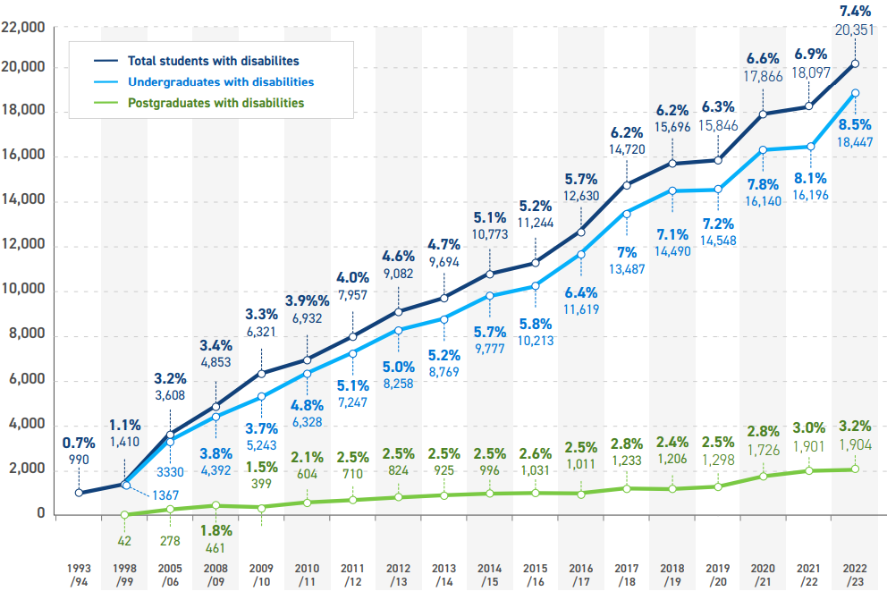
Increasing no of disabled students – but PG gaps remain
The numbers nearly halve again when we look at who is engaged with disability services
Notes:
Despite increasing postgraduates they are still under-represented. Some

Slide 5



Introducing LaunchPAD
The NAP Identified the importance of changing this statistic.
HEA partnered with the National Disabled Postgraduate Advisory Committee (NDPAC)
From this partnership came the AHEAD and NDPAC joint venture, LaunchPAD.
PAD stands for Postgraduate, Academia, and Disability
Notes:
Briefly about AHEAD and NDPAC and why our strengths match up
Notes re NDPAC:
Campaign to increase awareness of disabled postgrads began in 2019
NDPAC established to hear the voice of a group who were not at the decision-making table
Group organised, led and comprised of disabled people
Postgrads & Early Career Researchers from colleges across Ireland, and growing

Slide 6

Our Goals
3-year project plan and the following objectives:
Year one – Foster a Sense of Belonging by Establishing the NDPAC / AHEAD Partnership and Community
Year two – Research and policy mapping exercise. Influence Policy Development by Amplifying the Lived Experience of the Diverse Voices in the Community
Year three – Sustaining the Community to Make a Lasting Impact Through Engagement in HE Decision-Making

Slide 7

LaunchPAD Ambassadors
LaunchPAD Ambassadors will attend conferences and symposiums to talk about their lived experience as a postgrad with a disability.
They will also talk about LaunchPAD’s research
Have recruited 8 postgrads with disabilities
They will be trained in how to advocate effectively and how to present their lived experience amongst other skills
They are fully reimbursed for their time

Slide 8
Voices in the Community
*Research not finalised yet, surface level insights
Methodology
The disabled postgrad experience
Barriers to accessing disability supports
Supervisor/student relationships
Funding

Slide 9
Methodology
*Research not finalised yet, surface level insights
Participant | Pronouns | Area of Study
Participant 1 | He/him | Business management
Participant 2 | She/her | Business
Participant 3 | They/them | Peace Studies
Participant 4 | She/her | Geology
Participant 5 | He/him | Education (Diversity and Inclusion)
Participant 6 | She/her | Equality Studies (Social Sciences)
Participant 7 | He/him | Social Change
Participant 8 | She/her | English literature
Participant 9 | He/him | Anthropology
Participant 10 | She/her | Natural sciences (human geography)
Participant 11 | They/them | Human Computer Interaction
Participant 12 | She/her | Psychology
Participant 13 | She/her | Education
Participant 14 | He/him | Psychology
Participant 15 | She/her | Socio-legal: Disability rights

Slide 10
Disabled Postgrad Experience
“I didn't feel like I was part of a class. I didn't get, wasn't able to get to know anybody. I was, I don't know, I found that quite sad.” (Participant 8)
“Yeah, it's been tough because like, it's not just, you're not just doing a thesis, you're doing a thesis with, with all your conditions and all the different things that they bring.” (Participant 12)
“You have to fight for the basic requirements around buildings and access. You have to really, really fight for that. And you have to be the squeaky wheel. You have to be the voice and people say your complaining.” (Participant 1)

Slide 11
Funding
“Well, as I mentioned, the disability allowance, so I get to keep that. And I also get a SUSI grant at the special rate because the disability allowance. And that could potentially be problematic when it comes to the end of my PhD, because they give four years funding for both grads at a maximum. And I've already spent one on my master's, so I only have three years for a PhD.” (Participant 8)
"I wish that they'd offered me to do maybe part time, but at the time, like, the funding will only fund you if you're full time. But, Yeah, and also, I think if I became sick again, I wish I was able to apply to the IRC to do part time." (Participant 10)

Slide 12
Experiences in Accessing Disability Supports
“Then when I started the course, I had a meeting with the disability officer, and she gave me the [livescribe] pen, gave me my time, anything I needed, and, like, she would check in every semester and everything.” (Participant 2)
“But they want 850 euro for the diagnosis. Okay. So, at the time I couldn't afford that. No. So, I still haven't paid for it. Okay. And at the same time, I went to my GP and there was a seven-year waiting list.” (Participant 13)

Slide 13
Supervisor/Student Relationship
“I have to say, I, I do have a wonderful supervisor and very supportive. Even though she's never worked before fully with a visual impaired student before, she's very understanding and actually at the beginning I asked her to close her eyes and open the document so she can listen to my program and see in a way how I read.” (Participant 15)
“He wasn't particularly nice or encouraging or inclusive or anything that as an educator should be. So, he was kind of saying to me, well, if you submit that [thesis], I won't support you.” (Participant 5)
“There have definitely been some incidences where, kind of, I've not felt supported or I felt that, you know, the health problems are causing more trouble than they feel happy putting up with.” (Participant 4)

Slide 14
Conclusions
*Initial conclusion, not final.
Disabled Postgrad Experience
Funding
Accessing Disability Supports
Supervisor/Student Relationship
Socially isolating
Forced self-advocacy
Often inaccessible
Conferences
Few Pathways
Funding streams are inflexible
Students often in precarious financial positions
Positive relationship: understanding and patience
Negative relationship: no interest in impact of disability on student, won’t accommodate
Medical Sign off on diagnosis before access to accommodations
Self-accommodation
Poor quality PA and hidden cost of Disability

Slide 15

Any questions?

