Slide 1

WIDE framework
Catherine Murray
catherine.murray@ahead.ie
Dara Ryder
dara.ryder@ahead.ie
Notes:
Hello, my name is Catherine Murray, I'm one of the researchers working on the Widening Inclusion of Disability in Employment, better known as the WIDE framework, with Dara Ryder, CEO of AHEAD and our partners Employers for Change.

Slide 2
Agenda
AGENDA
1
Contextual Understanding
2
2
Legislative Overview
3
The WIDE Framework
4
Action
Notes:
Today’s session has four parts: firstly, some contexts and statistics followed by a brief overview of need-to-know legislation. I’ll then introduce the WIDE framework discussing the actions we’re taking to make employment more inclusive for disabled people.

Slide 3



Context
1.1 million people live with a disability
in Ireland
70%
of disabilities are
acquired
80%
of disabilities are
invisible
1 in 5
people
Source: Disability Federation Ireland - 2024
Notes:
Approximately, 5.3 million people are living in Ireland in 2025 1 fifth of which, live with a disability, that’s 1.1 million people. What might be most surprising is that 70% of those 1.1 million people have acquired their disability and 80% live with invisible disabilities.

Slide 4
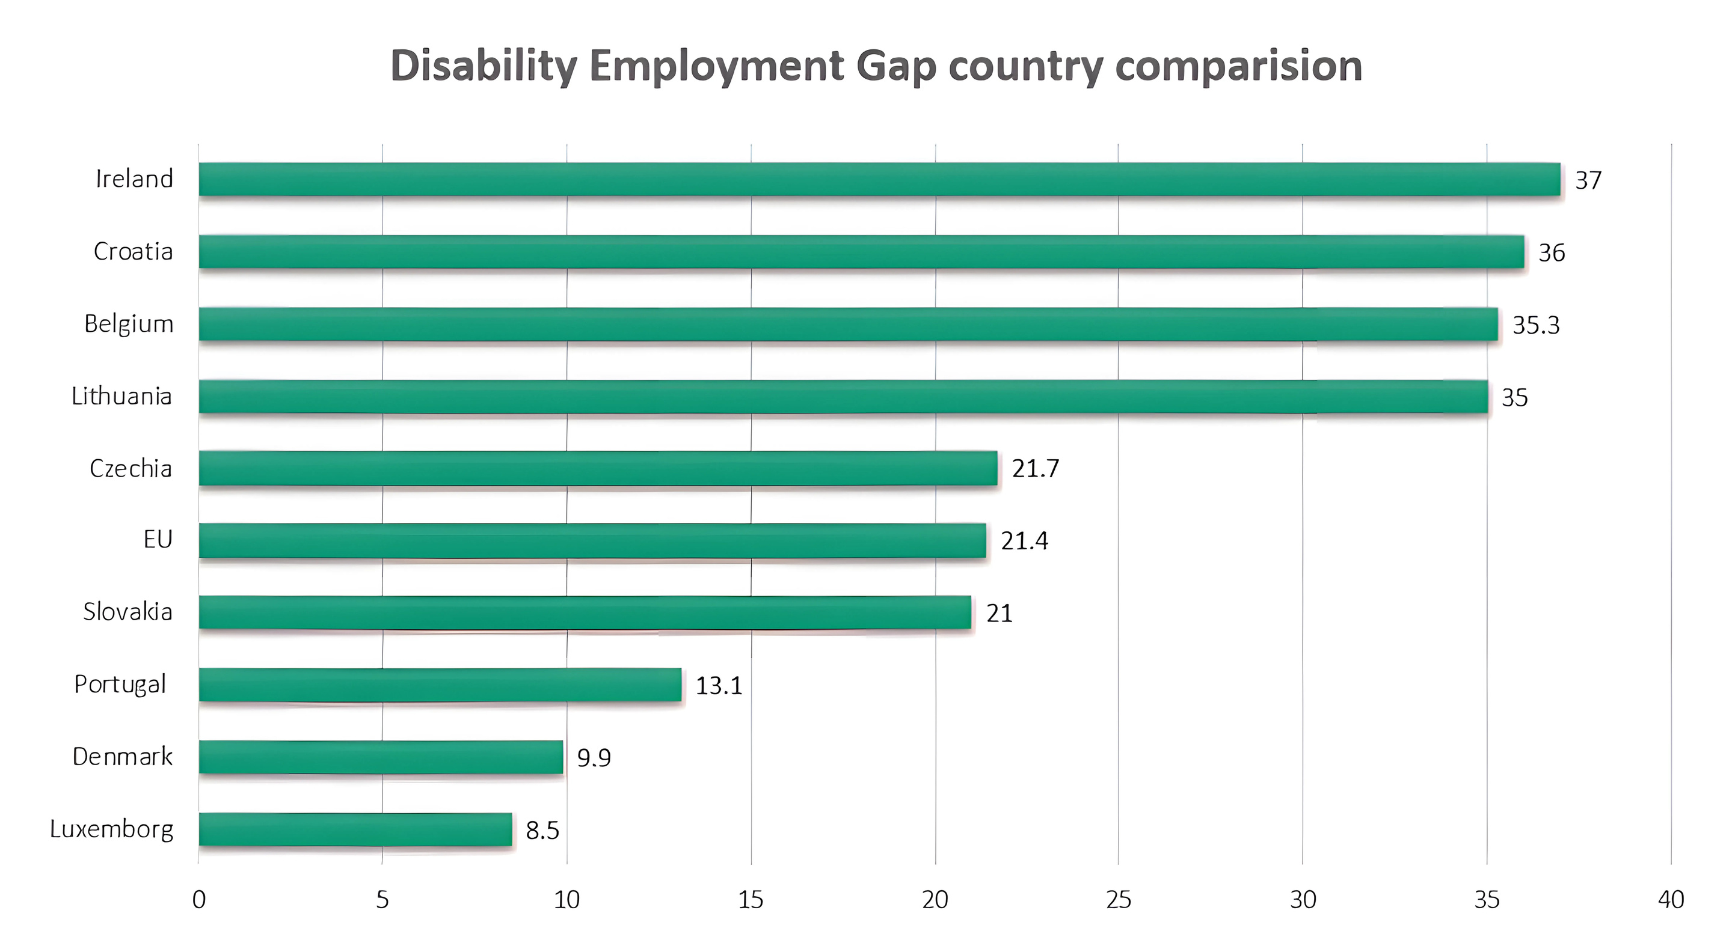



Disability employment gap country comparison
39.7
Can you afford to not to have an effective workforce?
Widest employment gap between disabled people and people without disabilities
Notes:
Specific to disability and employment, Ireland has the widest disability employment gap in the EU at nearly 40%, with even fewer disabled women employed than men. This contrasts sharply with the EU average of just over 21% and almost 9% in Luxembourg.
This matters because employment or lack of employment shockingly, directly relates to poverty. Disabled people in Ireland are currently experiencing one of the highest levels of poverty in Europe due in part to difficulties in gaining secure employment with a liveable salary.
Last month, a study by IHREC and the ESRI found that households with a disabled member need between 50-60% more disposable income to match the living standard of non-disabled households, this rises to where the household would require 93% extra disposable income where a loved one has complex disabilities.
The evidence from this study is clear, disabled individuals and their households are experiencing a double penalty; firstly, their living standards are lower as their labour income is lower and secondly, their consumption needs are higher due to their disability, keeping them trapped in the poverty cycle.

Slide 5


Legislative overview
1998-2015 (Policy) Employment Equality Acts
2000 (EU) Equality Framework Directive
2000-2018 (Policy) Equal Status Acts
2005 (Policy) Disability Act
2007 UNCRPD Article 27
2014 (Policy) Irish Human Rights and Equality Commission Act
2015 - 2024 (Strategy) The Comprehensive Employment Strategy for People with Disabilities
2015 - 2030 Sustainable Development Goal 8 Agenda
2017 (Strategy) Make Work Pay for People with Disabilities Report
2017 - 2022 (Strategy) National Disability Inclusion Strategy
2018 Global Disability Summit
2020 - 2025 (Strategy) Roadmap for Social Inclusion
2021 Porto Social Summit
2021 - 2030 Union of Equality: Strategy for the Rights of Persons with Disability
2021 - 2025 (Strategy) Pathways to Work
2022 CSRD
2025 Global Disability Summit
WHERE’S THE ACTION?
Notes:
Over the last 27 years, 17 conventions, events, policies, and strategies internationally and nationally have come into force, each putting in writing the rights of disabled people. I won’t go into each but it’s important to understand the key points.
In 1998 disability employment legislation began, prohibiting discrimination and requiring employers to make reasonable accommodations. Originally disability was defined based on the medical model but has shifted to align with the social model of disability.
In 2000, positive targeted measured were recommended to promote inclusion i.e., targeted recruitment of disabled people and in 2005, public bodies in Ireland where required to reach 3%. This target has been recently raised to 6% but considering that disabled people make up a fifth of the working age population, I’m sure you’d agreed that 6% should really be the baseline, not the ceiling target.
In 2015, The Comprehensive Employment Strategy for People with Disabilities aimed to improve employment access, but this strategy has been criticised by the NDA who noted no progress on key action for coordinating employment supports.
As stipulated by the UN sustainable development goals, we should achieve full productive employment for all by 2030. It’s looking very unlikely that we’ll achieve that in Ireland.
What might be apparent is there is a pattern of producing listed obligations without clear instructions on how to implement change. I wonder could that be part of the reason why the employment gap remains so wide in Ireland?
For the first time, in 2021, people with intellectual disabilities were recognised in the Strategy for the Rights of Persons with Disabilities, stressing they should also be employed.
Many of you will now be familiar with the CRSD which followed in 2022, detailing that companies operating in the EU will have to report on their inclusive practices making it part of corporate responsibility.
Lastly, the Global Disability Summit just took place this year, emphasising that inclusion is a fundamental human right, not a privilege where equitable access is paramount, recognising that exclusion has significant economic ramifications for each country. Now, children and adults with disabilities represent more than 16% of the global population and there has been marked progress towards inclusion however there are persistent challenges.

Slide 6
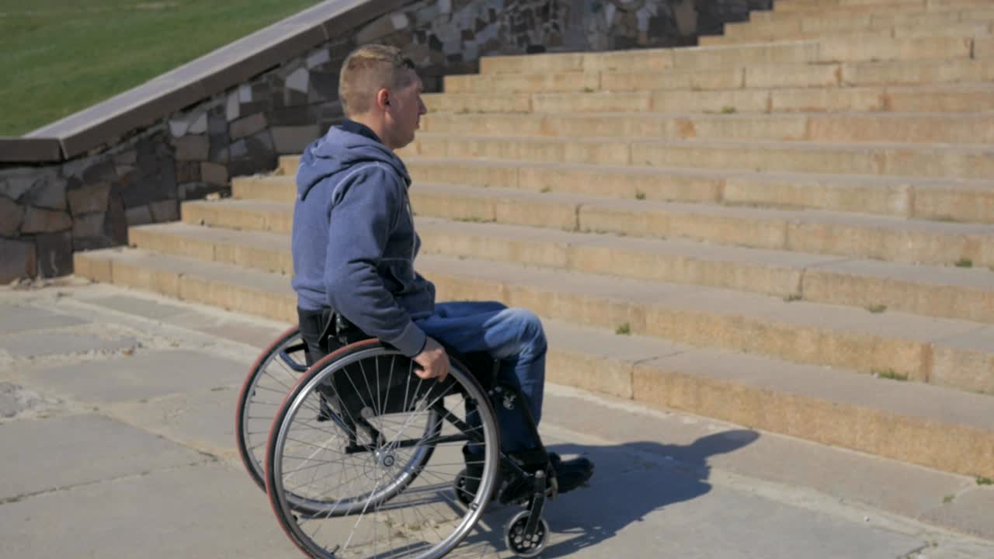
Two worlds apart. It’s all talk and no action.
Two worlds apart
All Talk
and
No Action?
Notes:
From our research, I can confidently say that legislation and practice are two worlds apart. It would appear to be a case of all talk and limited action.
I’d like to introduce you to the WIDE framework, representing the action we are taking to ensure equitable employment is standard. As will be detailed shortly, from disabled people, disability organisations, employers and literature, disabled people continue to face daily discrimination specific to employment.

Slide 7


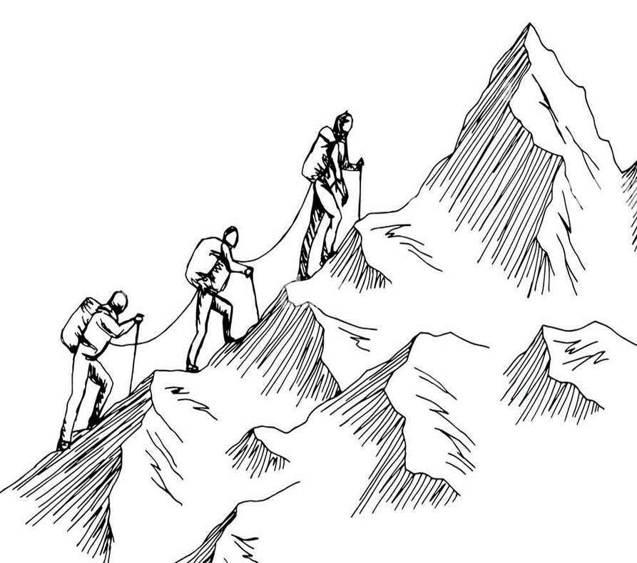
Introducing the WIDE Framework
THE WIDE FRAMEWORK
Framework aims
To support employers in hiring, retaining and promoting disabled employees, creating inclusive workplaces
What it will be
Freely accessible web platform/software providing employers with an improvement focused tool for self-review
Notes:
So why did we start creating the WIDE Framework well the stats and lack of action shows we’ve a long way to go. Employers have also explained to us that they want to do better but need help in ensuring inclusion to ensure their sustainability as a business. But it’s really driven by human rights for everyone including those of you who are yet to acquire a disability. So, we are giving the employers practical tools to make inclusion achievable.
Starting at the top of the mountain, the framework aims to provide support for all employers in all sectors of all sizes in Ireland, to hire, retain, and promote more disabled employees, and create inclusive workplaces. In terms of what it is; it is a web platform/piece of software, freely accessible to employers.

Slide 8


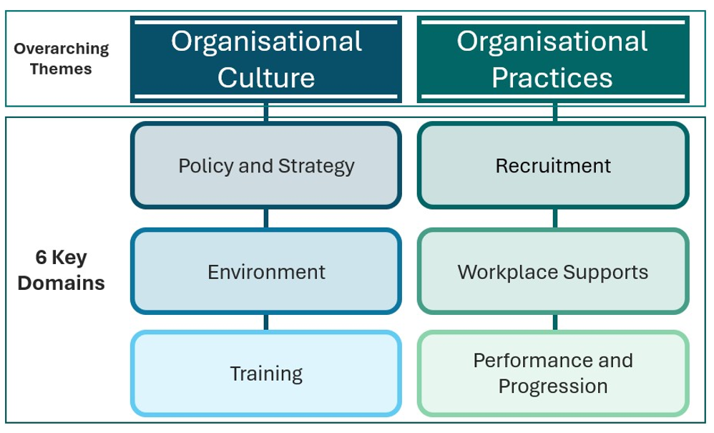

Framework domains
WIDE Framework Domains
Inspired by the UDL Framework
(Trusted, flexible and visible)
Notes:
Through literature review and the consultations findings which will be discussed shortly, the framework now consists of two themes including organisation culture and practices and 6 domains of policy and strategy, environment, training, recruitment and selection, supports and performance and progression.
Each domain features “areas of effort” containing “actions” to work towards.
Each actions have guidance notes to help employers implement it with resources linking to legislation.
The web platform functionality offers individual and organizational logins, task assignment, a self-scoring tool, a progress dashboard, exportable reports, a service provider directory, and an opt-in employer networking feature.

Slide 9









Methodology
Consultations with
25 disabled people
Thank you to all our
co-researchers!
Methodology
Consultations with
33 disability organisations
Creation of the
6th Framework draft
Consultations with
14 employers
Analysis
Notes:
How did we go about creating this framework?
The project started in September 2023, when we partnered with Employers for Change, completed the literature review with Dr Joanne Banks and formed The National Advisory group consisting of 16 representatives.
Throughout 2024, we completed 3 rounds of consultations with our incredible participants, without whom this work simply wouldn’t exist, so I’d like to acknowledge and thank every single one of them for their time and expertise.
The first round included 25 individuals with lived experience of disability, representing all ages, various educational and employment perspectives, and intersectional minorities.
It’s important to note that we had the largest amount of interest for this consultation group with over 120 expressions of interests received. Sadly, we had to narrow our group to 25 individuals, so we carefully used a thorough selection process to ensure a diverse range of voices and experiences from every county in Ireland including people from the travelling community, Irish speakers, minority religious denominations, nationalities and sexual orientations.
We then completed 2 employer consultations with 14 employers, representing 4 company sizes, 11 sectors operating nationally and internationally from private, semi-state, public and the civil service.
Finally, we held 2 consultations with 33 disability organisations representative of NGO’s, DPO’s and other disability groups.
Putting our rocket launchers on, Dara and I sped through massive amounts of data from the consultations and post consultation surveys, thematically analysed it all and created our 6th Framework draft.

Slide 10
Literature findings
Literature Findings
Hindering
  Discrimination, attitudes and behaviour
  Recruitment - “no foot in the door”
  Disability disclosure/communication about needs
  Cost of Disability
  Disability Allowance Criteria
Helping
  Disability policies and HR management
  Workplace accommodations
  Quota systems
  Workplace climate and culture
  Equality, Diversity and Inclusion training
  Universal Design in the workplace
Notes:
In terms of findings from literature, there’s undoubtedly steep barriers hindering progress.
The first barrier is discrimination from employers and co-workers, where there is a reluctance to employ and promote due to capability bias or concerns of costs of workplace accommodations which really limits opportunities and income for disabled people. Research details that many employers have ‘sincere yet ill-founded views about the work-related abilities of people with disabilities but notably ableism and negative attitudes vary by the type of disability and there actually marked differences is discrimination towards employees with mental illness compared to those with musculoskeletal illness for example.
The second barrier is the struggle to gain employment, due to a discrimination pattern known as “no foot in the door”. Disabled individuals are significantly less likely to receive interview call backs—due to biases in employer screening decisions.
The third major barrier is disclosure. Disclosing a disability at work is often challenging for disabled people and can affect access, retention, and career progression; unsurprisingly, because of their lived experience of discrimination many understand their job may be in jeopardy due to stigma and unclear processes.
The fourth barrier is disability costs. As mentioned previously, people with disabilities are more likely to experience poverty, partly due to significant extra daily living costs—ranging from healthcare and transport to home adaptations—that others do not face. Irish research shows disability costs can reach up to €12,000 annually, deepening income inequality and highlighting the importance of closing the disability employment gap to reduce poverty.
Lastly, in Ireland, while the Disability Allowance includes an ‘earnings disregard’ to support employment, research suggests current limits still act as a barrier to work and should be increased.
On a positive note, however, there are actions which are helping reduce discrimination and increase inclusion of disability in employment.
Disability policies and HR management including disability training are helping promote inclusion however so far there are mixed results in the effectiveness in improving employment outcomes.
Workplace accommodations play a crucial role in outcomes and productivity not just for disabled employees, but the evidence suggests that an accommodating culture benefits all employees by enhancing flexibility, morale, and retention.
Quota systems are widely used now globally to boost employment rates of disabled people but there are concerns about limited impact on new hires and weak enforcement of mechanisms, lack of penalties which undermine their effectiveness. This has meant, as is evident in Ireland, that employment rates are low even in countries with quotas in place.
Workplace climate and culture built on trust and diversity policies are key to promoting a sense of belonging. However, representation alone is not enough without strong leadership that promotes inclusion and fairness.
Equality, Diversity and Inclusion focusing on promoting hiring, retention and development of people with disabilities is really important but is most effective when there are inclusive practices across all HR functions.
Universal Design in the workplace focuses on creating environments that are designed for as many people as possible thus reducing the need for adaptation or specialised design. Research highlights the importance of inclusive common areas in promoting employee job satisfaction.

Slide 11

Irish Initiatives
Employers for Change
Equality and Human Rights in the Public Service eLearning module
The Ability Programme
Inclusivity Employment Toolkit (Open Doors)
Willing Able Mentoring (WAM) Programme
Irish
Initiatives
Work Placement Experience Programme (WPEP)
Disability Participation and Awareness Fund
Elevate
Oireachtas Work Learning (OWL) programme
Assisting People with Autism in Employment: Guidance for Line Managers and HR Professionals
Accenture and Specialisterne
The Trinity Centre for People with Intellectual Disabilities (TCPID)
Notes:
Lastly, government, organisational and employer initiatives such as Employers for Change, TCPID, the OWL programme and many others are many positives changes in supporting employers to offer placements and start inclusive recruitment practices.
The main criticism is though, that these efforts are not systematic and thus disabled people continue to have very mixed experiences in their employment journeys.

Slide 12



Findings – policy and strategy
Findings
Policy & Strategy
Employees should feel valued rather than employers viewing their disability as a challenge for the company to accept.
WIDE Consultation Participant – Disabled Person
Notes:
During the consultations held between August and December 2024, the literature findings where echoed and expanded.
In relation to the first domain of policy and strategy, a key quote from a disabled individual stressed “Employees should feel valued rather than employers viewing their disability as a challenge for the company to accept”.

Slide 13
Findings - environment
Findings
Environment
We've made as many accommodations universally available as possible, so people don’t have to disclose to get them, like captions are always available, and everyone has an adjustable height desk.
WIDE Consultation Participant - Employer
Notes:
In relation to the environment, an employer explained that in their workplace they’ve “made as many accommodations universally available as possible, so people don’t have to disclose to get them, like captions are always available, and everyone has an adjustable height desk”.

Slide 14
Findings – training and development
Findings
Training & Development
In most of the jobs I have had, I never feel included, rarely anyway. I'm not talking about the management here; I would be more talking about the broader work team. Most people, in my experience, they don't really understand or have any awareness of disability.
WIDE Consultation Participant – Disabled Person
Notes:
Another disabled person shared their story in relation to the third domain of training explaining, “In most of the jobs I have had, I never feel included, rarely anyway. I'm not talking about the management here; I would be more talking about the broader work team. Most people, in my experience, they don't really understand or have any awareness of disability”.

Slide 15
Findings – recruitment and selection
Findings
Recruitment & Selection
Unconscious bias is hard to shake off. Employers are very hesitant to hire me. The term ‘mental illness’ is viewed more negatively than ‘physical illness’ by colleagues /employers. But the brain is one of 100 very interconnected organs in the body so why distinguish between physical and mental health in the first place?”
WIDE Consultation Participant – Disabled Person
Notes:
Specific to recruitment, we heard countless heart-breaking struggles summarised by one disabled person as “Unconscious bias is hard to shake off. Employers are very hesitant to hire me. The term ‘mental illness’ is viewed more negatively than ‘physical illness’ by colleagues /employers. But the brain is one of 100 very interconnected organs in the body so why distinguish between physical and mental health in the first place?”

Slide 16
Findings – recruitment and selection 2
Findings
Recruitment & Selection
Inclusion of people with intellectual disabilities at work should be the gold standard of inclusive employment, considering that they experience significantly lower rates of employment”.
WIDE Consultation Participant – Disabled Person
Notes:
A significant point was main by another disabled person who said, “Inclusion of people with intellectual disabilities at work should be the gold standard of inclusive employment, considering that they experience significantly lower rates of employment”.

Slide 17
Findings – workplace supports
Findings
Workplace Supports
I’ve heard employers we work with say, ‘he didn’t disclose, how can I trust him?’, but they need to better understand the fear and trauma that people have experienced before and why they might be fearful.
WIDE Consultation Participant – Disability Organisation
Notes:
A disability organisation shared their experiences of the difficulties with workplace support, informing us that “I’ve heard employers we work with say, ‘he didn’t disclose, how can I trust him?’, but they need to better understand the fear and trauma that people have experienced and why they might be fearful”.

Slide 18
Findings – performance and progression
Findings
Performance & Progression
Bias is everywhere and there are still many negative presumptions about what disabled people can do. Sometimes this deficit thinking can lead to low expectations and patronising behaviour.
WIDE Consultation Participant – Disability Organisation
Notes:
Finally, performance and progression were discussed at length summed up by a disabled organisation. “Bias is everywhere and there are still many negative presumptions about what disabled people can do. Sometimes this deficit thinking can lead to low expectations and patronising behaviour”.
It’s clear that whilst practice is improving, much more action is needed to ensure human rights of disabled people are upheld and understood as the baseline and not the ceiling to aim for.

Slide 19

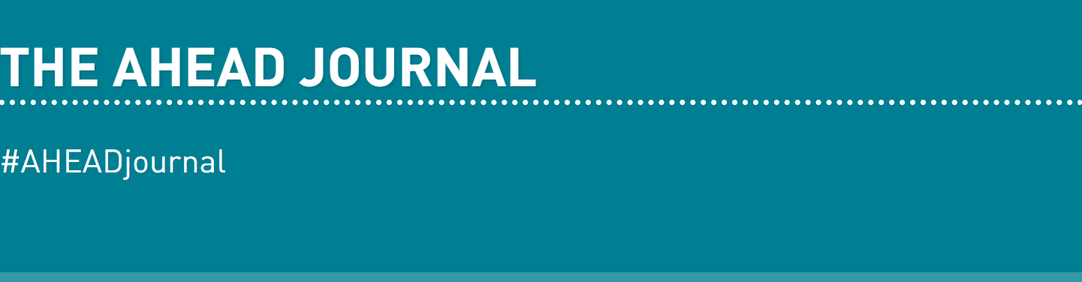
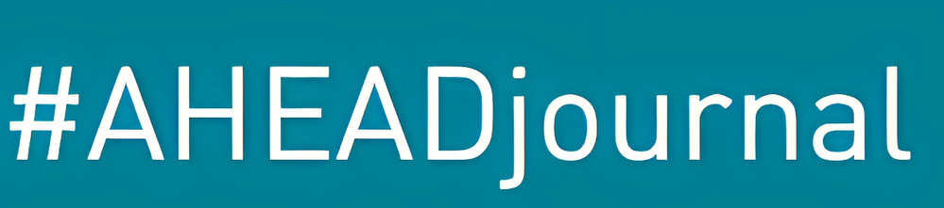


The AHEAD journal
PAPER 1
Widening Inclusion of Disability in Employment (WIDE): Findings from the Voices of Lived Experience of Disability, Employers and Disability Organisations
PAPER 2
Disability and the Corporate Sustainability Reporting Directive (CSRD) - A Driver for Change?
Widening Inclusion of Disability in Employment (WIDE):
Findings from the Voices of Lived Experience of Disability, Employers, and Disability Organisations
Disability and the Corporate Sustainability Reporting Directive (CSRD) – A Driver for Change?
AHEAD WIDE Framework
Notes:
If you’d like to learn more about the WIDE framework, perhaps you’d like to read about the full findings in much more detail, please visit AHEAD WIDE Framework or You can read our 2 papers about WIDE and the CSRD in the newly released AHEAD journal issue 18, which is out now!

Slide 20

Action
ACTION
“..a little less conversation,
[a lot] more action..”
  Currently in the web tendering process
- software development and testing
  The Advisory Group and previous participants are reviewing the 6th Framework = final content
  Hosting the Spring Round Up with all previous participants
  Autumn 2025 launch!
Notes:
In terms of our action to get the WIDE Framework off the ground, we’re currently in the web tendering process, developing the website, and will be moving into the testing phase in the summer.
Our advisory group and consultation participants are reviewing the 6th Framework draft- I’ll be able to start actioning their feedback from next week to create the final framework content.
We’re hosting the Spring round up where we’re bringing together disabled people, employers and disability organisations, tomorrow, to discuss the key findings from each of the consultations and how we have translated all of their voices into the framework.
This is all in preparation to launch the WIDE Framework in Autumn this year.

Slide 21
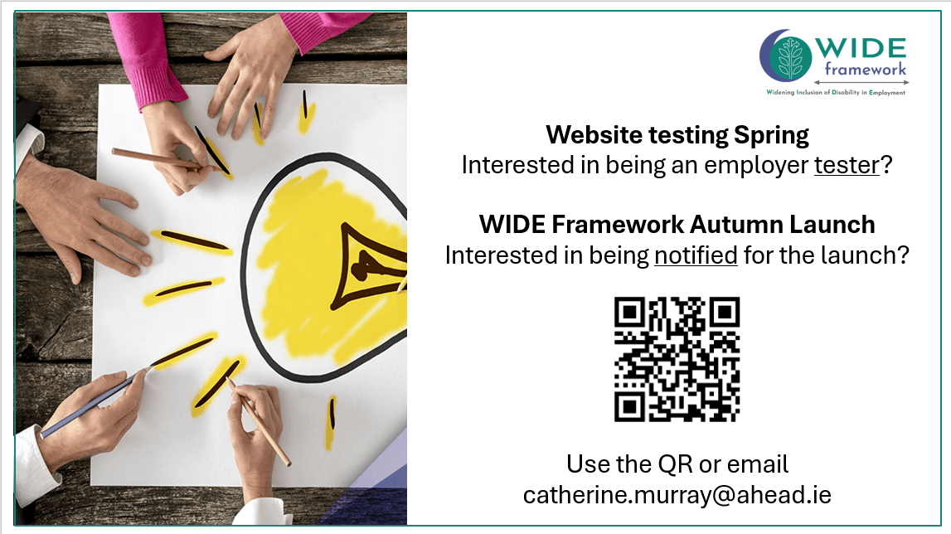

QR code to sign up to be a tester and or get notifications for the autumn launch
Use the QR code
or
Email catherine.murray@ahead.ie
Notes:
So, if you are as dedicated to changing society, to eradicating discrimination towards disabled people in the workplace, you can help us get the framework over the line so we can launch nationally across Ireland. We are looking for web testers and we would love to have you at the launch – so please do sign up!

