Slide 1
Power of Disability
'BREAKING BARRIERS’.
INCLUSION
ADVOCACY
ACCESS
EQUITY
ACTIVISM
EDUCATION
Student Union Leaders: Accessibility Advocates

Slide 2
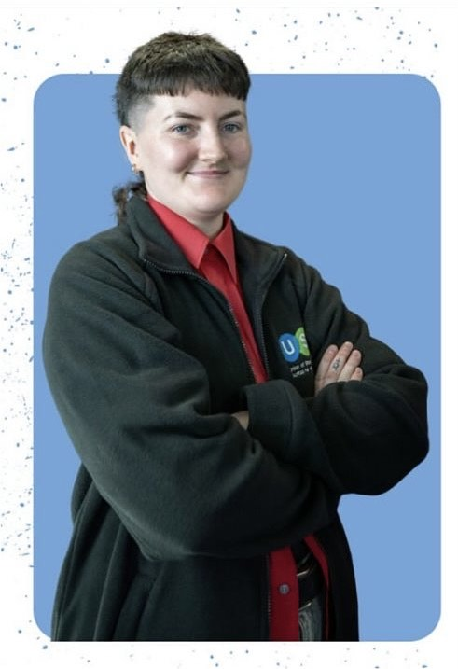

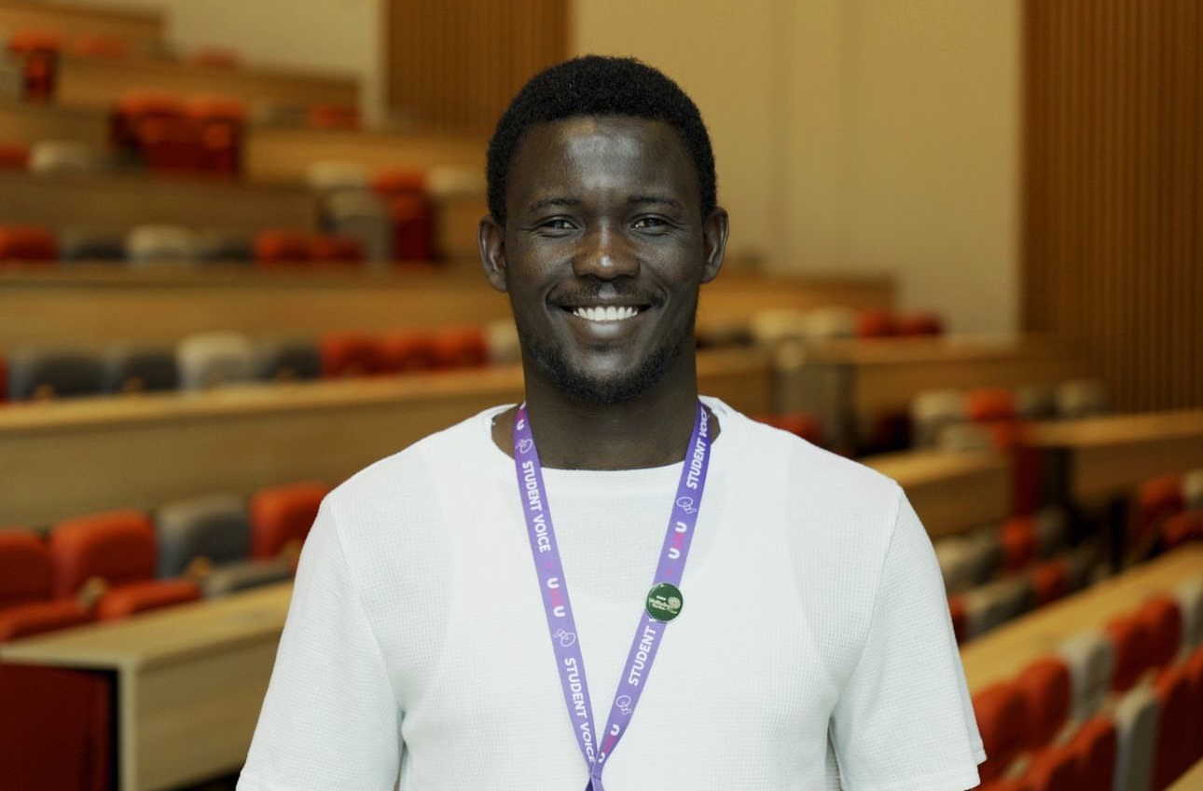
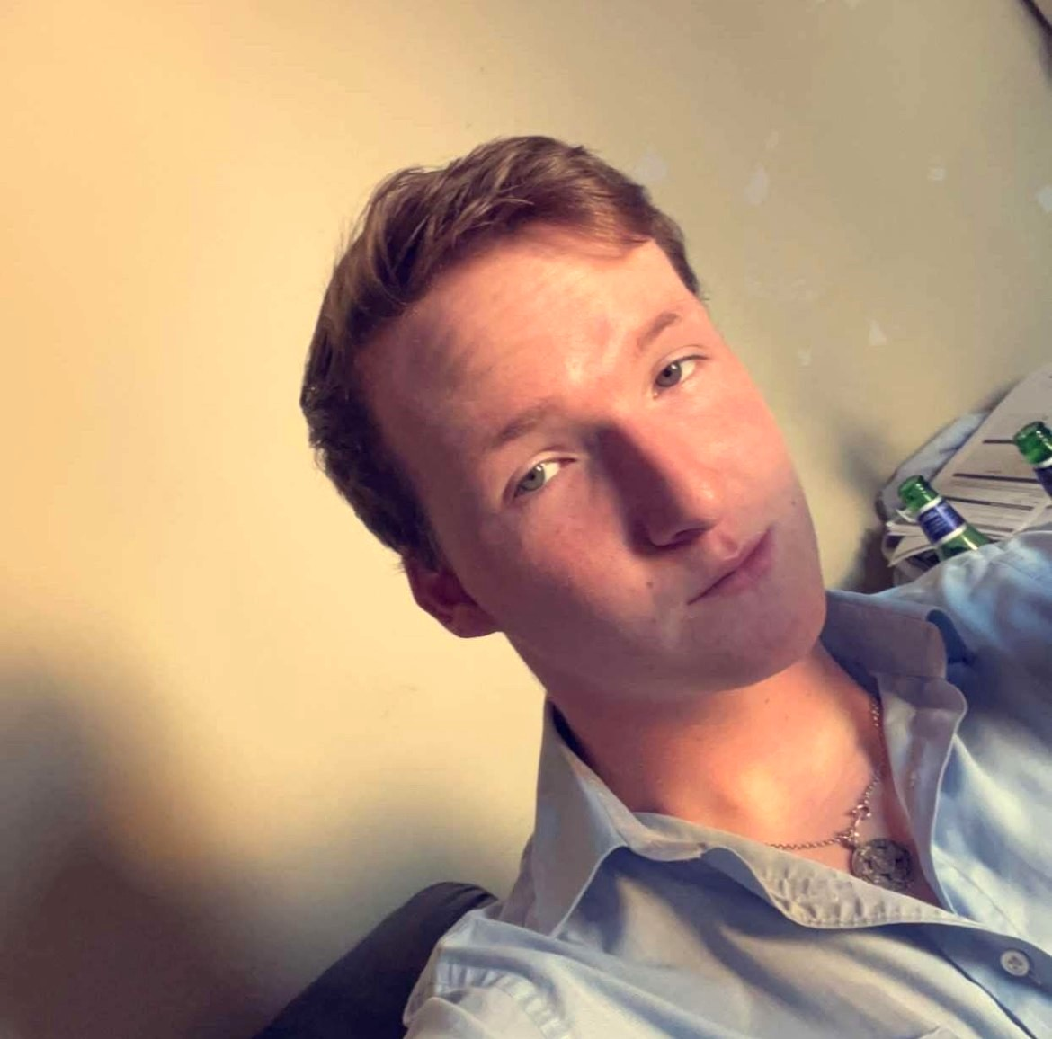
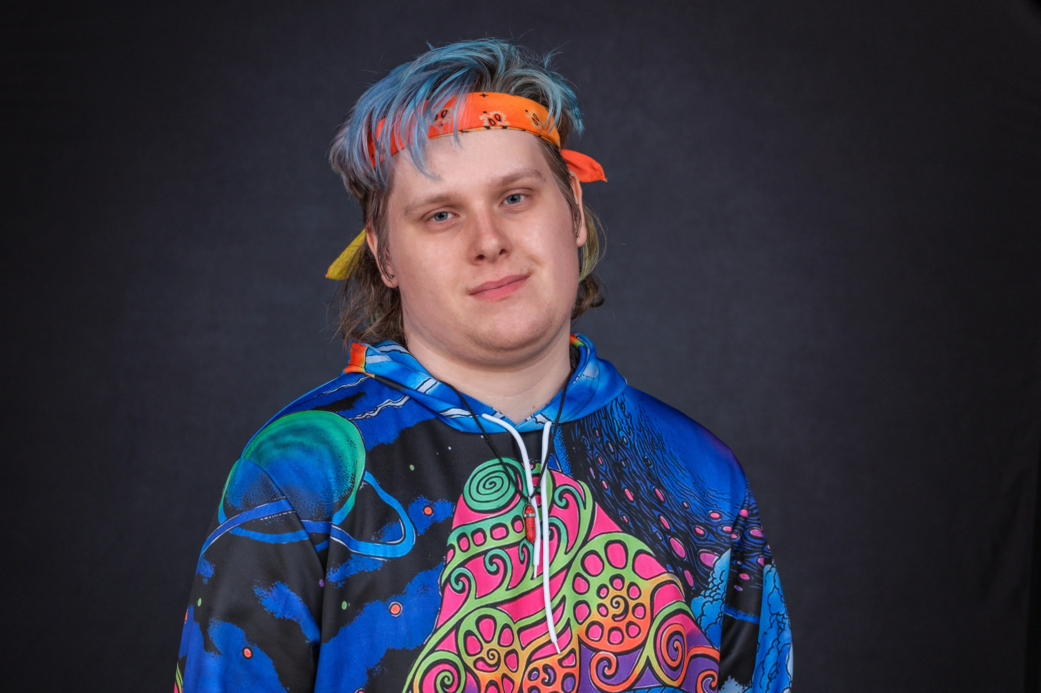
Contact details:
Niamh Kennedy ​
USI VP Equality & Citizenship​
Contact: equality@usi.ie​
Daniel Sanusi
Ulster University
d.sanusi@ulster.ac.uk
Oisin Putt
Technological University Dublin
disabilities@tudublinsu.ie
Julka Taylor
University College Cork
brod@uccsocieties.ie

Slide 3
Facilitator Questions
What inspired you to become an advocate for accessibility?
How do you engage students with disabilities in shaping union policies and activities?
Can you share examples of campaigns or initiatives that had a significant impact?
What advice would you give to other student leaders looking to champion accessibility?

Slide 4
Thank you!
Any questions?
INCLUSION
ADVOCACY
Power of Disability
'BREAKING BARRIERS’.
ACCESS
EQUITY
ACTIVISM
EDUCATION

