Slide 1

Speech-to-Text Technology: Enhancing Engagement and Inclusion for Non-Native and Hard-of-Hearing University Students
Presenter: Shahzad Yazdanpanah, MEd, Thompson Rivers University
Recipient of the 2026 CASJE Emerging Scholar Award
Research Team: Shahzad Yazdanpanah & Shadi Noohikashani
May 21st , 2026

Slide 2
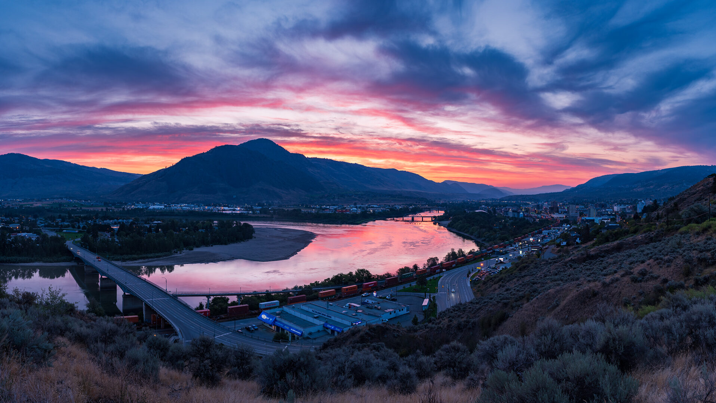
Land Acknowledgement
I acknowledge that I am located on the traditional and unceded territory of the Tk̓emlúps te Secwépemc.

Slide 3
Who the Researchers are
Shahzad
Hard of hearing
International student
Educator
Shadi
Audiologist
International student
Language learner
Shared experiences:
Struggling with diverse accents
Exclusion
Participation anxiety

Slide 4
Why this research matters
Bridging the gap between policy and practice.
Most studies focus on each group of students separately (Venturini et al., 2022).
No studies combine the perspectives of a hard of hearing non-native student and a non-native student with audiology background.
Research often treats STT as an accessibility tool (Alsalamah, 2020).

Slide 5
theoretical framework & Methodology
Disability Justice
Duoethnography
Two researchers, two lived experiences
Observation + Reflection + Dialogue
Disability justice provides a holistic, inclusive framework.
Prioritizes intersectionality, dignity, humanity to drive systematic change.
Co-construted understanding
(Sins Invalid, 2015)
(Sawyer & Norris, 2013)

Slide 6
Key Finding 1
Comprehension
Real-time captions supported understanding
Helped with accents, fast speech, academic vocabulary
Made learning more accessible

Slide 7
Key Finding 2
Confidence (Emotional Impact)
Reduced anxiety
Increased confidence
Less fear of missing information
Students felt more capable
Increased sense of belonging & inclusion

Slide 8
Key Finding 3
Participation (Engagement)
More active involvement
Greater willingness to speak
Better interaction with peers
From silent → engaged learners

Slide 9
Critical Insight
STT is not perfect
Can cause:
  Cognitive overload
  Eye strain
  Distraction
Most effective when used as support, not replacement

Slide 10
From Accommodation to UDL practice
Let go of bias
Normalize STT for everyone
Turn on captions in lectures, videos, Teams, etc.
Use STT to support emotional inclusion
Invite student voice and co-design

Slide 11
How to set up STT
Quick Demo:
How to set-up STT…

Slide 12
Conclusion
STT should be viewed not only as an accessibility accommodation, but also as an inclusive teaching practice.
STT supported comprehension, confidence, participation, and sense of belonging.
Accessibility is not only about technology, but about creating learning environments where students feel seen, valued, and included.
Inclusive technologies can help transform students from silent observers into active participants.
When accessibility tools are normalized rather than individualized, classrooms become more participatory, equitable, and human-centered.

Slide 13
References
Buettgen, A., Fontes, F., & Eriksson, S. (2023). Disabled people and the intersectional nature of social inclusion. Social Inclusion, 11(4), 287–290. https://doi.org/10.17645/si.v11i4.7798
Dolmage, J. T. (2017). Academic ableism: Disability and higher education. University of Michigan Press. https://muse.jhu.edu/book/57058/
Lopez, J., & Grey, F. (2025). Anti-ableism in higher education: A changemaking report. https://doi.org/10.17605/OSF.IO/MKEFZ
Marom, L. (2019). Under the cloak of professionalism: Covert racism in teacher education. Race Ethnicity and Education, 22(3), 319–337 https://doi.org/10.1080/13613324.2018.1468748
Nair, R., & Vollhardt, J. R. (2020). Intersectionality and relations between oppressed groups: Intergroup implications of beliefs about intersectional differences and commonalities. Journal of Social Issues, 76(4), 993–1013. https://doi.org/10.1111/josi.12409
Sawyer, R. D., & Norris, J. (2013). Duoethnography. Oxford University Press.
Venturini, S., Vann, M. M., Pucci, M., & Bencini, G. (2022). Towards a more inclusive learning environment: The importance of providing captions that are suited to learners’ language proficiency in the UDL classroom. In Transforming our world through universal design for human development. IOS Press. https://doi.org/10.3233/SHTI220884
Wolbring, G., Mahr, D., & Lamoureux, R. (2025). Teaching about the intersectionality of disabled people using an intersectional pedagogy framework: A primer. Learning Object. https://doi.org/10.11575/PRISM/48644

Slide 14

Have a Question?
Reach me at
shahzady6990@gmail.com

Slide 15
Thank You!

