Slide 1
Power of Disability
'BREAKING BARRIERS’.
INCLUSION
ADVOCACY
ACCESS
EQUITY
ACTIVISM
EDUCATION
Student Engagement:
A tool for Change

Slide 2
Student Engagement:
A tool for Change
What are the key barriers to meaningful student engagement, and how can they be overcome?
Can you share examples of successful student-led campaigns or initiatives?
How can institutions better support diverse student voices, including those from marginalised communities?

Slide 3
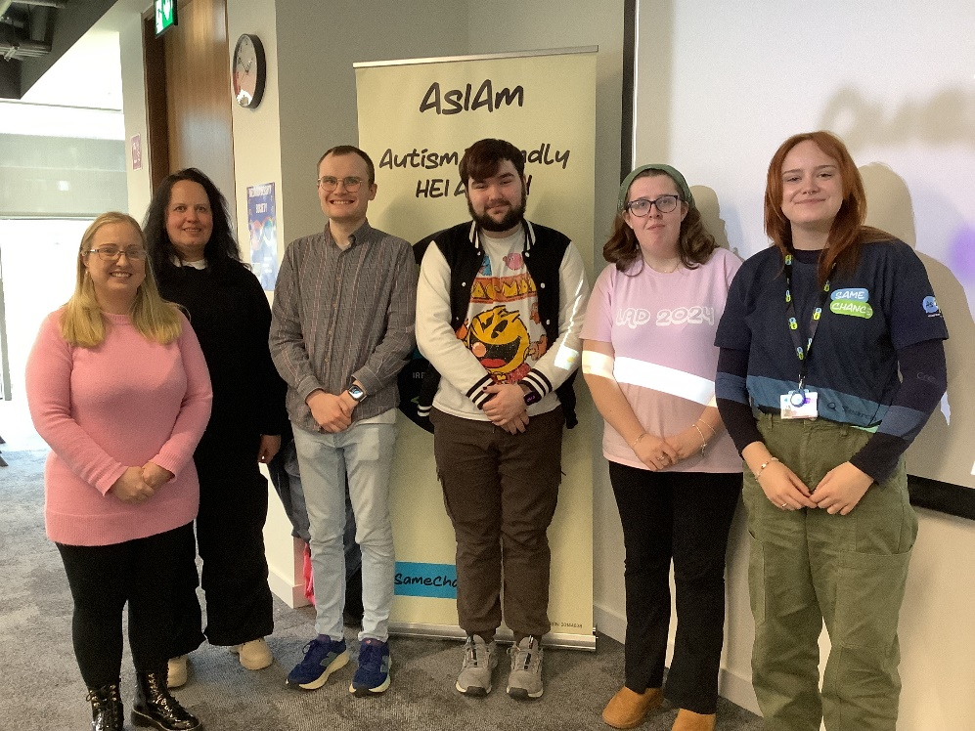
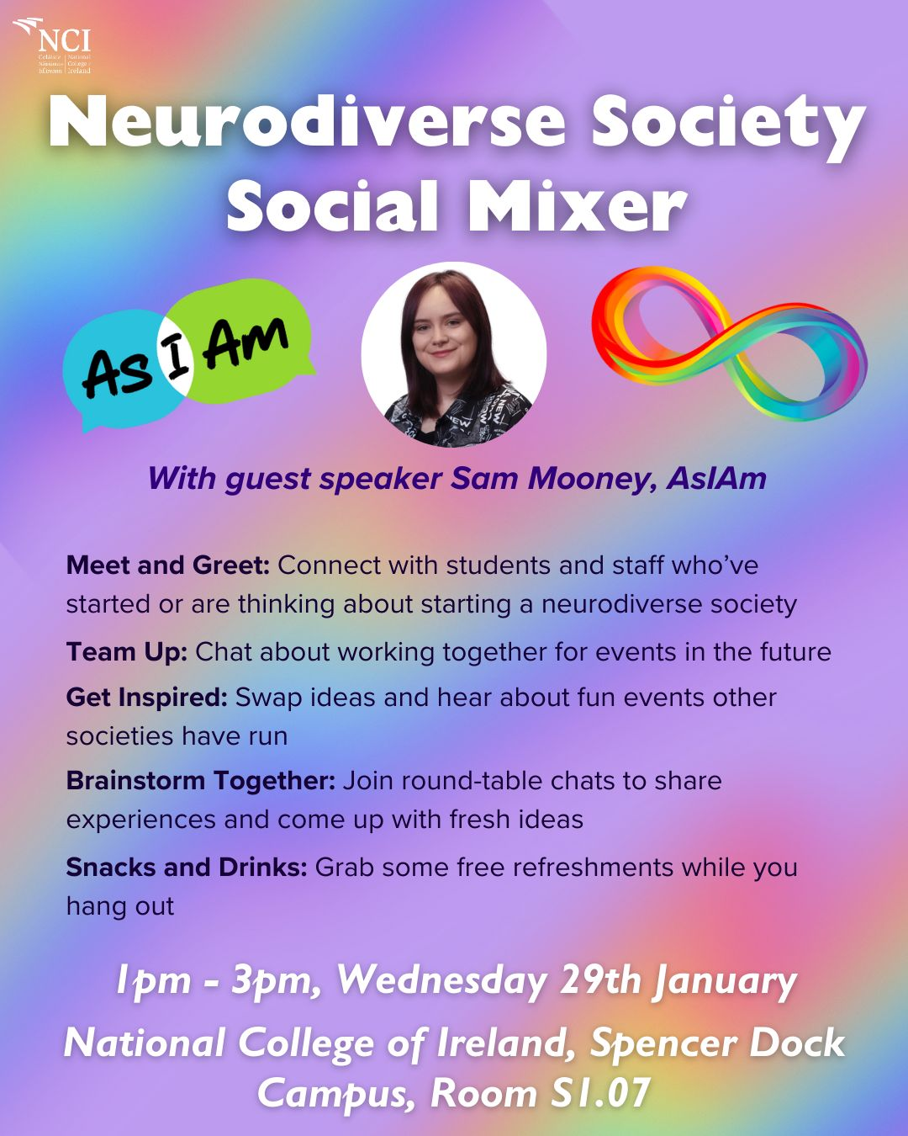

Panel Discussion: Strategies for Engaging Students
Create safe and inclusive spaces for Neurodivergent Students to come together and share their perspectives.
A society mixer between universities, where students can swap ideas and hear about events that other societies have run.

Slide 4
AsIAm Events:
1. Basic Life Admin for the Autistic Community: 19th and 26th Feb 7-8pm
Session 1: Setting Up a Bank Account & Understanding Taxes
Session 2: Navigating Disability Allowance & Employee Benefits
Sign up at the link below:
https://calendly.com/subscriptions-i4a/life-admin
2. Employment Seminar – National Collage of Ireland – 29th of March – Free event
Keynote Speaker: James Cusack Chief Executive at Autistica, the UK's autism research charity.
https://asiam.ie/events/asiam-employment-seminar

Slide 5

Contact details

Slide 6


NSTEP contact details

Slide 7


Students with Disabilities Advisory Group
The students with disabilities advisory group is a diverse group of students that works to advocate for and promote accessible and inclusive learning environments.
The members of the group work to inform the strategy and policy of both AHEAD and USI concerning the inclusion of students with disabilities in Higher and Further Education in Ireland. The advisory group serves to ensure that the disabled student voice is being heard and reflected in wider policy work.

Slide 8

AHEAD and the National Disabled Postgraduates Advisory Committee LaunchPAD Partnership
The aims of the partnership are to:
Foster a Sense of Belonging by Establishing the NDPAC / AHEAD Partnership and Community
Influence Policy Development by Amplifying the Lived Experience of the Diverse Voices in the Community
Sustain the Community to Make a Lasting Impact Through Advocacy and Influence in HE Decision-Making
LaunchPAD will be looking for postgrads to volunteer for paid opportunities throughout the year. They will also be hosting a number of virtual events aimed at building a disabled postgraduate community.
If you are interested in being a part of the LaunchPAD community then you can sign up at this link: https://mailchi.mp/5286e5a5d826/launcpad-sign-up

