Slide 1



AHEAD Better Options 2021
'Options and Routes to Courses'
Saturday November 27th 2021
Options, Access and Adult Guidance Supports
Mary Stokes, FET Guidance Programme Coordinator,
National Centre for Guidance in Education
Mary.stokes@ncge.ie
Notes:
The Role of
Group introductions
Expectations

Slide 2
National Centre for Guidance in Education, Ireland
Who are NCGE?
An agency of the Department of Education and Skills (DES) and Department of Further and Higher Education, Research, Innovation and Science (DFHRIS), Representative for Ireland in EU. NCGE engages exploration of Career Skills and is informed by National, European and global developments.
What skills are currently seen as valuable for Careers?
Consistent in all contexts is the increased value for employability are competencies such as Project Management, Transversal skills, Communications, Information Technology and Digital Skills, Creative and Innovative skills, and skills like problem solving, communication skills and interpersonal skills.
Notes:
Creative – seeing “new ways” to consider existing services/ provision/ networking…
Innovation – comes from “ideas” nurturing – try and fail/ try better…

Slide 3
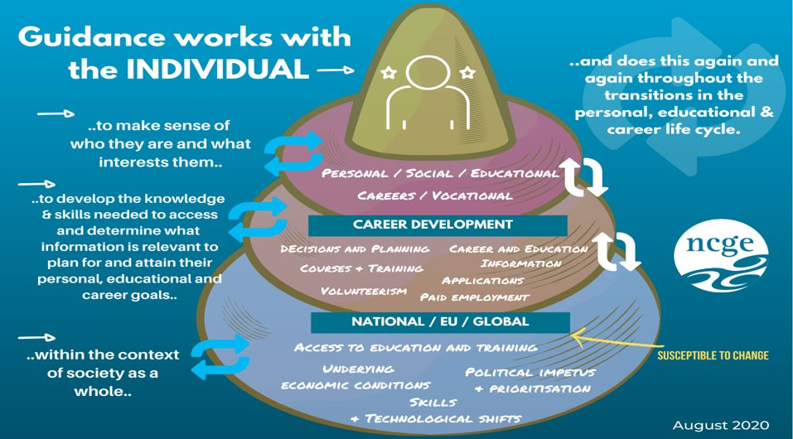
What is Career Guidance?

Slide 4
What is FET?
SOLAS Future FET: Transforming Learning 2020 – 2024
Ambitious new strategy based around the three core pillars of building skills, fostering inclusion, and facilitating pathways.
SOLAS FET Strategy 2020-2024 Ambitions:
Access to year-round learning options in a local FET centre or college … share my experience with other learners
Part-time options will be available at Level 5 and Level 6 to allow … re-skill or up-skill and enter a new career or provide a pathway to further study in FET or HE
access learning in bitesize chunks, taking modules and courses that fit with personal and working commitments, that enable … to also build my credits and credentials over time
Learning opportunities will be available in flexible modes, allowing study at learner’s pace, using technology/ blended and online options..
Community education options which can link to longer-term pathways within FET and beyond
The outcomes of all the learning I undertake can be recognised
Learner support and guidance will be tailored to my individual needs and available within my local community setting

Slide 5
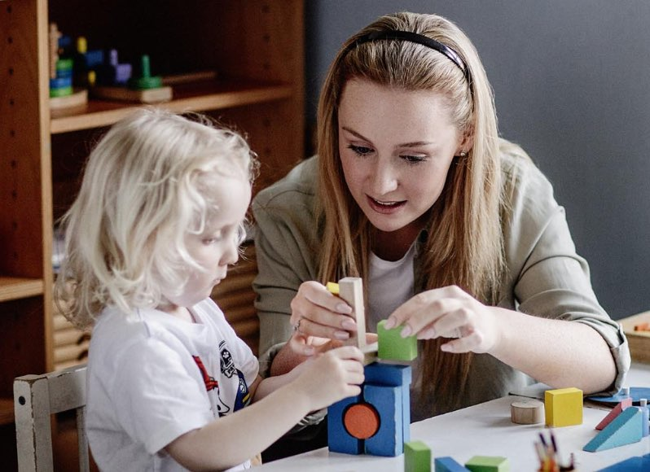

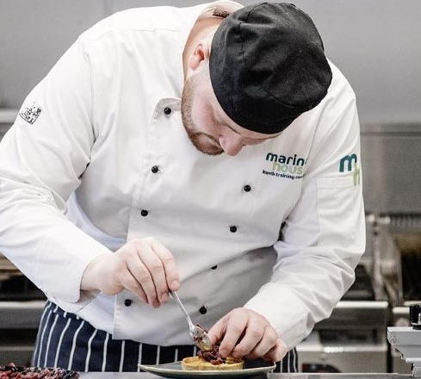
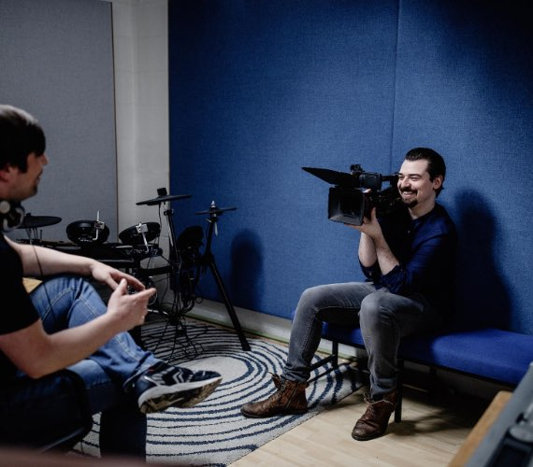

Full time opportunities in FET
FET Courses are as diverse as they are wide and include computer game programming, lab techniques, sports therapy, nursing studies, make-up, fashion, special effects, business, design and supervisory management.
Post Leaving Certificate (PLC) Courses
Vocational Training Opportunities Scheme (VTOS)
Youthreach
Bridging/Foundation Courses
Specific Skills Training (SST)
Traineeship
Community Training Centres (CTCs)
Specialist Training Providers (STPs)
The Local Training Initiative Programme (LTI)
Apprenticeship
Notes:
Where are FET students going?
20 per cent of PLC graduates are progressing to higher education, one-fifth of the overall first-year intake at institutes of technology and technological universities
emerging evidence better prepared to complete their degree programmes than those entering higher education directly from Leaving Cert
Growing interest among school-leavers in traineeship programmes, which run from six-24 months in vocational areas with a minimum of 30 per cent on-the-job training leading to employment opportunities: available in interesting areas like hospitality, medical administration, animation and healthcare, and they’re being developed in exciting new areas like barista, machine tool operation, biopharma, equestrian.”

Slide 6
Part time opportunities
Progression routes… and part time opportunities…
Where are FET students going?
Almost 20 per cent of PLC graduates are progressing to higher education, nearly one-fifth of the overall first-year intake at institutes of technology and technological universities.
Emerging evidence that they are well prepared to complete their degree programmes
Growing interest among school-leavers in traineeship programmes, which run from six-24 months in vocational areas with a minimum of 30 per cent on-the-job training leading to employment opportunities. Traineeships available in hospitality, medical administration, animation and healthcare, and developed new areas like barista, machine tool operation, biopharma, outdoor pursuits…
Back To Education Initiative (BTEI)
Adult Literacy, Numeracy and Digital Skills(AL)
English for Speakers of Other Languages (ESOL)
Skills for Work
Evening Courses
Blended Learning Courses
Community Education

Slide 7
Useful and valuable skills,
an introduction to supports…
In every type of employment and life circumstance, it is vital to support everyone to develop literacy, numeracy and digital skills, and to encourage us all to keep on learning!
Development of skills demands access and reliable information and support – especially when an adult has a disability!
Career guidance supports career exploration, career management and new skill development, and facilitate career mobility and resilience…
These videos may help you to explore your options…
https://youtu.be/RxcRAJeO894?t=26
https://youtu.be/JZni2i1wWyU
https://www.aontas.com/assets/resources/Information/One-Step-Up-Info-Booklet.pdf
Notes:
Adult Guidance Services, Guidance in Post Primary, in FET…

Slide 8
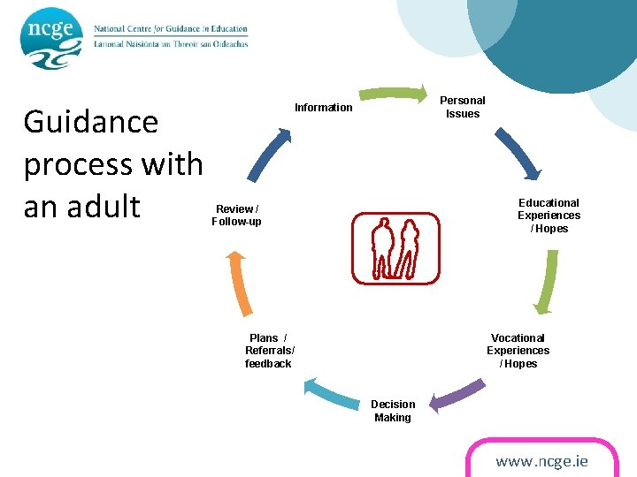
The Guidance Process
ETB Adult guidance and information services are free, impartial and professional services to support to all, in equitable and appropriate ways
Trust is vital and the availability of reliable, professional information and guidance is key as well as integrated career support any education or training, higher level courses to support “upskilling” or “reskilling”.
Confidence is also key - confidence is boosted through citizen engagement, through skill development and importantly through facilitating Informed Choice.

Slide 9
Guidance provision across FET sector
‘Guidance and Information facilitates people throughout their lives to manage their own educational, training, occupational, personal, social, and life choices so that they reach their full potential and contribute to the development of a better society.’ National Guidance Forum Report 2007
Guidance in Ireland is provided in the FET sector through various services, FET / Adult Education Guidance Services, Colleges of Further Education / PLC Programmes, Youthreach / Community Training Centres, Training Centres, Adult and Community Education, Youth Information, Back To Education Initiative and Prison Services.
Information and Guidance Services in the Further Education and Training (FET) sector provide impartial careers and education information, one-to-one guidance and group guidance, which help people to make informed educational, career and life choices.

Slide 10
The role of adult guidance and information
‘lifelong learning is to be nurtured through valuing the voice of the learner to allow for increased participation and equity of access’
facilitates how an Individual can achieve their full potential and the learning system can respond in a flexible way to the changing needs of society.
is important in the context of accessing education and in support of lifelong learning
Mechanism for human capital development
supports Reskilling and/or upskilling of individuals for the knowledge economy.
provides Mechanism to recognise the skills of immigrants and other sectors of society such as the voluntary sector, and older workers.
supports the employability and mobility of older people, women and early school leavers.
Education and Training Sector, Overview of Service Delivery and Reform (Department of Education and Skills
Notes:
‘The mission and visions outlined in Ireland’s Education and Training Sector, Overview of Service Delivery and Reform (Department of Education and Skills, 2015b), underpin the conditions necessary for RPL to thrive: where an individual can achieve their full potential and the learning system can respond in a flexible way to the changing needs of society. This report stated that lifelong learning is to be nurtured through valuing the voice of the learner to allow for increased participation and equity of access. ‘
RPL is important in the context of accessing education and in support of lifelong learning. It provides a mechanism for human capital development and the reskilling and/or upskilling of individuals for the knowledge economy. RPL also provides a mechanism to recognise the skills of immigrants and other sectors of society such as the voluntary sector, and older workers. RPL can be used to support the employability and mobility of older people, women and early school leavers.

Slide 11
Lifelong learning and inclusive Practise
21st century lifelong learning emphasises the importance of a competence-based approach to education that puts the delivery of transversal competences and “life skills” as central.
Significant issues include - Funding – eligibilities, entitlements, choice…
Connectivity across service provision…
Vertical linkages - linking different levels of education as well as connecting various developmental stages of learners.
Horizontal integration refers to the linking of learning to life spheres and activities of community, family, school, workplace and other social organizations. It also involves the task of linking different types of education – formal, non-formal and informal.
Integrated career development and provision of impartial career guidance should support all at all stages on their journey.

Slide 12
AEGI Contact Details
A free and confidential service available nationwide.
ETB Adult Education Guidance Services offer a guidance service to adults which includes impartial adult education information, one-to-one guidance and group guidance, which help people to make informed educational, career and life
Click on the list below to access YOUR local AEGS contact details:
Adult Education Guidance Services in the Leinster region
Adult Education Guidance Services in the Munster region
Adult Education Guidance Services in the Connacht region
Adult Education Guidance Services in the Ulster region

Slide 13

Thanks!
Thank you AHEAD!
Questions Welcome!!
Go raibh maith agaibh
mary.stokes@ncge.ie
www.ncge.ie

