Slide 1

New Apprenticeships
Sales
Case Study: Sales Apprenticeship
Siobhan Magner
27/11/2021

Slide 2
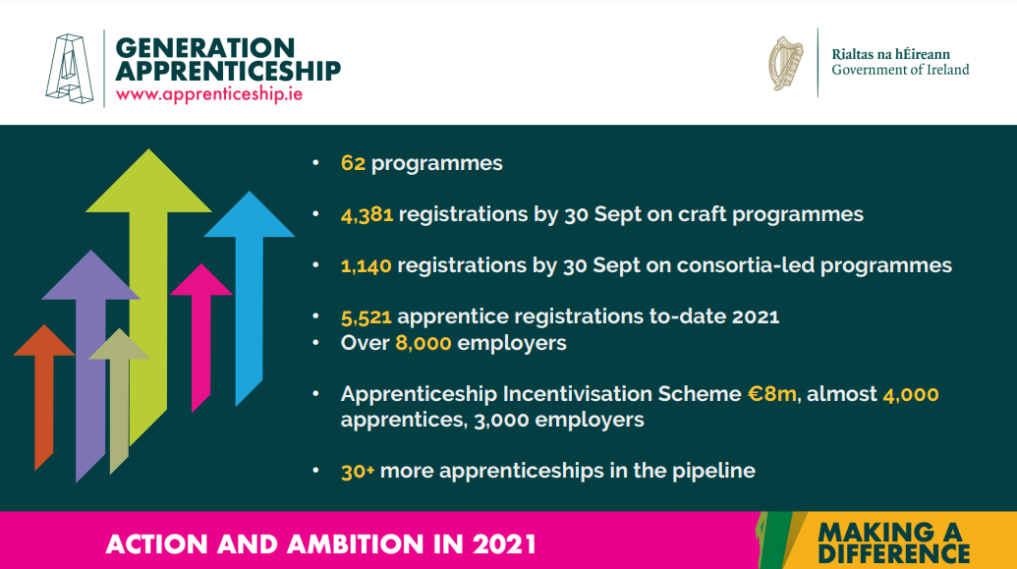
Information
New Apprenticeships in Ireland
Industry-led
Lead to an award at Levels 5 to 10 on the NFQ
Between 2-4 years in duration
Minimum 50% on-the-job learning
Flexible delivery
Apprentices are employed under a formal contract of apprenticeship and are paid a salary

Slide 3

10 Apprenticeship Myths Busted
Myth 1: Apprenticeships are for people who aren’t academic
Myth 2: I won’t be able to afford it
Myth 3: Apprenticeships are only available in certain sectors
Myth 4: Apprenticeship limit future career prospects
Myth 5: I won’t get a good qualification
Myth 6: If I do an apprenticeship I’ll get stuck in one job
Myth 7: Apprenticeships are only for school leavers
Myth 8: I need experience to get an apprenticeship
Myth 9: Businesses are not hiring apprentices
Myth 10: I’ll be making tea all the time!
Notes:
What it is
…..an opportunity to earn a salary as an employee while gaining valuable knowledge and skills. You will learn both on-the-job and in a college setting while being paid throughout
….. start your career, gaining practical, on-the-job experience and skills along with a globally recognised qualification

Slide 4
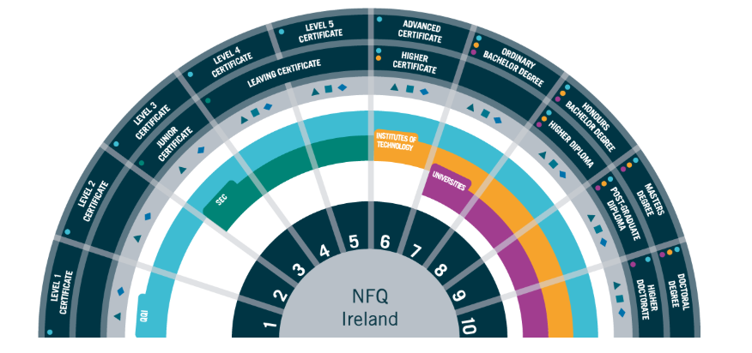
New Apprenticeships in Ireland
Industry-led
Lead to an award at Levels 5 to 10 on the NFQ
Between 2-4 years in duration
Minimum 50% on-the-job learning
Flexible delivery
Apprentices are employed under a formal
contract of apprenticeship and are paid a salary

Slide 5



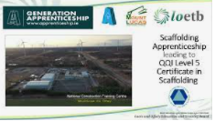




New Apprenticeships in Further Education and Training (FET)

Slide 6

Sales Apprenticeship
2-year programme leading to a Level 6 Advanced Certificate in Sales
84% delivered via on-the-job training & 16% delivered via off-the-job training
13 modules informed by industry and SMEs
Industry focused work based tasks and assessments

Slide 7



































SALES APPRENTICESHIP EMPLOYERS
Notes:
38 companies & 14 more in November

Slide 8
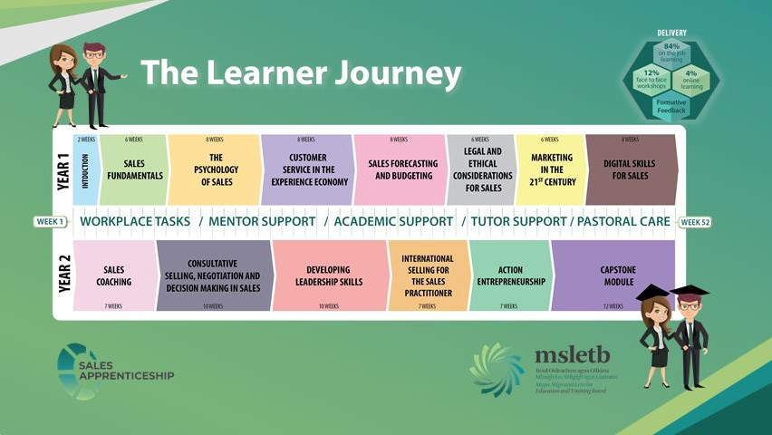
Workplace Mentors
Must be an experienced member of the employer’s management or senior supervisory team
Must have a major award at NFQ Level 6 qualification in a cognate area and a minimum of 2 years' industry experience in the sector
or
must have a minimum of 5 years’ experience working within in the sales sector (at least 2 years at supervisory level)
Does not grade assessments however does support the apprentice in completing work based tasks
Is required to complete a 1 day bespoke Workplace Mentor Training Programme facilitated by MSLETB

Slide 9

Anatomy of a sales apprenticeship graduate

Slide 10

Our website
What next?
https://apprenticeship.ie/
https://apprenticeship.ie/

Slide 11

Thank you
S
THANK YOU
Sales Apprenticeship
apprenticeship@msletb.ie

Slide 12
Any Questions

