Slide 1
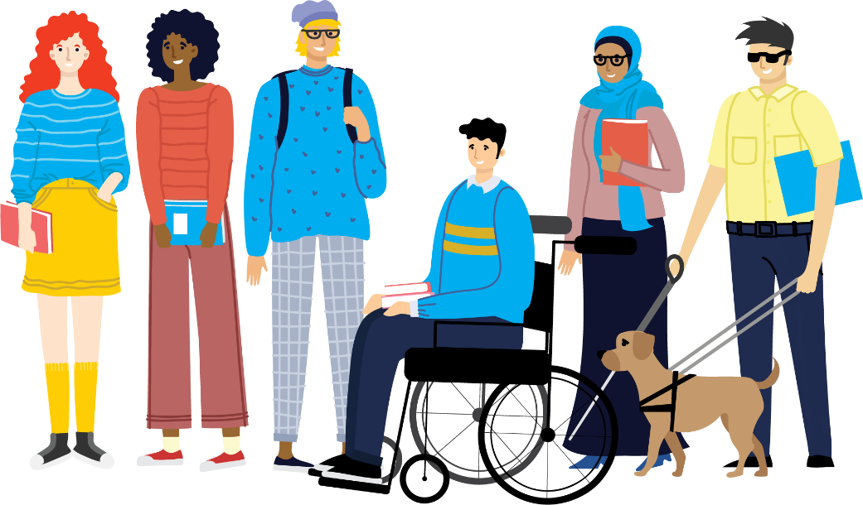

Getting the Most from College Life
Hannah Kelly (AHEAD) & Bukky Adebowale (USI)

Slide 2
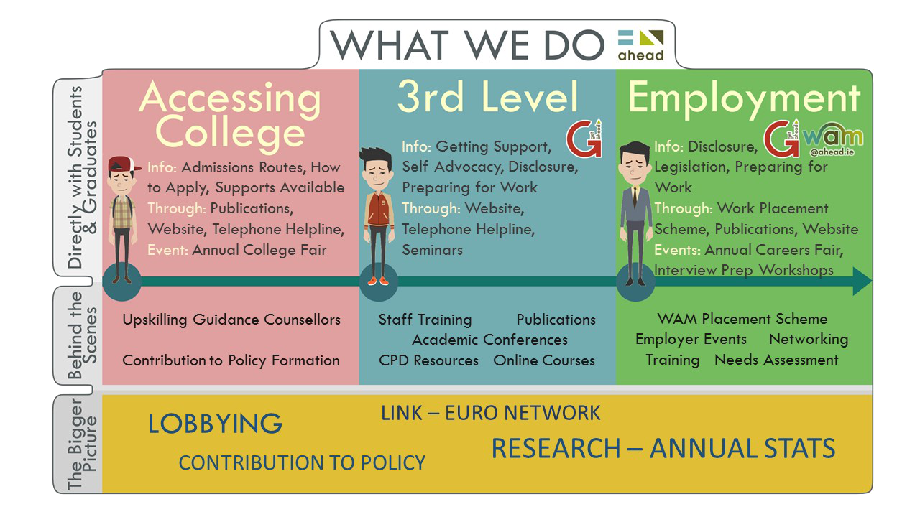
What we do
Notes:
hannah

Slide 3
The Union of Students in Ireland
The Union of Students in Ireland (USI) is the sole
representative body for students in Ireland.​
USI represents 374,000 students in over thirty member colleges across Ireland, North and South.​
Throughout its history, USI has worked relentlessly in the pursuit of student rights in all areas of the student experience. ​
The goal of USI is to work for the rights of students and a fair and equal third-level education system in Ireland.
Notes:
Bukky

Slide 4
Number of Students with Disabilities
Notes:
Hannah

Slide 5
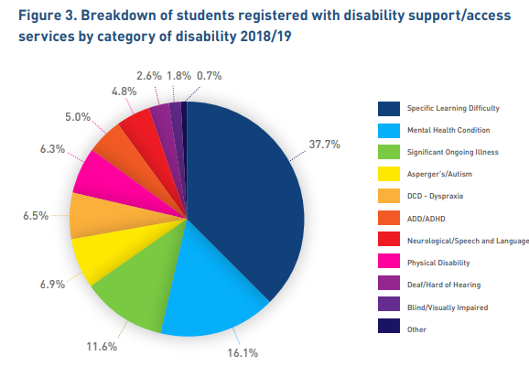
Breakdown of disabilities
Notes:
Hannah

Slide 6
Supports - GetAHEAD Programme
A network of student and graduates with disabilities currently making the transition from third-level education to full time employment.
Upskill students/graduates with disabilities by providing training events, information and resources including;
  Interview preparation
  CV Writing
  Networking
  Using Reasonable Accommodations/AT
  Legislation/Grants
  Disclosure
Notes:
Hannah

Slide 7

Supports - Your Disability/Access Office
Orientation to DARE students
If not DARE, register as soon as possible
Needs Assessment- less stress on you
Apply for Fund for Students with Disabilities
Notes:
Hannah

Slide 8



Supports – Your Student Union
Every College has a Students’ Union which represents students within the College, provides support and organises events and information campaigns for students.
Your SU represents you at a College level and can highlight the issues you’re facing - reach out to them.
Notes:
Bukky

Slide 9
Power of Disability Conference
It was great to hear other people with the same issues, I’m not alone
I just feel so not alone after this, I feel really heard and encouraged. After months of feeling isolated with my learning difficulties, it just feels really nice.
Annual Student Led conference for students with disabilities
Last year over 400 students registered
Focus on education and constructive advocacy
I just feel so not alone after this, I feel really heard and encouraged. After months of feeling isolated with my learning difficulties, it just feels really nice.
This will help me to advocate what I need throughout my time in college
Notes:
Hannah & Bukky

Slide 10
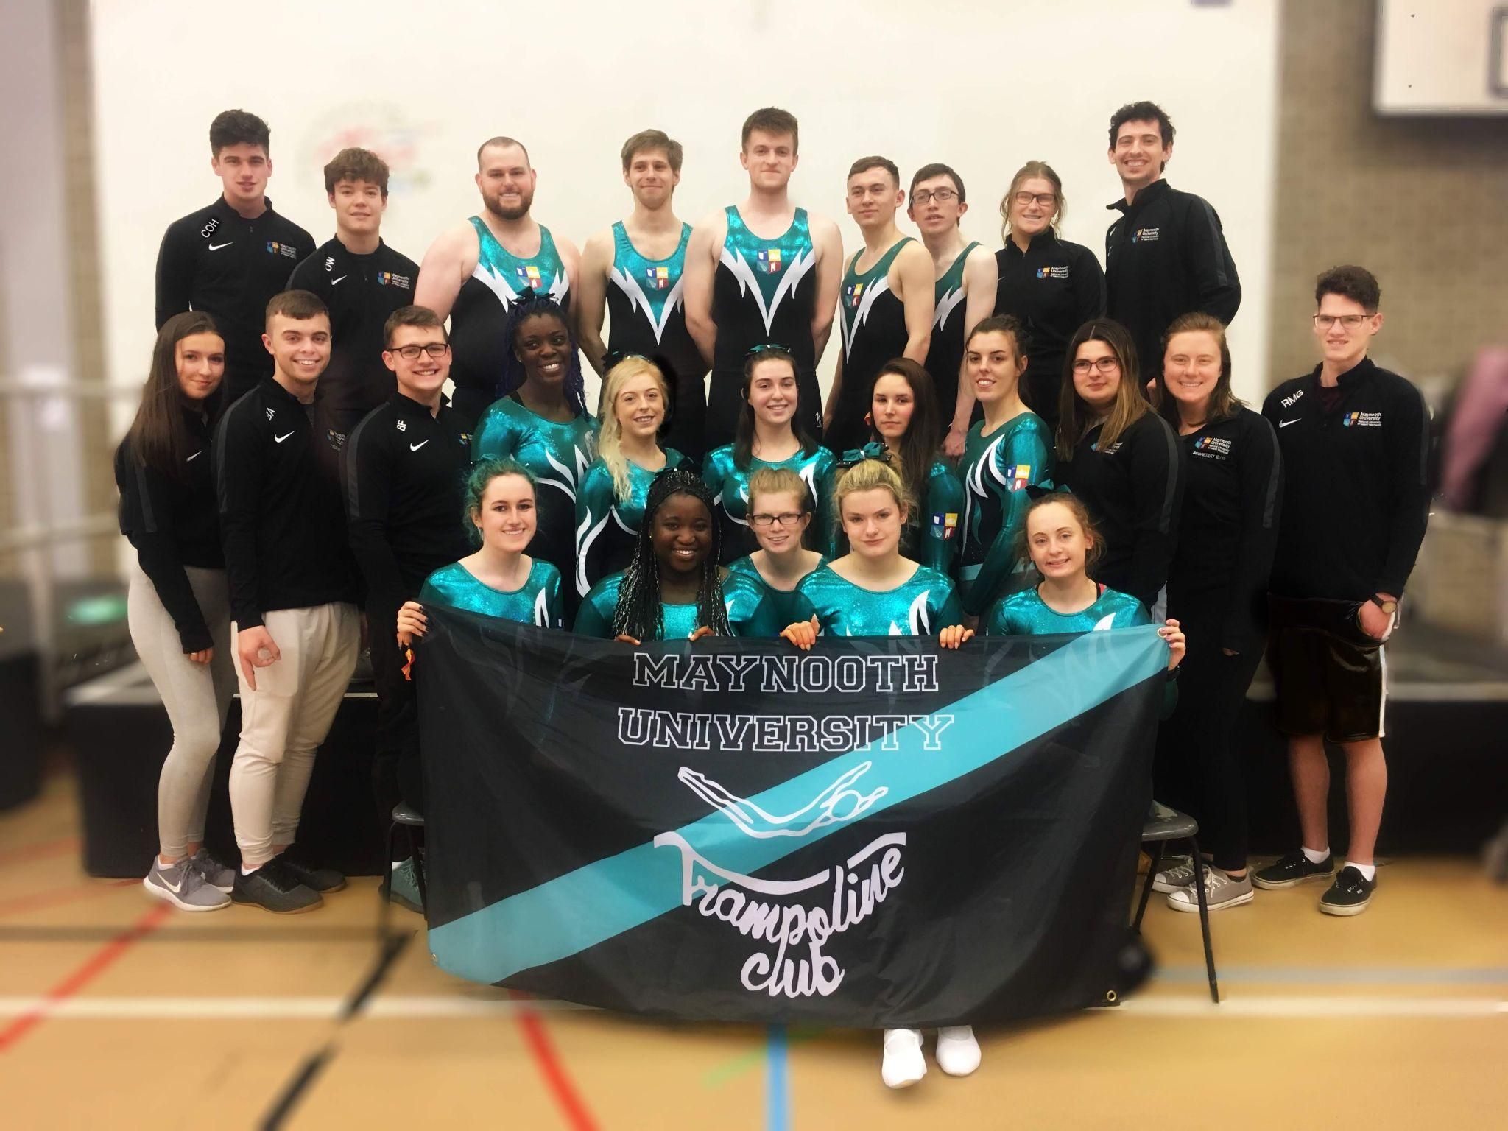


Get Involved – Clubs and Societies
Clubs and Societies are a place to develop friendships,
allow for personal growth, career development and
inclusion within groups of similar interests.
Develop skills and talents that you may not able to learn or develop through normal third level education.
You are joining a group of like-minded people who will go forward to plan events together, have nights out together, raise
money together and even travel to foreign countries
together.
They provide a world of opportunity and can open so
many doors especially within the career field.
Notes:
Bukky

Slide 11



Get Involved – Clubs and Societies
Many colleges have their own specific disability clubs or societies:
  DCU Neurodivergent society
  NUIG IMPACTE Society
  Trinity Sign Language Society
If there isn’t one in your college - you can make your own!
Notes:
Bukky

Slide 12
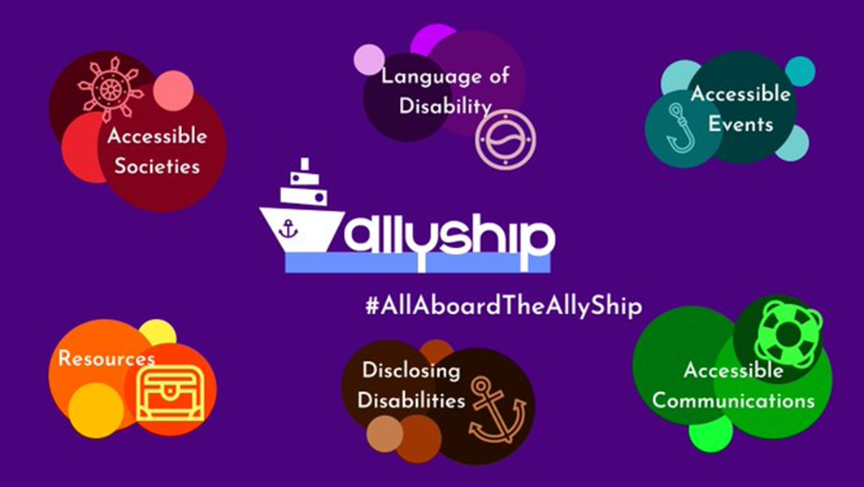
Behind the Scenes - Allyship
Resource hub for SUs and Clubs and Society committees
Enables students to create more accessible and inclusive C&S environments
Notes:
Hannah

Slide 13
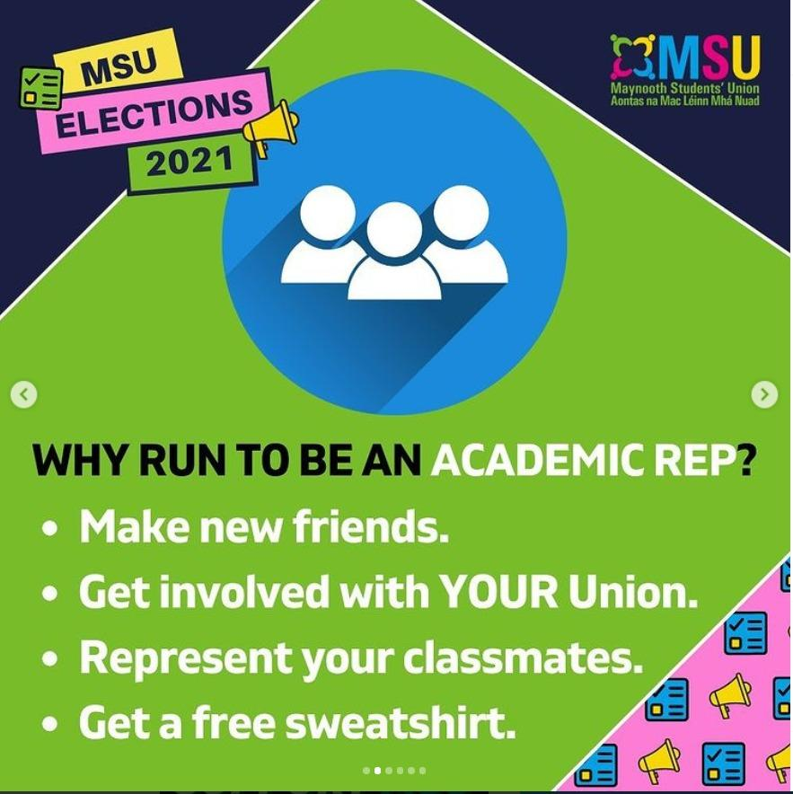
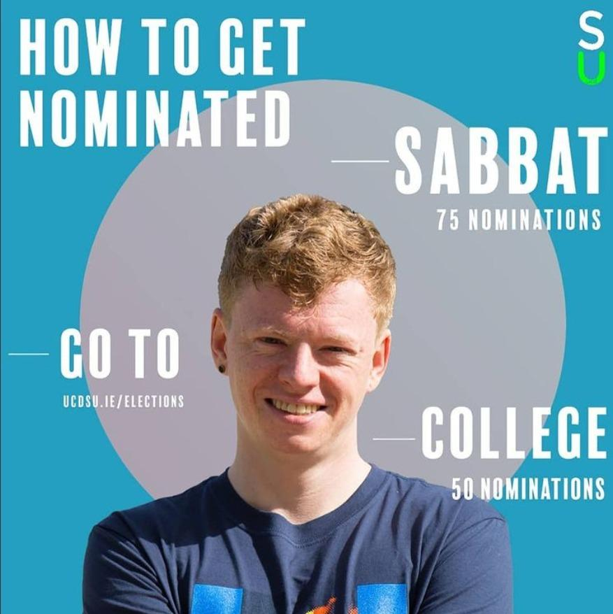
Get Involved – Your Student Union
Class Reps/Running for SU Positions

Slide 14
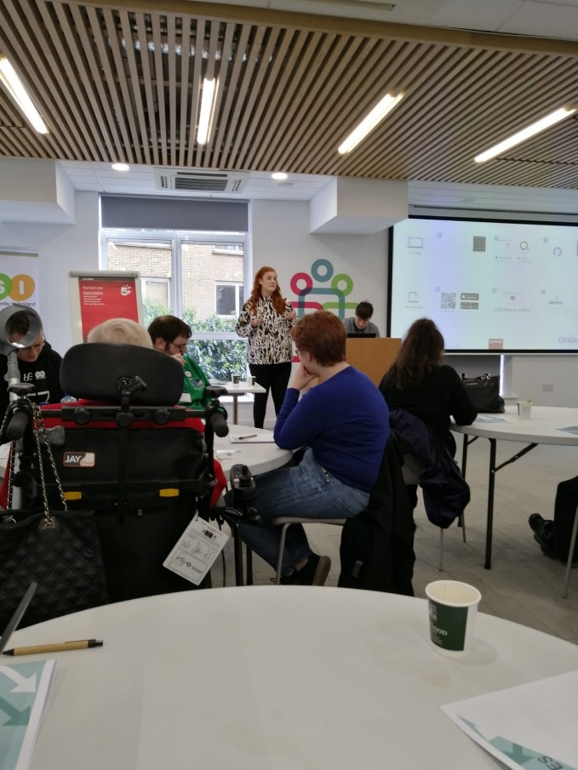
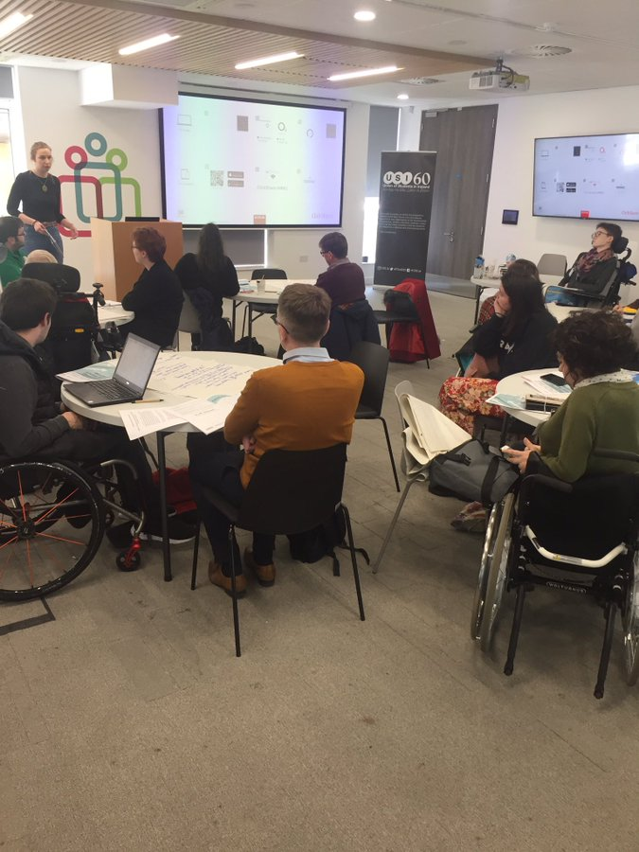
Behind the Scenes – Student Union Training
USI officers given Disability Awareness Training
Some committee members in Universities/Colleges given Disability Awareness Training

Slide 15

Behind the Scenes –
Co-chaired (USI/AHEAD) student group - both FET and HE
Raise issues on the ground to feed into our work
Provide feedback/input on projects and events
Highlighting good work in inclusive practice

Slide 16
Thank you
Any questions?
Visit www.ahead.ie for more information
Tweet us @AHEADireland

