Slide 1
UDL Curriculum Design Workshop Series: Creating an inclusive learning recipe one class at a time!
Dr Niamh Plunkett, Head of Teaching & Learning (ATU) Sligo Maureen Haran, PhD(c) SFHEA, Lecturer (ATU)
Siobhan Wynne, BA MBS FCII, Development Manager, Insurance Institute of Ireland

Slide 2
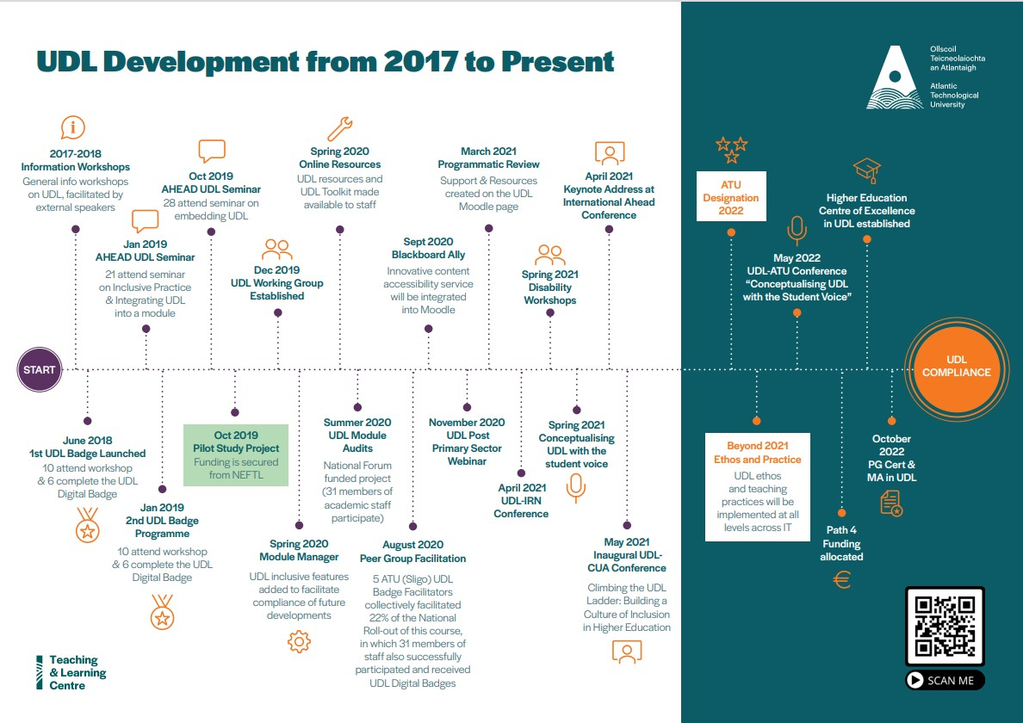
ATU UDL Timeline

Slide 3
Development of Level 9 Post Graduate Certificate / Masters in UDL
Natural progression from Digital Badge in UDL – Local & National Roll out
ATU Curriculum Development Team: Maureen Haran, Dr Niamh Plunkett, Dr Breda McTaggart
External Expertise/Advisors -review & input to the module & programme learning outcomes
Dara Ryder, CEO AHEAD
Dr Lisa Padden, Programme Manager, University for All, UCD

Slide 4
Internal Review Panel Validation May 2022
Letter of Support: Dr Fiona Malony, Director of Further Education & Training Support Services, ETBI ​
Panel Members – review and interview programme team​
Dr Sean Bracken, Principal Lecturer, University of Worchester​
Dr Gina Noonan, Head of Teaching & Learning, SETU (Carlow)​
Carol Neenan, Active Inclusion Officer, Cork Education & Training Board
Programme approved with commendations

Slide 5
Post Grad Cert/ MA in UDL
Post Graduate Certificate in UDL: 30 ECTS
Two (15) credit modules in year one (September – May)
Understanding the UDL Framework: Inclusive Education – Beyond Threshold Concepts (Semester 1: Sept –Dec)
Implementing the UDL Framework: Supporting Student Learning (Semester 2: Jan-May)
Learners have the option to progress to:
Master of Arts in UDL: 60 ECTS
Research Project: Year 2
Proposal – 15%
Project – 75%
Viva Voice- 10%

Slide 6
Post Graduate Certificate in UDL Commenced September 2022
8 participants in first cohort (Sept 2022 – May 2023)
ATU Donegal, Sligo & Galway Mayo
St. Angela's College
Insurance Institute Ireland
Lecturers and Guest Lectures comprise:
Maureen Haran, Programme coordinator
Dr Lisa Padden, UCD
Dara Ryder, CEO AHEAD
Dr Sean Bracken, Principal Lecturer University of Worchester
James Northridge, Project Manager for Inclusive UCC
National rollout commencing Sept 2023: Postgraduate Certificate in Universal Design for Learning (Online) - Atlantic Technological University Sligo (itsligo.ie)
International Rollout planned for Sept 2024

Slide 7

you will learn….
1. Constructive Alignment under the UDL Lens
2. Case study - Post Grad Certificate/MA in UDL
Siobhan Wynne, Insurance Institute of Ireland
3. Syllabus Management Software

Slide 8
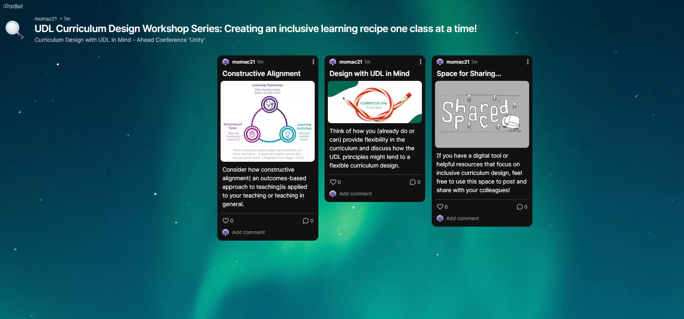
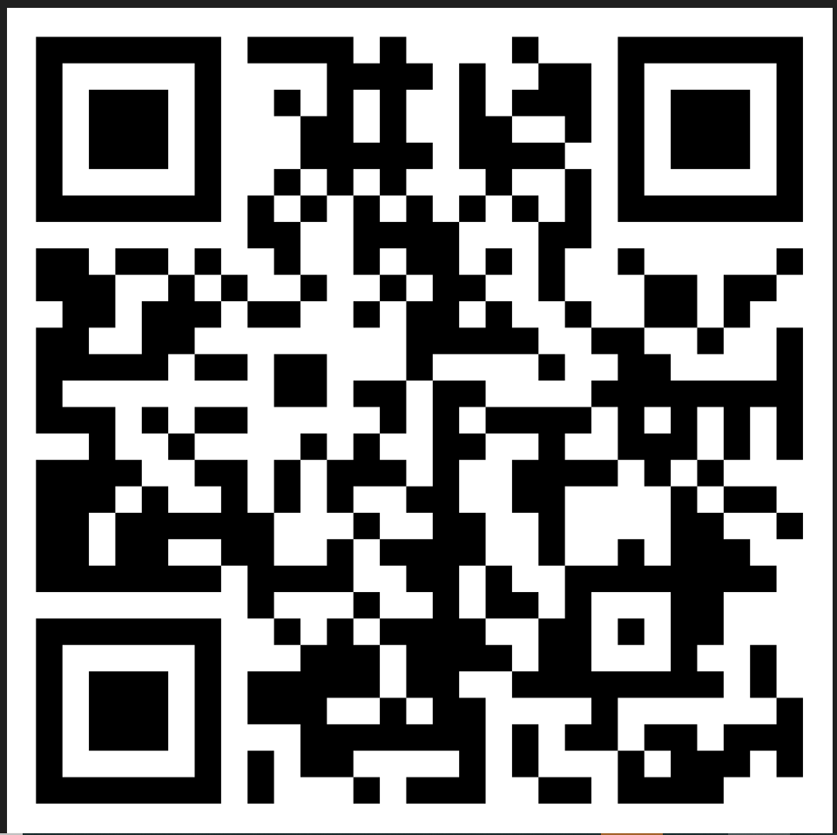
UDL Conversation Padlet
Start the conversation…
https://padlet.com/momac21/udl-curriculum-design-workshop-series-creating-an-inclusive--o0psvcz3cpjy1vs5
Notes:
Start the Conversation….
Constructive Alignment
Designing with UDL in Mind
Shared Space to share posts and resources

Slide 9
UDL & Biggs Model of Constructive Alignment in Curriculum Design

Slide 10
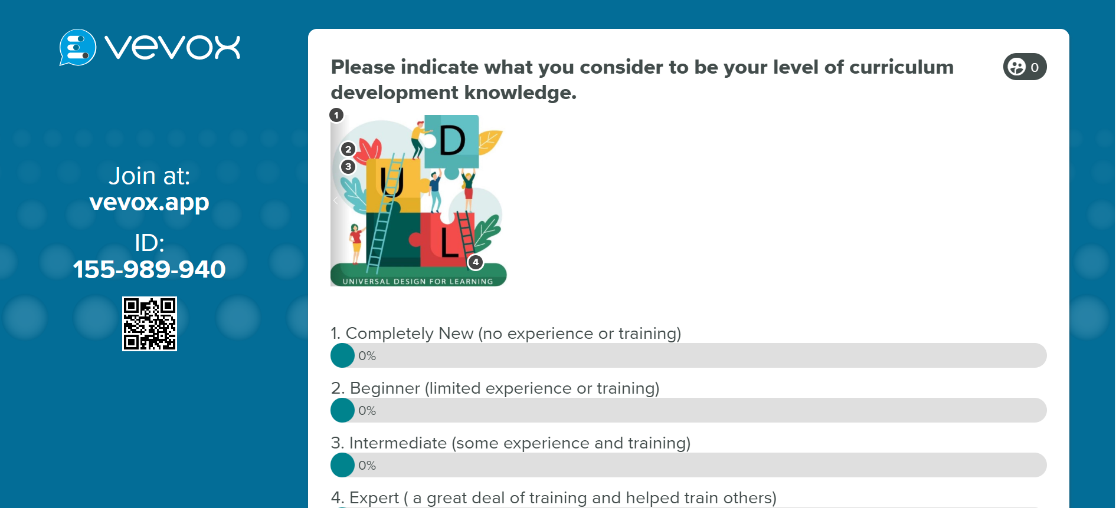
Vevox Poll on Curriculum development knowedge
Notes:
Vevox - What is your level of curriculum development knowledge?

Slide 11
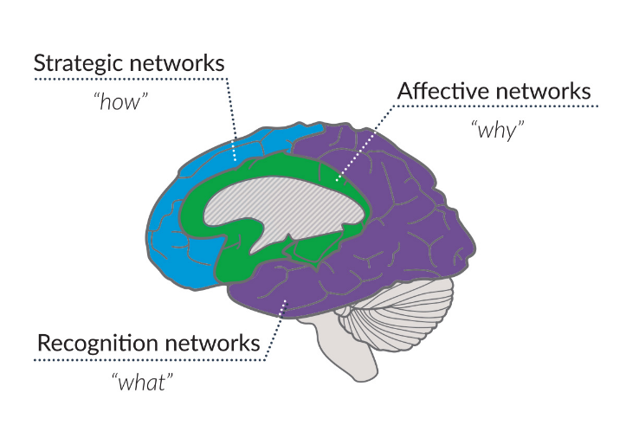
Scientific neuro-science (3) Principles
Learning Networks of the Brain
.
Notes:
Universal Design for Learning (UDL) is based on neuroscience of learning and instructional supports is more widely adapted as an instructional design method in higher education.
The UD principles were considered in the conceptualization of UDL but UDL is derived from the three neural networks for learning.
Green- (Why)Affective Networks: Interest, Persistence, Regulation
Purple – (What) Recognition: Perception, Comprehension
Blue – (How) Strategic: Access/ AT, Multi-media-communication, Strategic Goals
Cognitive Psychology- the framework depicts how the brain learns.

Slide 12
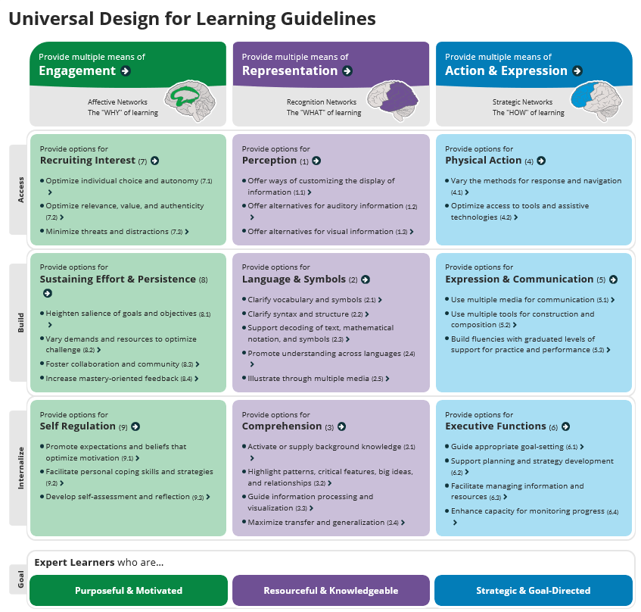
UDL Guidelines
Notes:
The UDL Guidelines were created by the CAST Organisation and these consider the 3 principles of UDL and drill down into how you can use/ apply the principles in teaching and learning.
The guidelines can be applied to design curriculum and infused into teaching & learning activities, T&L and assessment strategies.

Slide 13
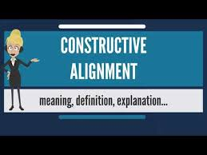
What is Biggs Constructive Alignment?
Constructive alignment was devised by Professor John B. Biggs, represents a marriage between a constructivist understanding of the nature of learning, and an aligned design for outcomes-based teaching education. ... Learner’s construct meaning from what they do to learn.
Notes:
learning, needs to be aligned by design for outcomes-based teaching education. ... Learner’s construct meaning from what they do to learn (teaching & learning activities).

Slide 14
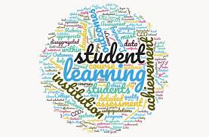
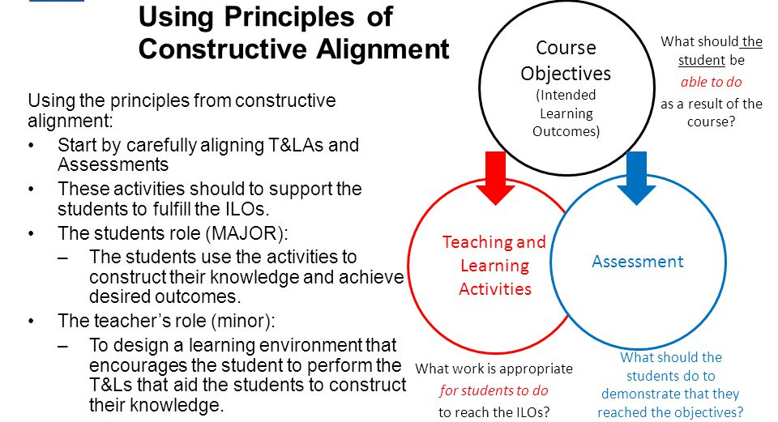
Using Principles of Constructive Alignment
Notes:
Objectives/ Outcomes – what students need to be able to do as a result of the learning.
Teaching & Learning – appropriate learning tasks to reach the objectives/ outcomes.
Assessment – the assessments should be purposeful, meaningful and provide the opportunity to demonstrate they’ve reached the objectives.

Slide 15

Time for some fun..

Slide 16

Constructive Alignment
Work with a colleague to write 3 Learning outcomes/ objectives on a simple concept (baking an apple tart)
Discuss your specific learning task:
identify what others should learn as result of undertaking a training or class
write these as Learning Outcomes/Objectives.
(c) decide what the assessment(s) for this will be and
(d) design the teaching and the learning activity.
Be prepared to share these in the large group!
Keep your learning objectives concise.
State the intended learning outcomes
Choosing 1-2 teaching/learning activities likely to lead to help and encourage students to attain these objectives.
Consider 1-2 assessment methods that reflect the learning outcomes using methods that enable students to demonstrate the intended learning and evaluating how well they match what was intended.
Notes:
PG Cert TLA – tutorial activity on constructive alignment.
Explain the task.

Slide 17
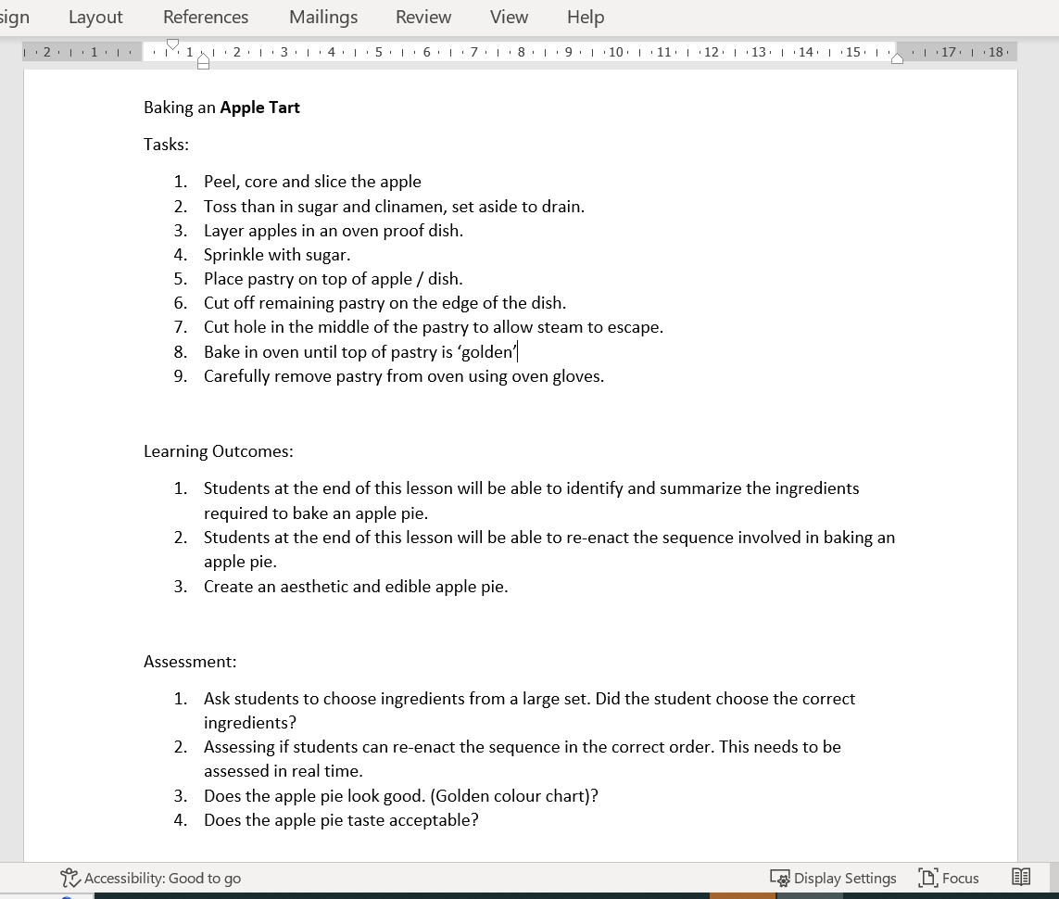
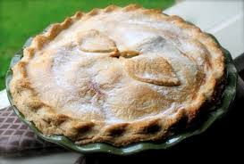
Student examples of alignment
Notes:
Result – aligned.

Slide 18
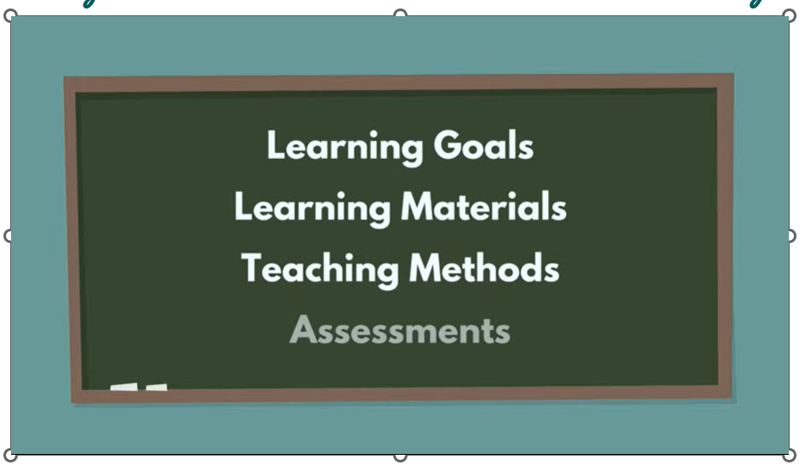
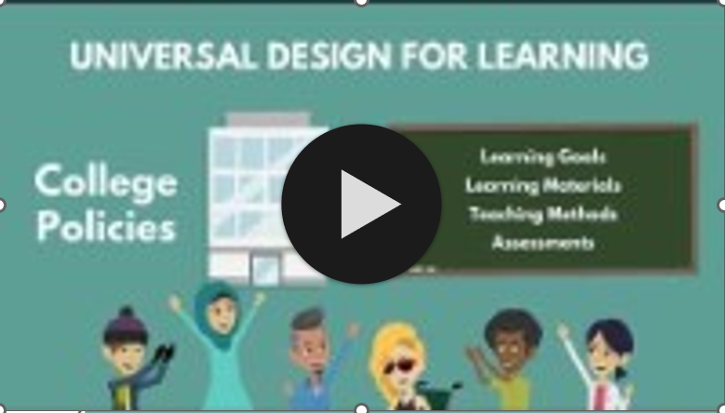
How might the UDL Framework enhance this curricular design?
Notes:
This is an image of a short clip from AHEAD, gives a succinct and easy understanding of what UDL is.
Specifically mentioned is considering FLEXIBILITY in the learning goals, learning materials, teaching materials and assessments.

Slide 19
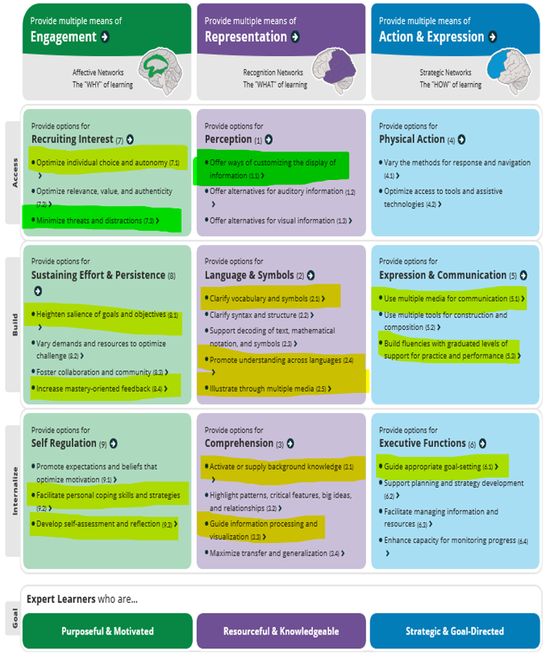
Student Example with UDL
Notes:
Same activity – But now we added in how we could have designed with UDL in mind. The students were asked to go over their previous constructive alignment activity (that was aligned well) and this time see where they could design using the UDL Guidelines.

Slide 20
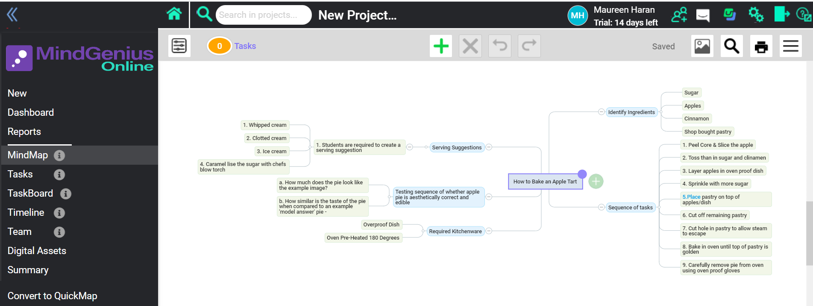
Mind Map – Student Created
Notes:
Offering ways of customising the display of information.

Slide 21
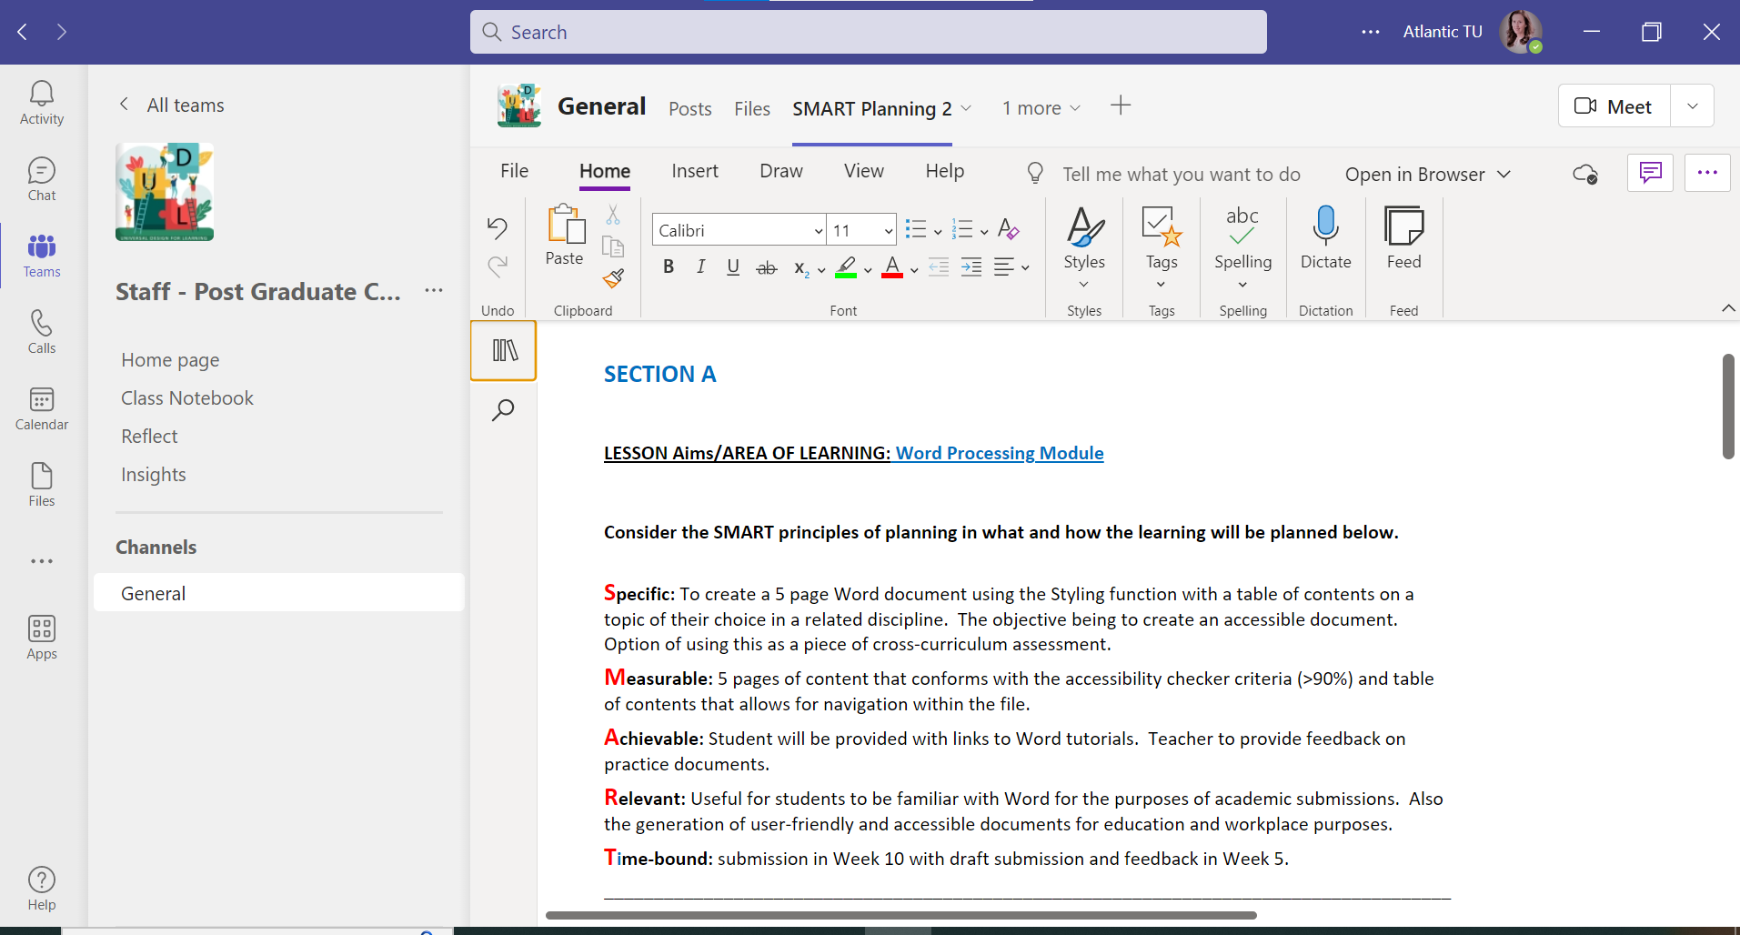
Student Example with UDL
Notes:
Masters in UDL programme
SMART Principles of Planning SPECIFIC, MEASURABLE, ACHEIVABLE, RELEVANT, TIME-BOUND
Students were asked in break out rooms using OneNote in Teams to plan for a college (either level6,7 or 8) area of learning.

Slide 22
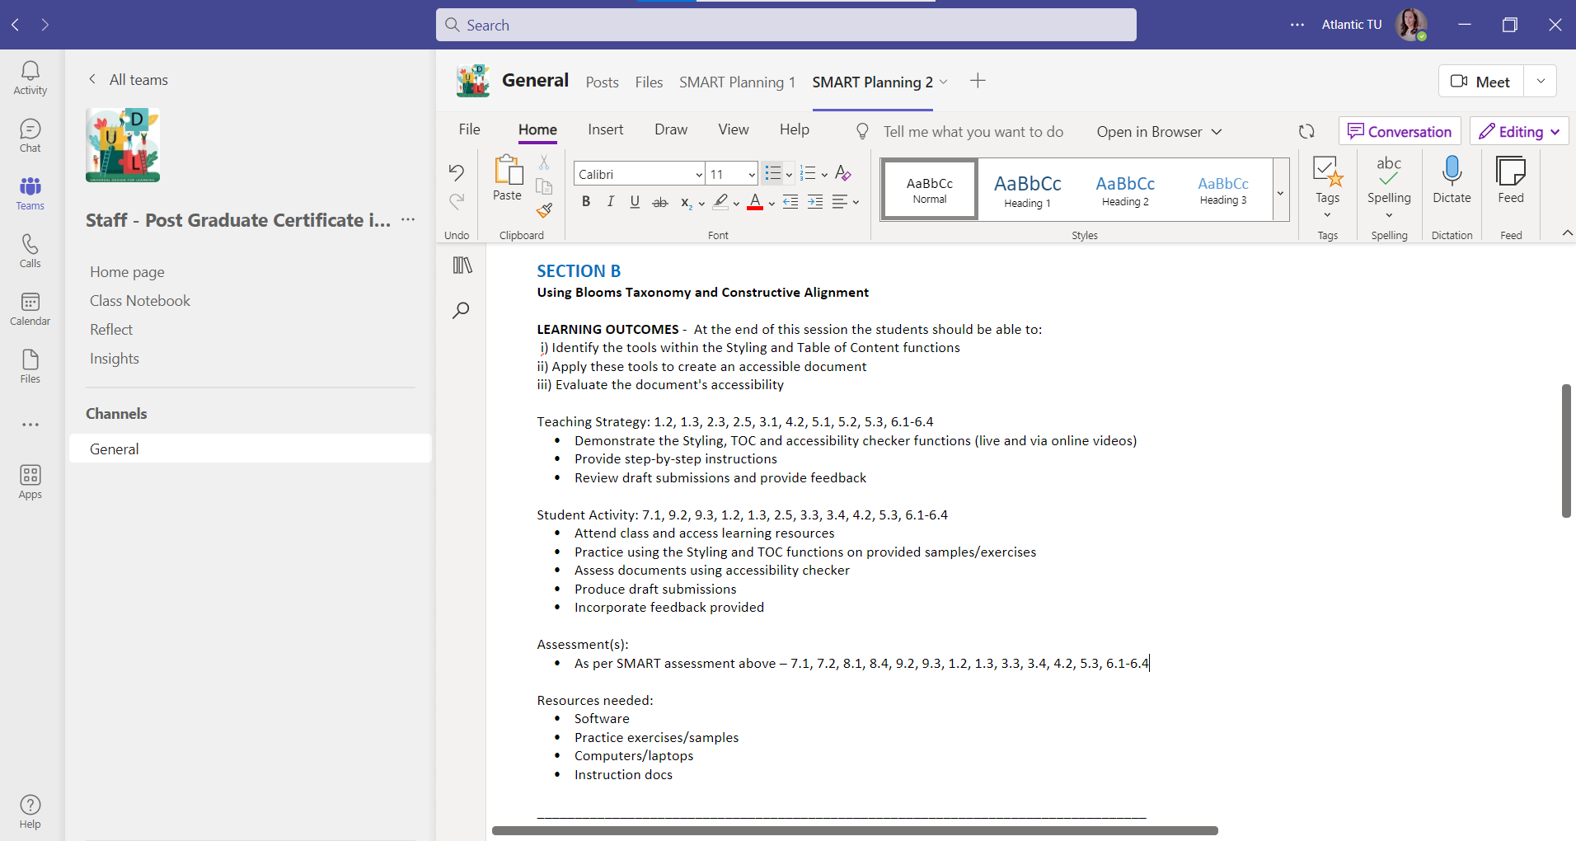
Student Example with UDL
Notes:
Next, using Blooms Taxonomy at the appropriate level of learning, they had to apply Biggs Constructive Alignment.
Exolain how the LOs, strategy and assessment all align.

Slide 23
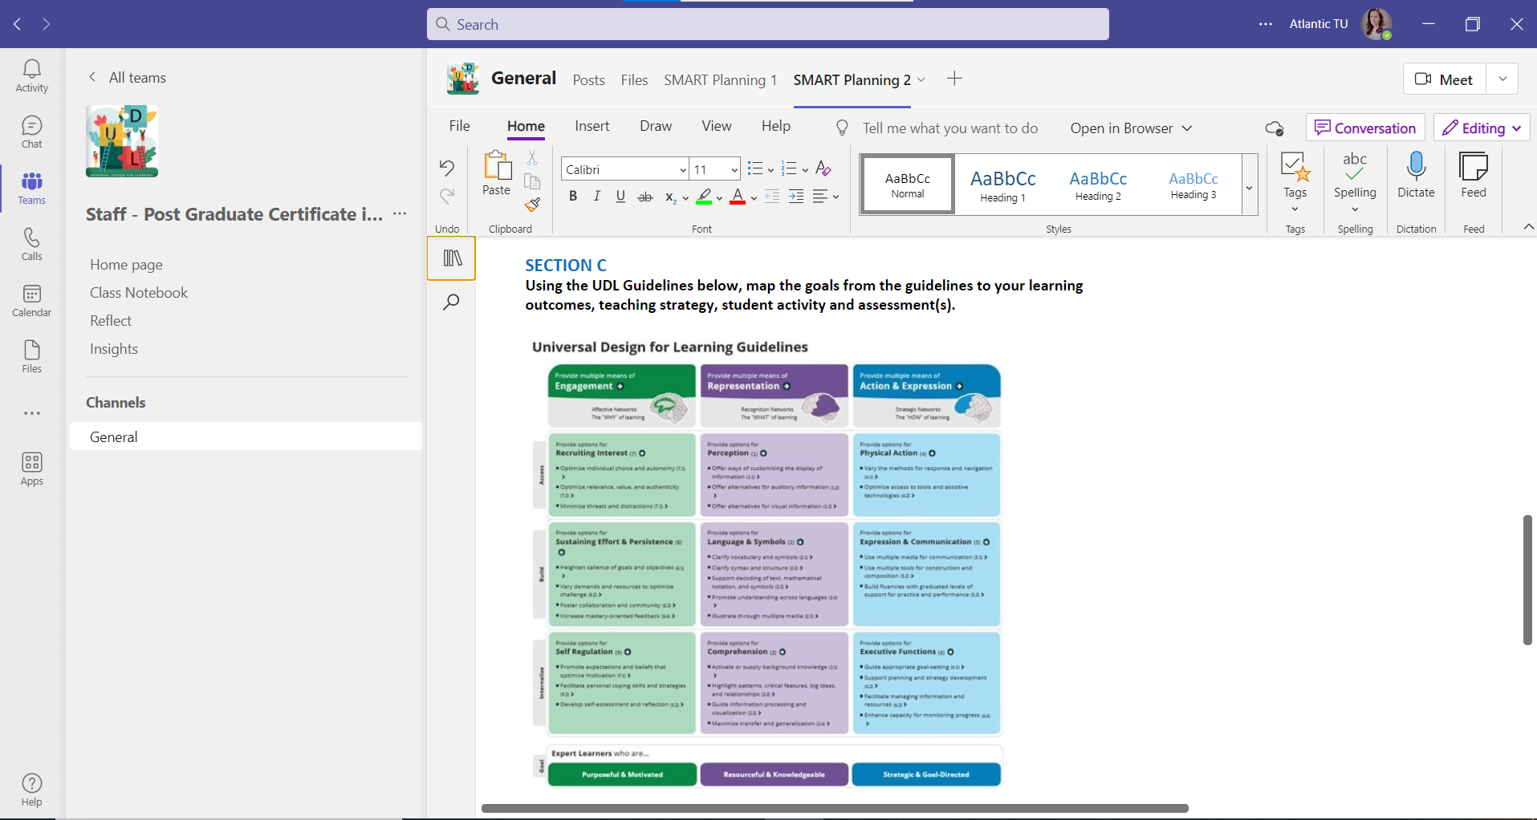
Student Example with UDL
Notes:
Following on the Section C of the learning activities, the students had to review the UDL Guidelines, decide which guidlelines mapped to their curriculum and map these across.

Slide 24
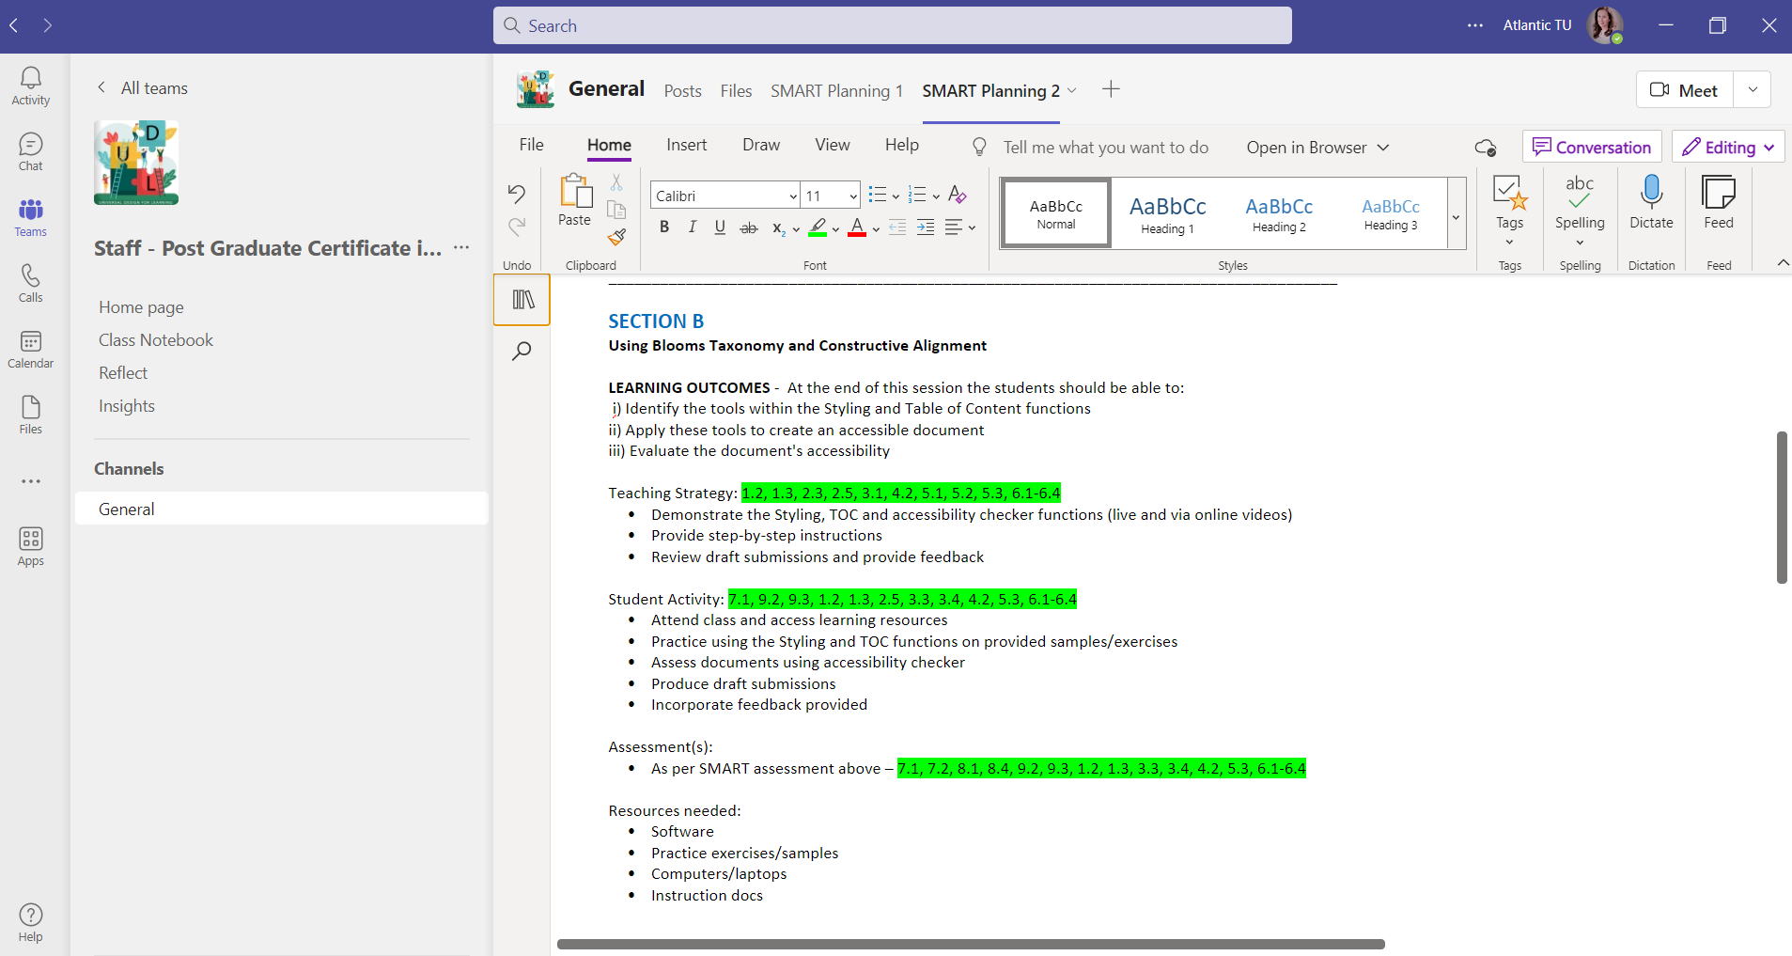
Student Example with UDL
#designwithUDLin mind
Notes:
This group not only mapped the guidelines highlighted in green but gave a solid rationale and explained each connected guideline.

Slide 25
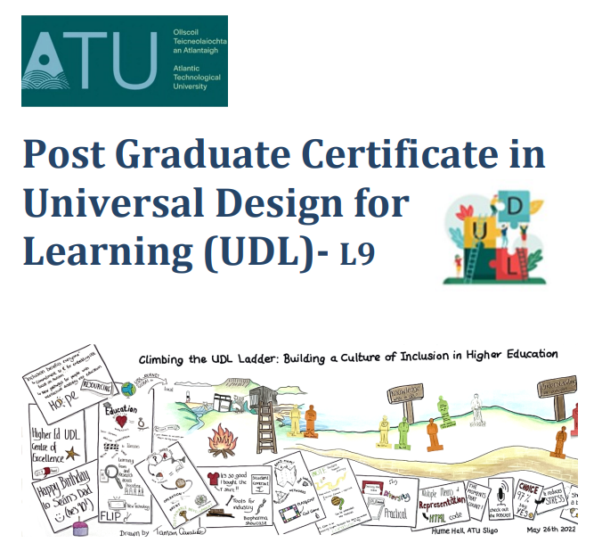
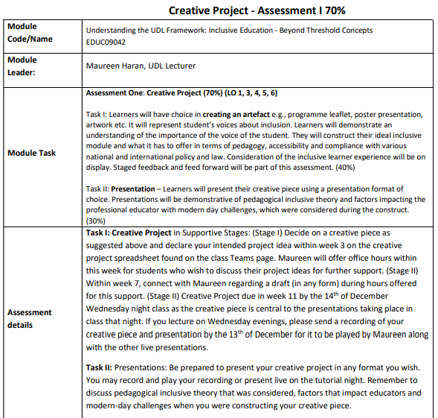











Creating an inclusive module using UDL assessment brief
Notes:
PG Cert and MA in UDL programme
Creative project task – Students could create an artefact – programme leaflet, poster, presentation, artwork and so on – that had to represent student voice and inclusion. They were given total autonomy to work with a module they deliver to construct an ideal inclusive module and consider pedagogy, accessibility and compliance with various national and international policy & law.
Staged feedback & feedforward is part of the assessment.
PRESENTATION – Students had to present their creative artefact using a presentation form of choice - be it recording, present live of do a PPt voice over. They had to relate what the challenges were and discuss what they had to consider in the construct of the project.
Siobhan happened to be working on a new programme content and decided to take a UDL approach to this development and used her programme for her project and what she produced in relation to design was amazing!!

Slide 26
Case study from Post Grad Certificate/Masters in UDL
Case study from Post Grad Certificate/Masters in UDL: Siobhan Wynne BA MBS FCII, Insurance Institute of Ireland

Slide 27
WELCOME
Introduction
Background
Pedagogy
UDL
Demonstration and alignment
Siobhan Wynne
Atlantic Technological University, Sligo &
The Insurance Institute of Ireland

Slide 28
Introduction
Introduction
Background
Pedagogy
UDL
Demonstration and alignment
Introduction – ‘Living the dream’
Background to The Nature of Insurance module
Pedagogical inclusive theory
Universal Design for Learning
Demonstration of artefact and its alignment with UDL

Slide 29

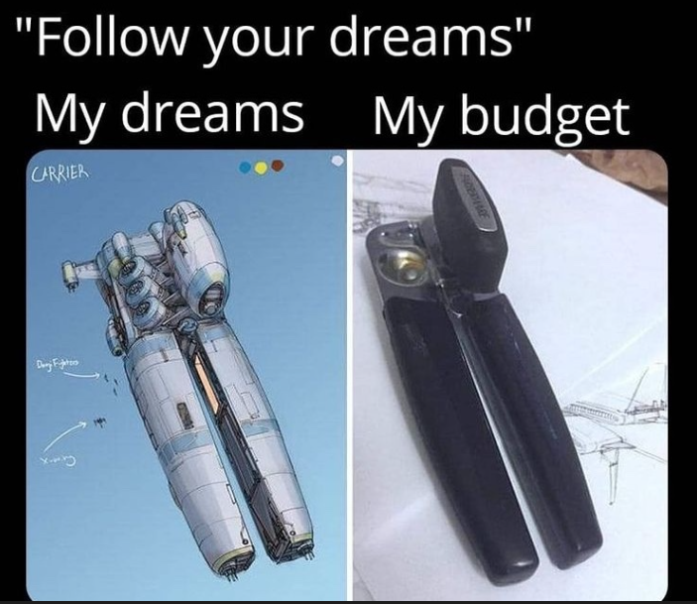

Introduction
Background
Pedagogy
UDL
Demonstration and alignment

Slide 30


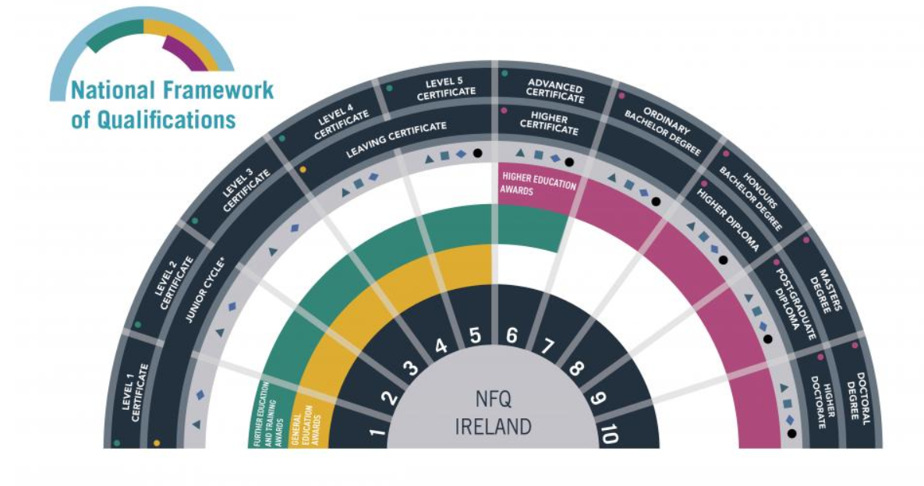
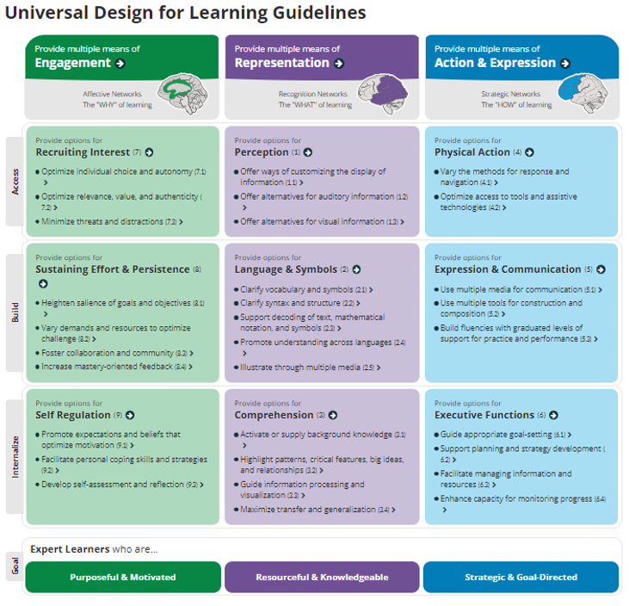


Background
Pedagogy
UDL
Demonstration and alignment
Introduction
Background
Contributes to the attainment of the CBI’s competency level objective
Summary
Central Bank of Ireland
Minimum Competency Code
. Initial training programme
. Supervision and direction
. Recognised qualification
. Relevant experience
Competent employee
&
Expert learner
Regulatory requirements
Combines academic learning with a system of mentoring that allows tacit knowledge, professional behaviours and workplace experience to be passed on
‘autonomous professional practice in a structured setting or in an organisation’
Academic standards
Recruits the learner’s interest
Highlights the relevance of the module to the learner’s profession and career
Professional environment
Develops the learners’ executive functions including planning, time management, independent learning, research, communication and self-reflection.
Universal design approach

Slide 31
Pedagogy
Background
Pedagogy
UDL
Demonstration and alignment
Introduction
Constructivist theory
Something missing ……
Vygotsky
Bruner
Meaning making
Knowledge situated in a social context
Learners as an active agent in the interpretation of the world
Learning constructed through meaningful real-world experiences
Scaffolding
Collaborative learning

Slide 32
Background
Pedagogy
UDL
Demonstration and alignment
Introduction
Cognitive apprenticeship
Brown
Collins
Duguid
Johnston
Duncan
Master-apprentice
Cognitive rather than physical skills
Situated/contextual learning: knowledge, procedure & skill in a realistic context
Bridge the gap between school, work and community
Overlap with UDL

Slide 33
UDL
Background
Pedagogy
UDL
Demonstration and alignment
Introduction
Flood, M. and Banks, J. (2021)
Universal Design for Learning:
Is it gaining momentum in Irish education?
‘a key pedagogical framework which seeks to address the traditional ‘one size fits all’ curriculum’

Slide 34
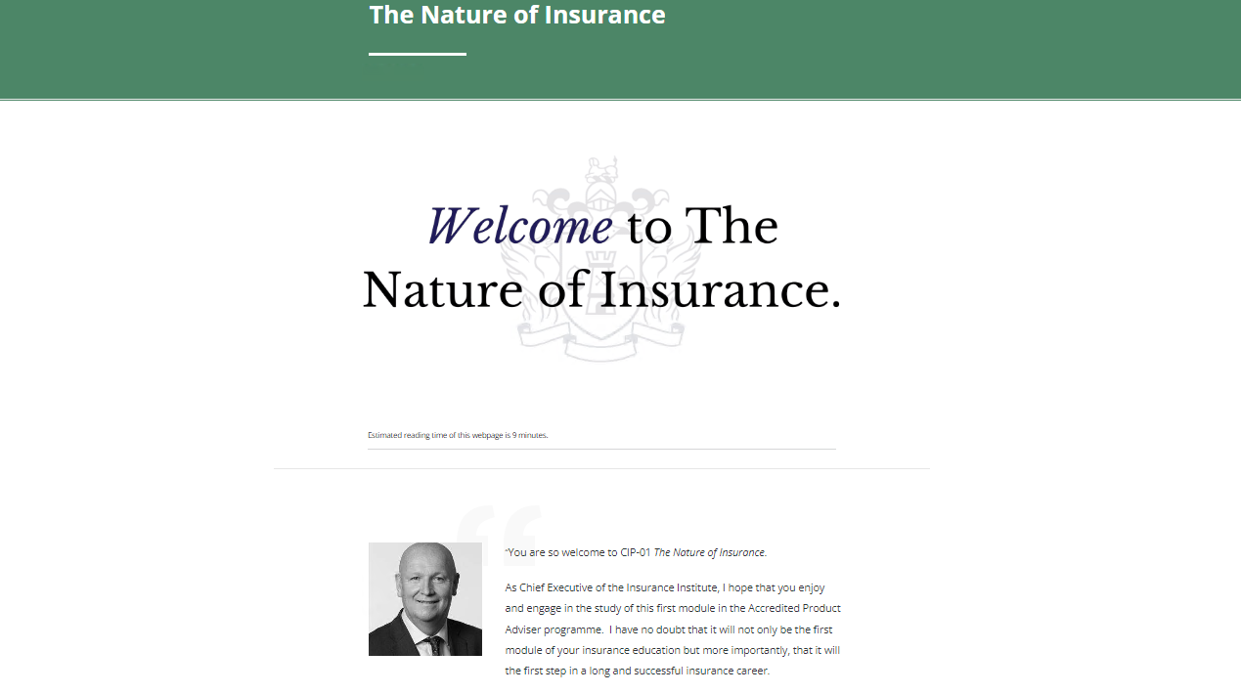
Demonstration and alignment
Background
Pedagogy
UDL
Demonstration and alignment
Introduction

Slide 35
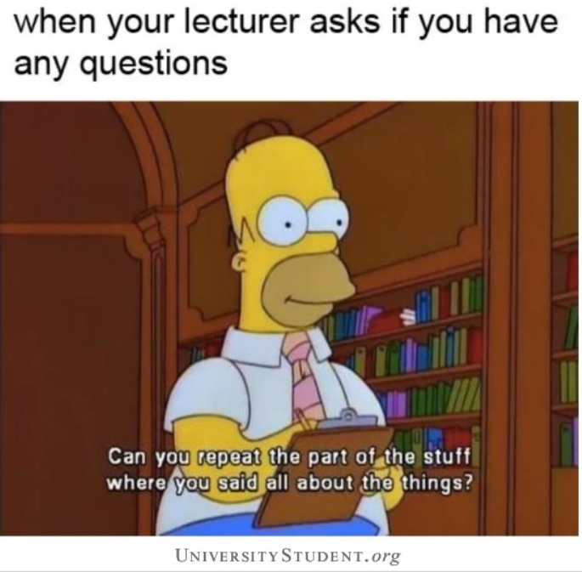
Any questions
Thank you for your attention
Any questions?

Slide 36
Syllabus Management
Software – Module Manager

Slide 37
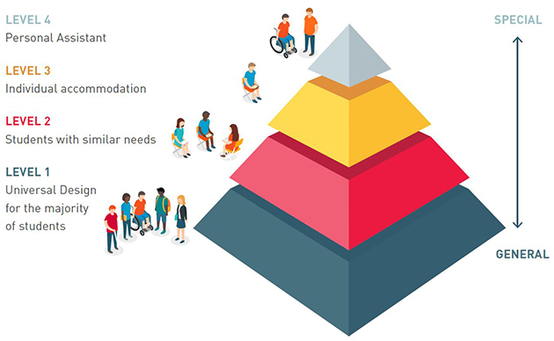
The Inclusive Education Pyramid
Notes:
The Inclusive Education Pyramid shown presents four levels through which we can understand inclusive practice. This tiered approach of the Pyramid illustrates the different levels of learner support required within an inclusive education environment. From a UDL perspective, most attention should be focused on the mainstream learning environment (Level 1) as it is this space that seeks to be inclusive of most learners. Solve for one, extend to many. So lets look at an example of how all this information is taken into account in one modules design.

Slide 38
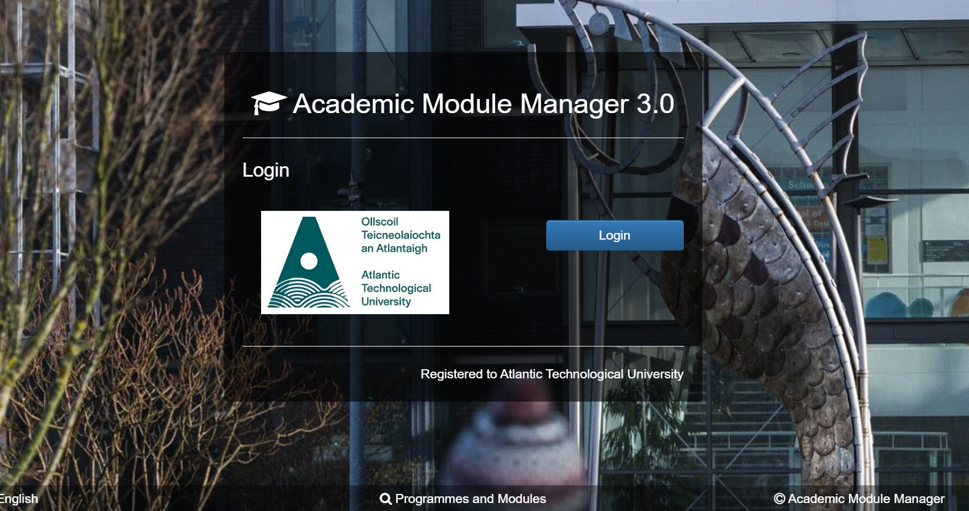
How do we constructively design using a digital tool that embeds UDL?
Inclusive Curriculum Digital Tool
Notes:
Syllabus Management Software – Module Manager
Create new module and programme development
Previously a Very basic structure and the UDL Working Group with national Funding made improvements to the system.

Slide 39
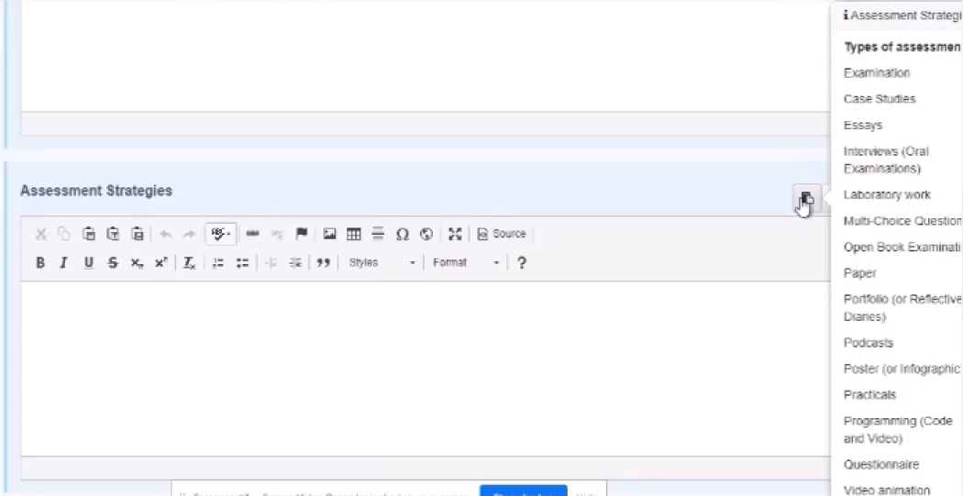
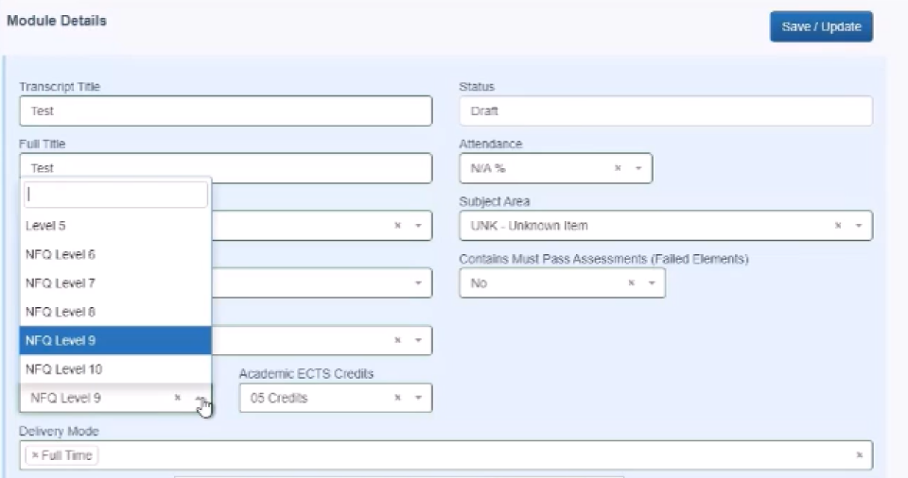
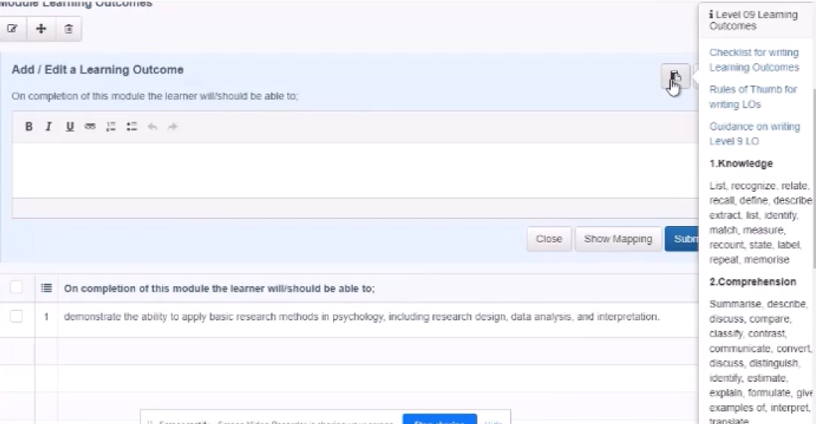
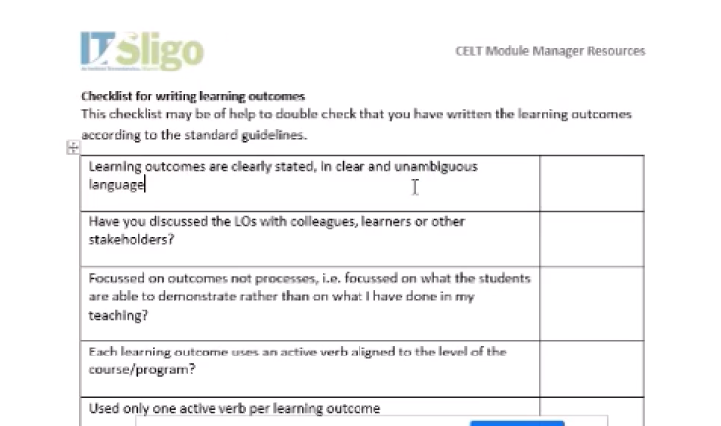
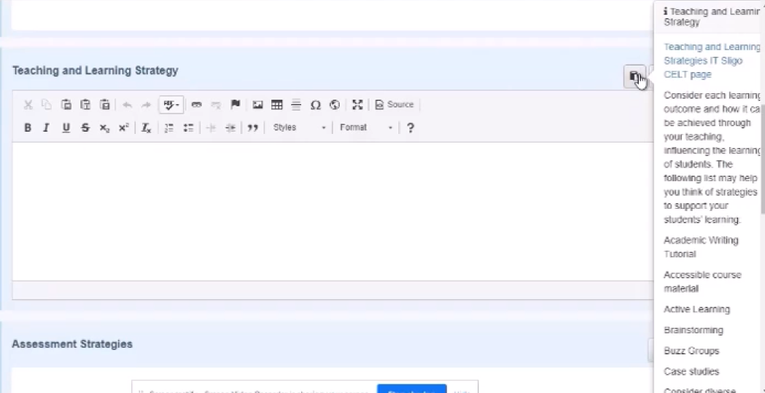
MODULE MANAGER – INCLUSIVE CURRRICULUM DEVELOPMENT

Slide 40
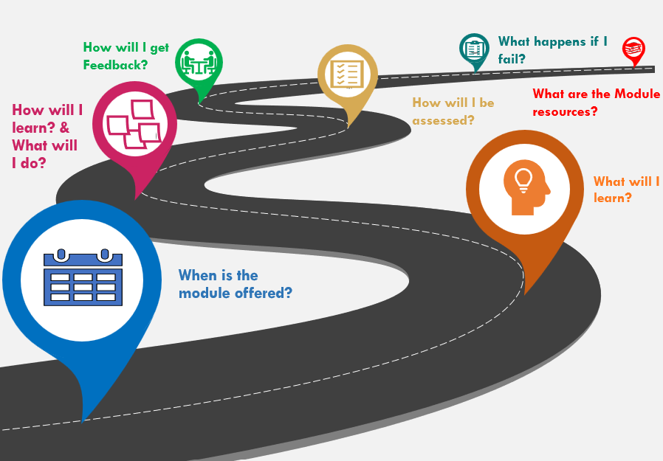
Module Roadmap (Mary Malone, Lecturer- ATU)
Notes:
IDEALLY, When the students select the module, they will be guided by a roadmap on their journey. Looking at the pertinent details of the module.
When is the module offered - included to ensure students know in advance to be able to align professional and personal commitments. The expected workload is outlined. As I said this module is for part time students – so this aspect is quite critical for them to understand if the module is something they can take on. We will now move on through the journey.

Slide 41
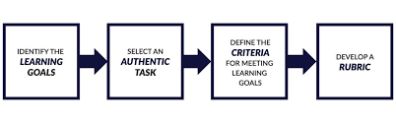


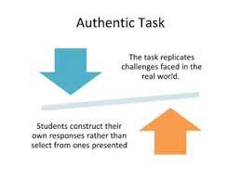
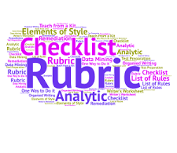
ALIGNMENT
Notes:
Lovely checklist for constructive alignment BUT
Design is Not Always Linear

Slide 42
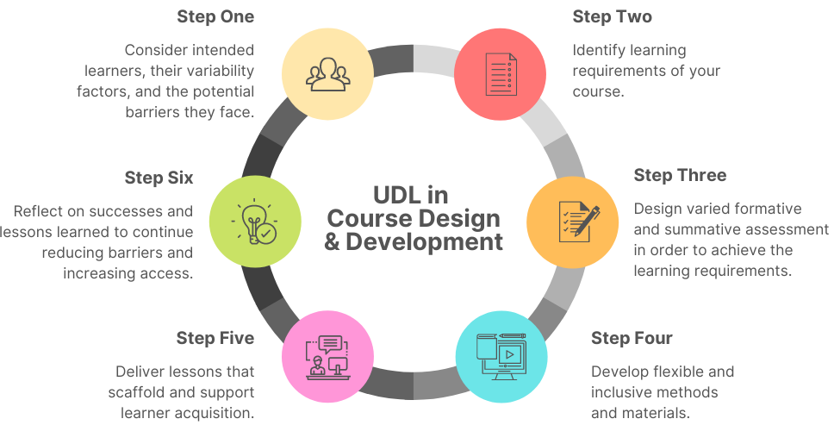
UDL in Course Design & Development
Notes:
It is quite cyclical…
Stages of if UDL in Course Design

Slide 43
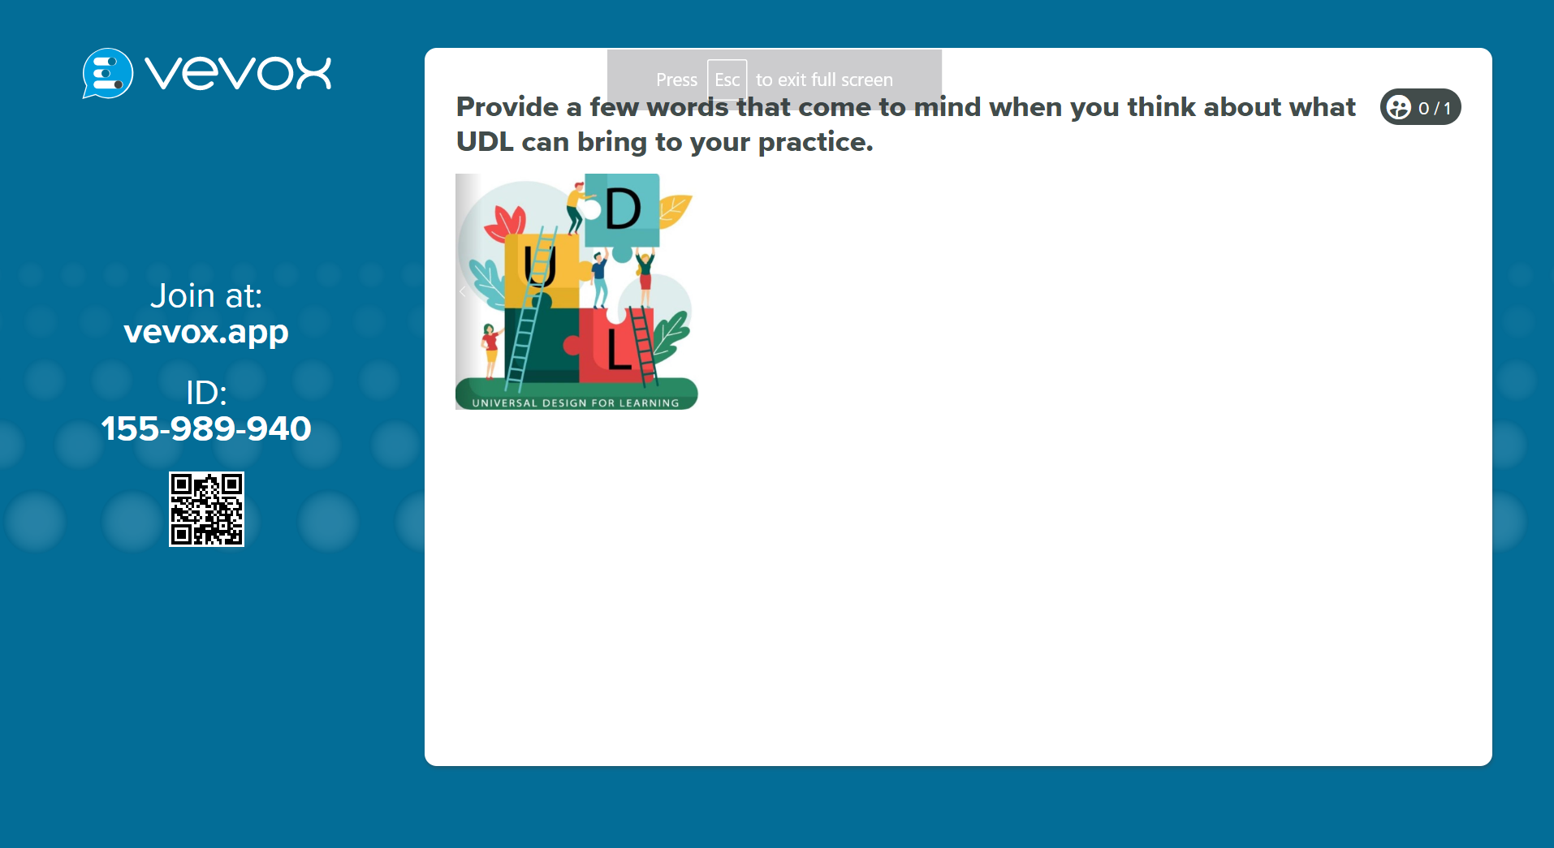
Notes:
Provide a few words that come to mind when you think about what UDL can bring to your practice

Slide 44
Keep the conversation going…
https://padlet.com/momac21/udl-curriculum-design-workshop-series-creating-an-inclusive--o0psvcz3cpjy1vs5
Notes:
Keep the Conversation Going….
Constructive Alignment
Designing with UDL in Mind
Shared Space to share posts and resources

Slide 45
Resources
Bloxham,Sue Boyd, Pete (2007) Developing Effective Assessment in Higher Education, A Practical Guide. Open Press University, Berkshire England
Ansari, Daniel & De Smedt, Bert & Grabner, Roland. (2011). Neuroeducation – A Critical Overview of An Emerging Field. Neuroethics. 5. 1-13. 10.1007/s12152-011-9119-3.
CAST (2018). UDL and the learning brain. Wakefield, MA: Author. Retrieved from http://www.cast.org/our-work/publications/2018/udl-learning-brain-neuroscience.html
Ding, Lei ; Kang, Zhino ; Rippetoe, Joe ; Shehab, Randa L. ; Yuan, Han : West, Stephan G.
Universal Design for Learning in the Framework of Neuroscience-based education and Neuroimaging-based assessment; (2017) 2nd International Conference on Bio-engineering for Smart Technologies -BioSMART
Kelly, Dr. Anna M.; Padden, Dr. Lisa, UCD Access & Lifelong Learning (2018) Publication No.2 - University for All Publication Series
Myran, S., Normore, A. H., Miller, F. S., & Sanzo, K. L. (2012). Transforming Learning Environments : Strategies to Shape the Next Generation. Bingley, U.K.: Emerald Group Publishing Limited.
http://www.ahead.ie (2018)

Slide 46
Thank you!
For more information contact:
Maureen.haran@atu.ie
ATU - UDL Centre of Excellence

