Slide 1



Banner image opening slides
Notes:
Opening speeches

Slide 2





Event Agenda
Agenda
9.30am – Welcome and Opening – AHEAD and Department of Climate, Energy and Environment
10.00am – HeX Digital -Embedding Digital Accessibility from Design to Delivery
10.30am – Culture Change Panel – Broaden your understanding of cultural change through diverse perspectives
11.15am – Short Comfort Break
11.30am – WIDE Framework - Workplace Inclusion: It Takes a Village...and a Plan!
12.00pm – Breakout Sessions – Peer to Peer led discussions on learning from the day
12.40pm – Feedback from Breakout Sessions & Closing Remarks
1.00pm - Lunch and Networking
2.00pm - Finish
Notes:
AH to run through Agenda

Slide 3


Slido
Audience Q&A
Join slido.com
Enter #1652766
Scan QR Code
Notes:
Reminder about Slido

Slide 4

HeX Productions
Embedding Accessibility in
Procurement and
Digital Design Processes

Slide 5


Hello…
James Hall
Creative Director

Slide 6

Statue of man with bow and arrow

Slide 7
Accessibility is
The heartbeat of HeX Productions

Slide 8
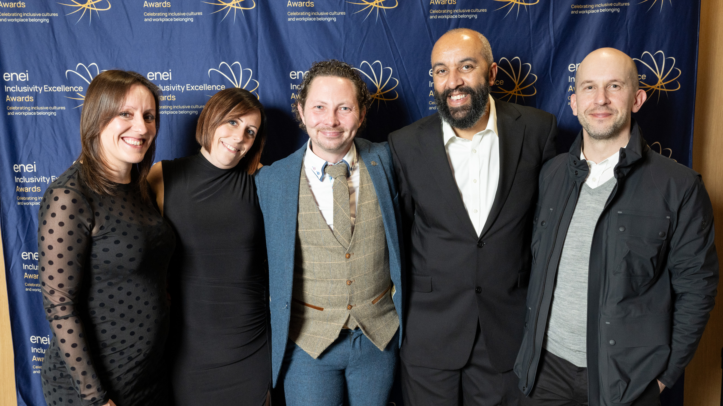
Image of Hex Team

Slide 9
Accessibility is
For everyone

Slide 10
1 in 5

Slide 11
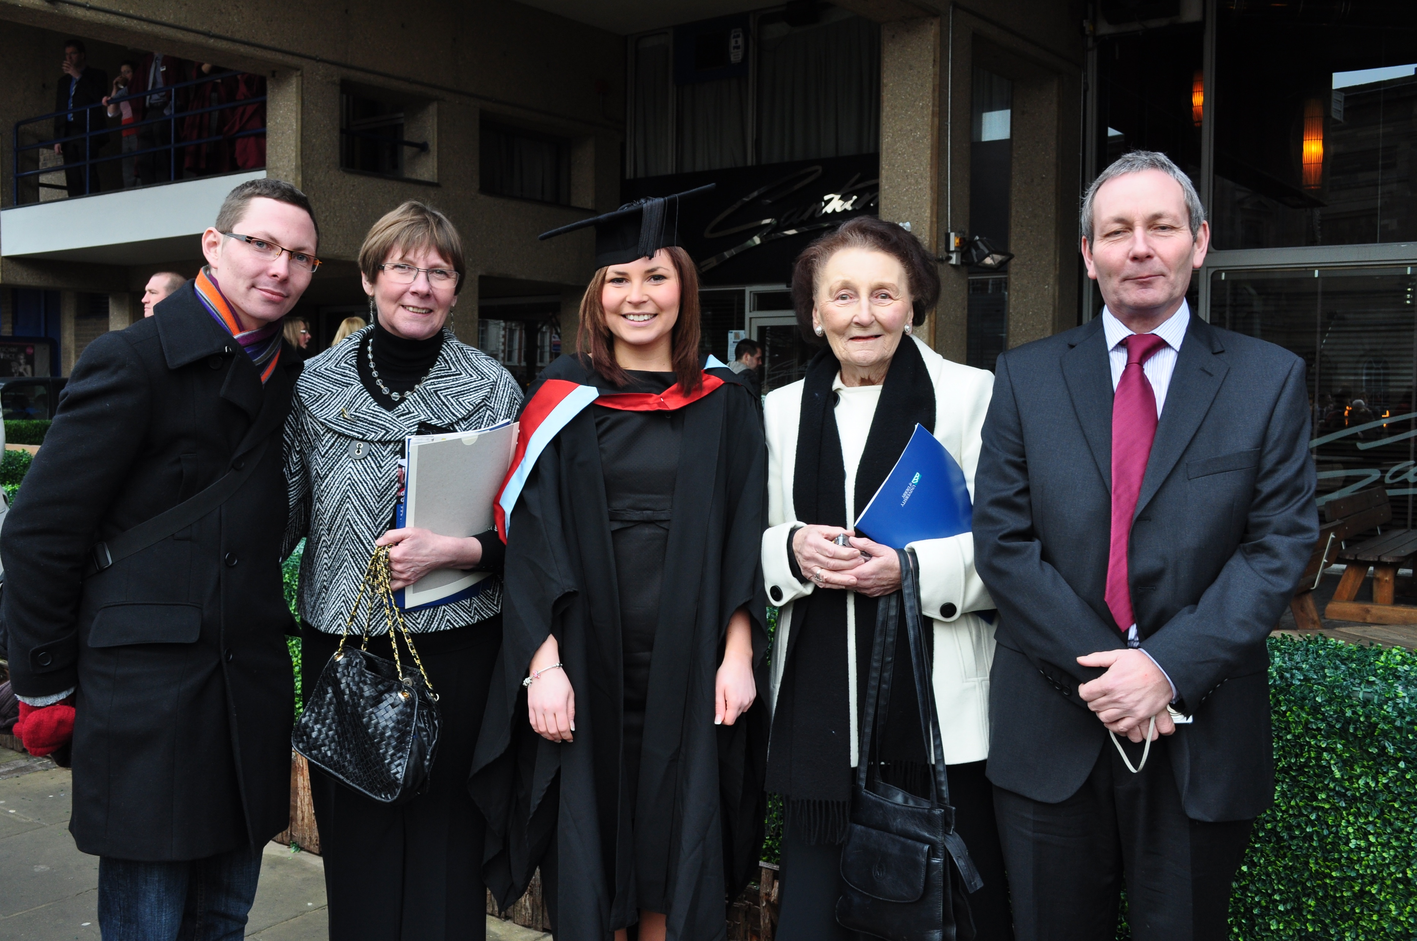
Family of 5 people

Slide 12
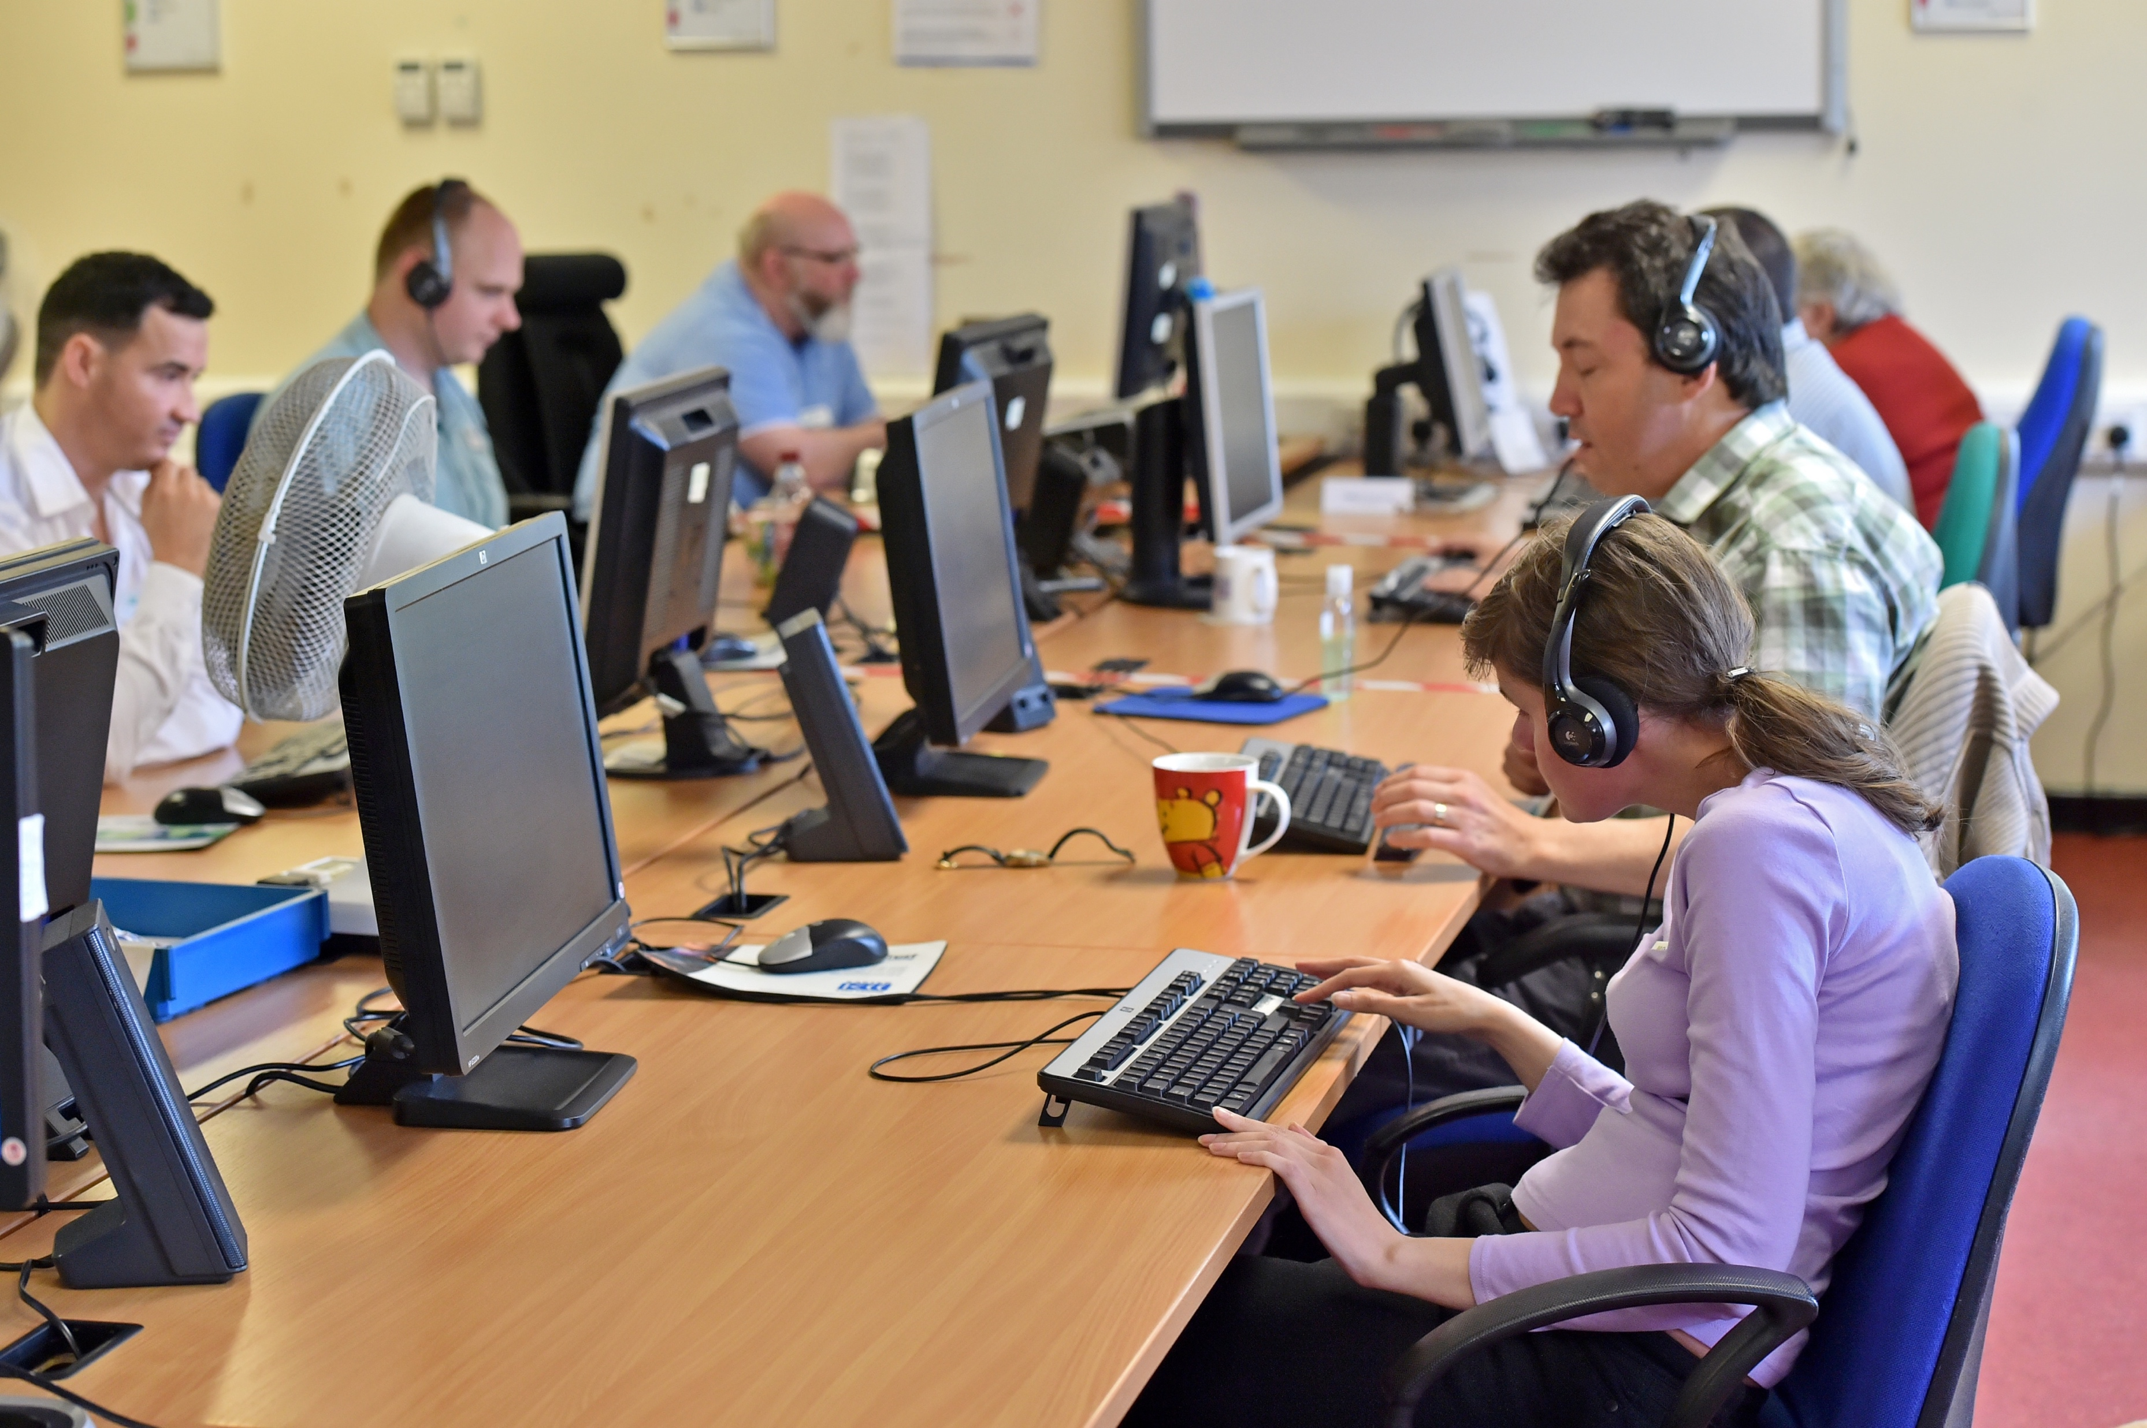
Office workers sitting on computers

Slide 13
Accessibility is
Overwhelming

Slide 14

Multicolour Legos

Slide 15
Accessibility is
A journey

Slide 16
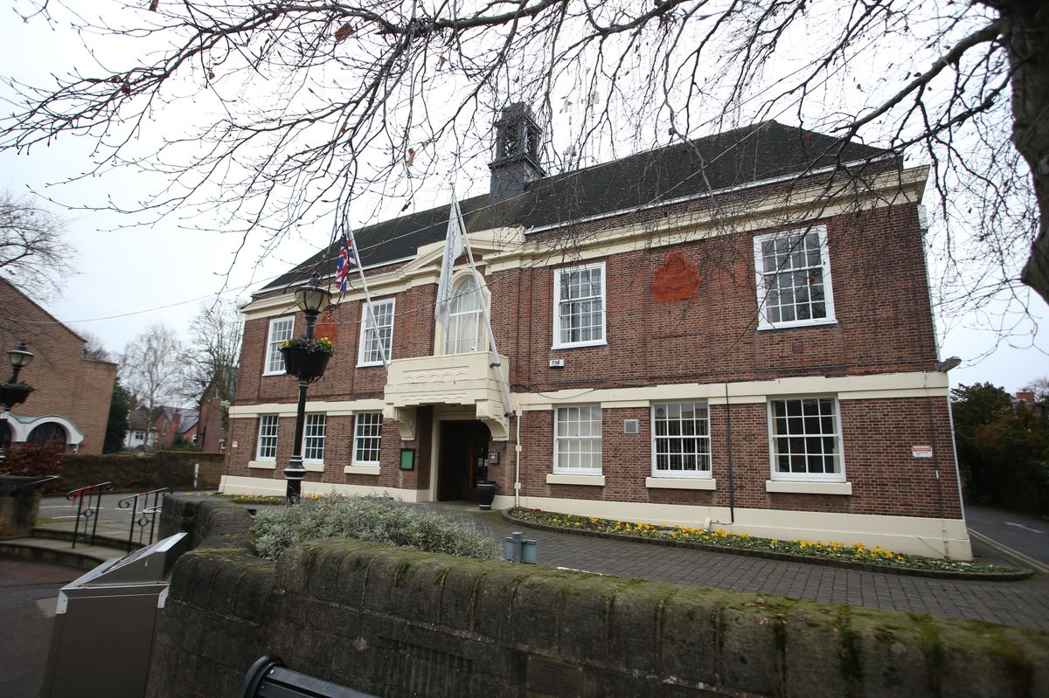
Old Building

Slide 17
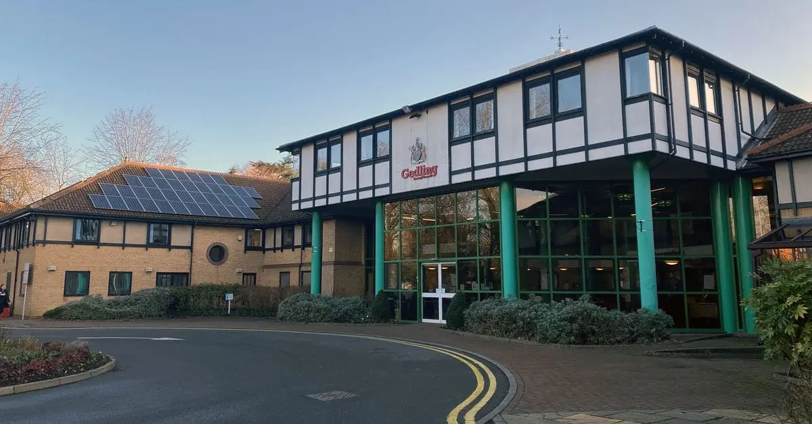
Tudor building

Slide 18
Accessibility is
A – Z or á - ú

Slide 19

People building Lego block

Slide 20

Lego people

Slide 21
Accessibility is
Trust

Slide 22

Bullet journal task list

Slide 23

Lego characters

Slide 24

Keyboard

Slide 25
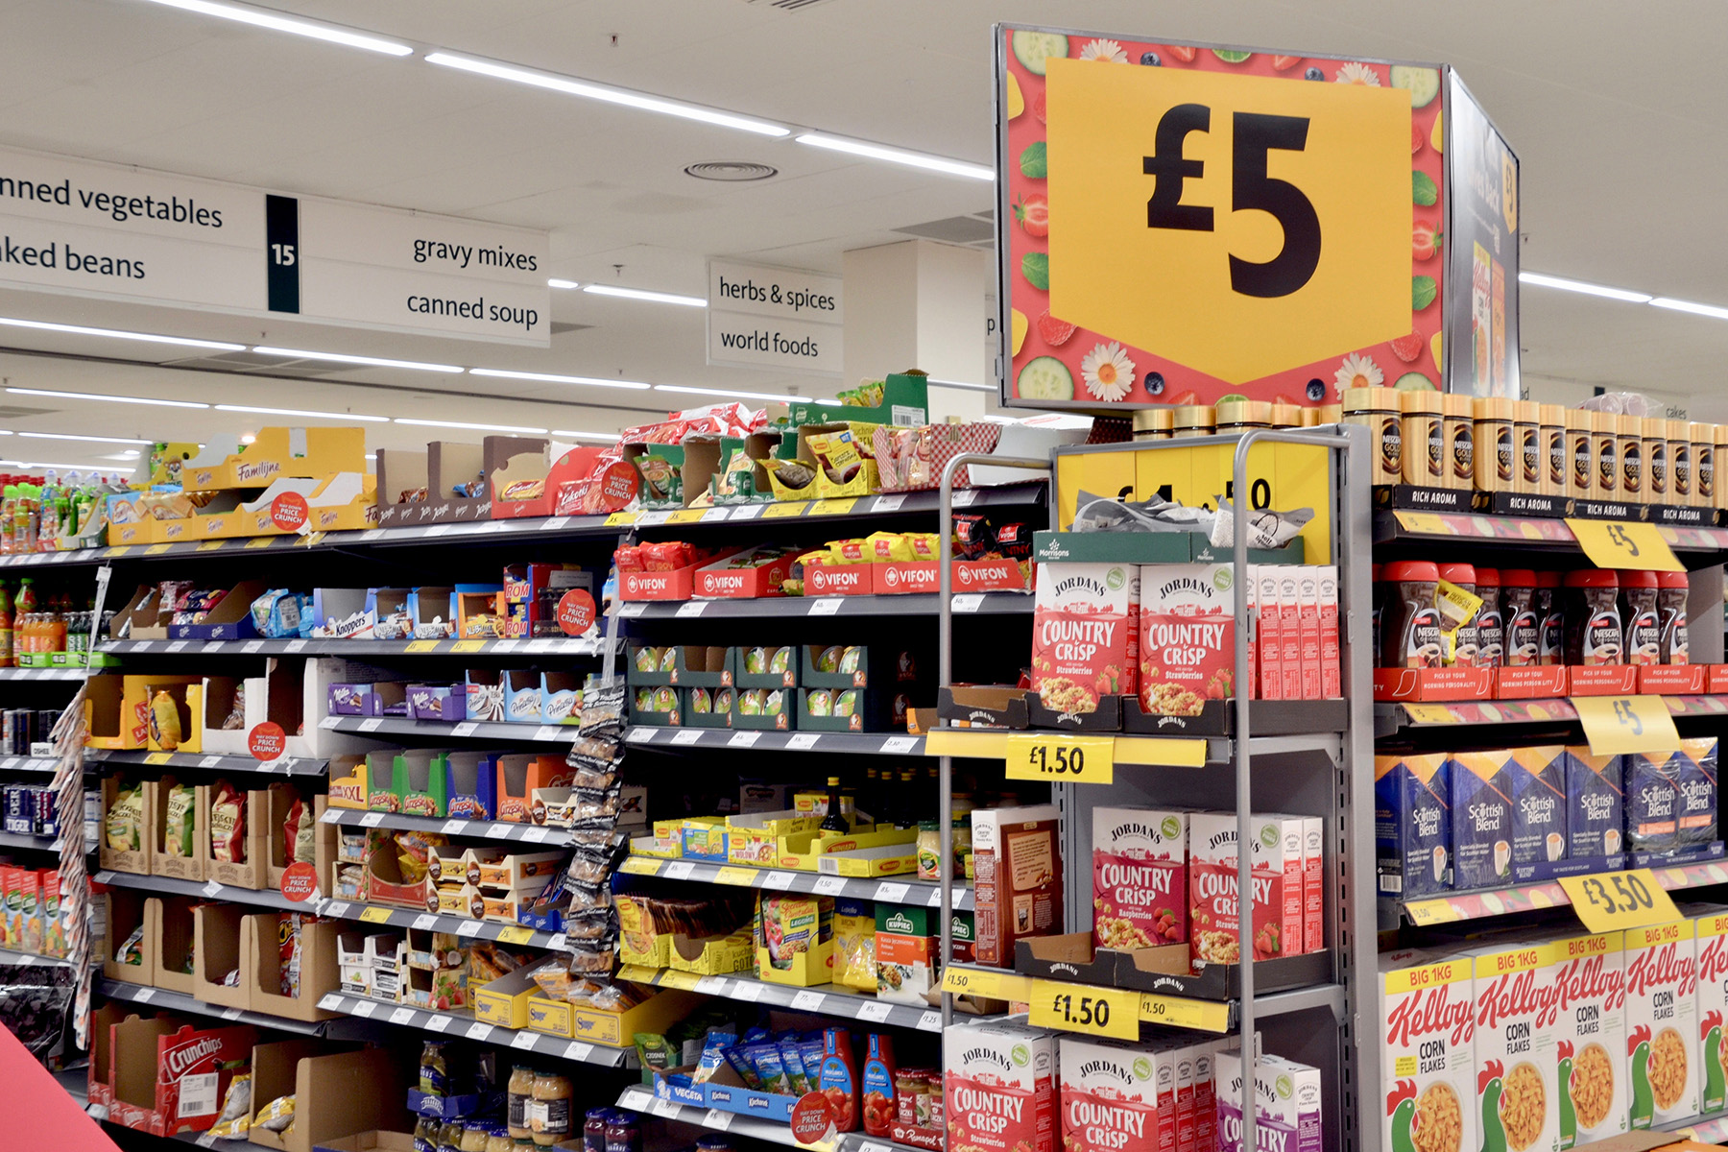
supermarket

Slide 26

crayons

Slide 27
Accessibility is
External AND Internal

Slide 28

Lego

Slide 29

Free Healthcheck
www.horlix.com/health-check

Slide 30
HeX Productions
Embedding Accessibility in
Procurement and
Digital Design Processes
Thank you
Notes:
Relevant past work examples
WCAG/UX expertise
Commitment to accessibility, inclusion & innovation
Closing statement: “We don’t just build platforms—we help shape cultures.”

Slide 31
Culture Change Panel
Deirdre Moore (Moderator) - Employment Manager – AHEAD
Liz Donnelly – Senior HR Manager– Bord Bia
Ciaran Butler – Health, Safety and Welfare Officer & WAM Mentor– BnM
Megan Kelly – WAM Graduate – Dept. of Transport
Shauna Peyton– Staff Voice Channel – Dept. Climate, Energy and Environment

Slide 32
Slido and comfort break
Short comfort break
Join slido.com
Enter #1652766

Slide 33





WIDE Framework
Workplace Inclusion: It Takes a Village... and a Plan!
Notes:
DR

Slide 34

In This Session
1) Exploring culture – what matters?
2) The WIDE Framework - how was it developed?
3) About the WIDE platform
4) Getting started with WIDE – your next steps

Slide 35
1) Exploring Culture – what matters?
“Inclusion is
everyone’s business!”
But how do we operationalise it?

Slide 36
What Factors Influence Organisational Culture?
Factors | What? | Evidence
Leadership & values | Style, vision/mission, values-based leadership | (Shamsudin & Velmurugan, 2023; Men & Yue, 2019; Bavardi, 2025; Jaiyeola et al., 2025; Warrick, 2017; Szczepańska & Kosiorek, 2017; Aryani & Widodo, 2020)
Environment & work design | HR practices, work–life balance, empowerment/agency of employees, physical space | (Shamsudin & Velmurugan, 2023; Mehendale & Hande, 2025; Paais & Pattiruhu, 2020; Obydiennova et al., 2025; S & Arunprakash, 2025)
Communication & relationships | Openness, internal communication quality, trust | (Shamsudin & Velmurugan, 2023; Costa, 2025; Men & Yue, 2019; Khan et al., 2024; Aryani & Widodo, 2020)
External Context | Industry norms, national culture, external environment | (Gordon, 1991; Obydiennova et al., 2025; Szczepańska & Kosiorek, 2017)

Slide 37

Controlling What You Can Control
We take governance measures to manage other key elements of the business – so why not inclusion?
To govern, we need to:
  Know what matters and what levers we have at our disposal (evidence)
  Know where we are at (review)
  Know where we need to go (improvement planning)

Slide 38
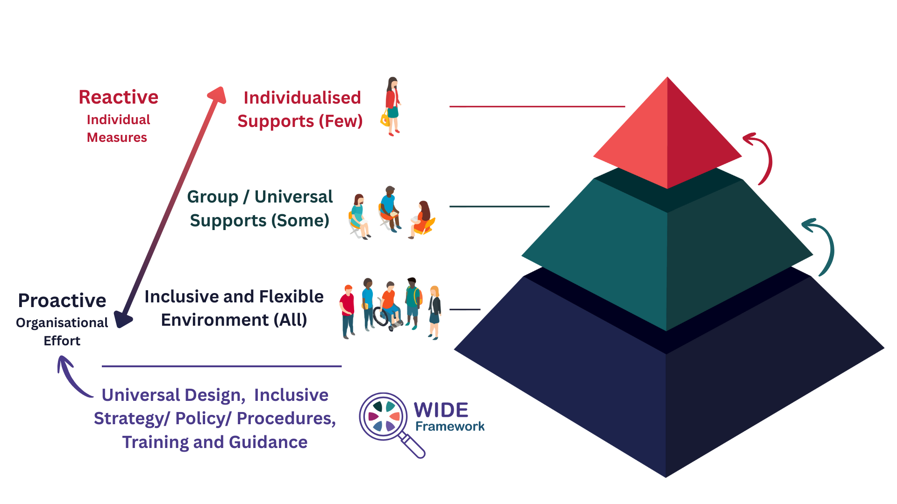
Thinking About the Governance of Inclusion

Slide 39

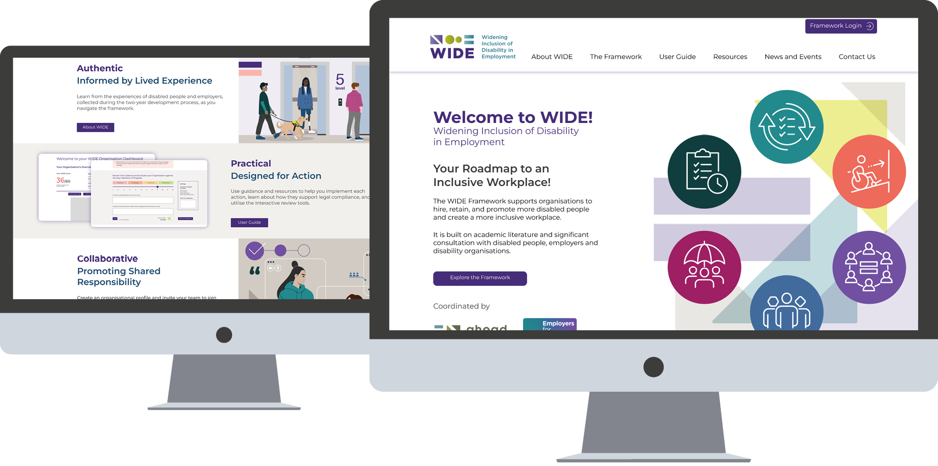
2) The WIDE Framework:
What it is and how was it developed?
Notes:
AB - So what is WIDE and how was it developed?

Slide 40


Your Roadmap to an Inclusive Workplace
Designed to support employers to hire, retain, and promote disabled talent,
and create inclusive workplaces, across the Island of Ireland.

Slide 41




2-Year Development Process
National Advisory Group
(Collaborative design – by the community for the community)
Evidence-Based
(International Literature Review and Extensive Consultation)
Iterative Design
(disabled people and employers at heart of process, 7 stages of drafting)
Platform Accessibility Prioritised
(Accessible Design Experts + Disabled User Testing )

Slide 42
3) The WIDE Framework:
About the WIDE Platform
Notes:
AB - So what does the platform offer

Slide 43
What does the Platform Look Like?
Notes:
As you open the site, you’ll find the homepage with a navigation bar along the top including
About WIDE, The framework, The User Guide, Resources, News and Events and Contact us.
On the home page there are also a number of ways to explore the framework and or register and create an individual and company profile

Slide 44




‘Open Access’ Features
WIDE Framework and User Guide
Manual
Resource Library
(submissions welcome – 60-day review)
Supplier Directory
(submissions welcome – 60-day review)
Legislation Guide and Funding
(ROI – focused)
Notes:
The platform contains 6 open access features including
- The WIDE framework and user guide
- The resource library and supplier directory
- Republic of Ireland focused legislation and funding information

Slide 45
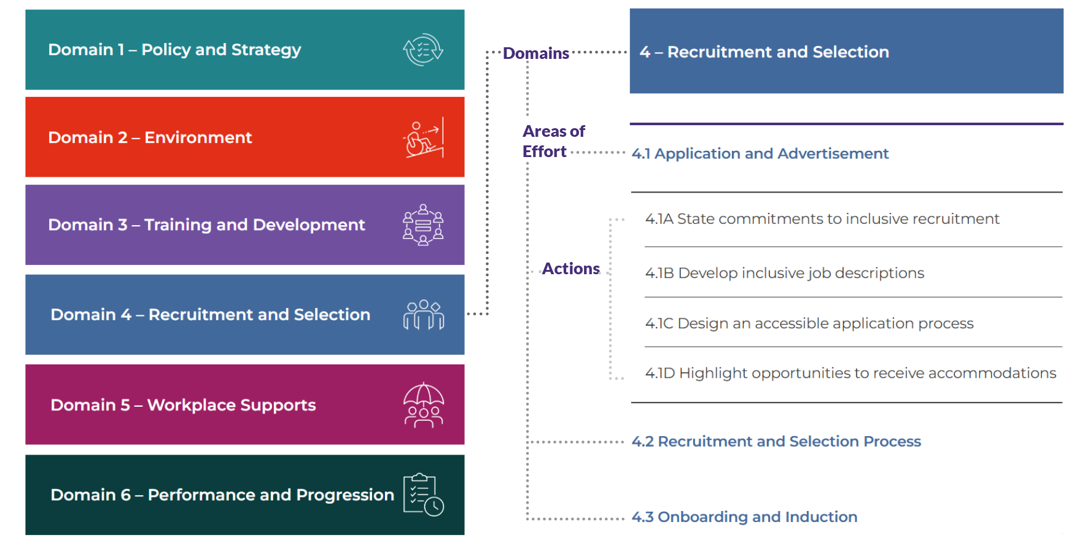
The Framework – 6 Domains
Notes:
The WIDE Framework itself is open access and be viewed by anyone.
It is organised into 6 domains, including
policy and strategy
environment
training and development
recruitment and selection,
workplace supports and
performance and progression.
Each domain is further organised into areas of effort.
For example, on the screen, domain 4 recruitment and selection is highlighted.
Its 3 areas of effort are visible which include
4.1 application and advertisement,
4.2 recruitment and selection process and
4.3 onboarding and induction
Area of effort 4.1 is opened to show its 4 actions, which include:
4.1A State commitments to inclusive recruitment
4.1B Develop inclusive job descriptions
4.1C design an accessible application process
4.1D Highlight opportunities to receive accommodations

Slide 46
The WIDE Framework:
Exploring the Platform Features
Notes:
CM - So lets explore some of the features of the platform and how they are used

Slide 47
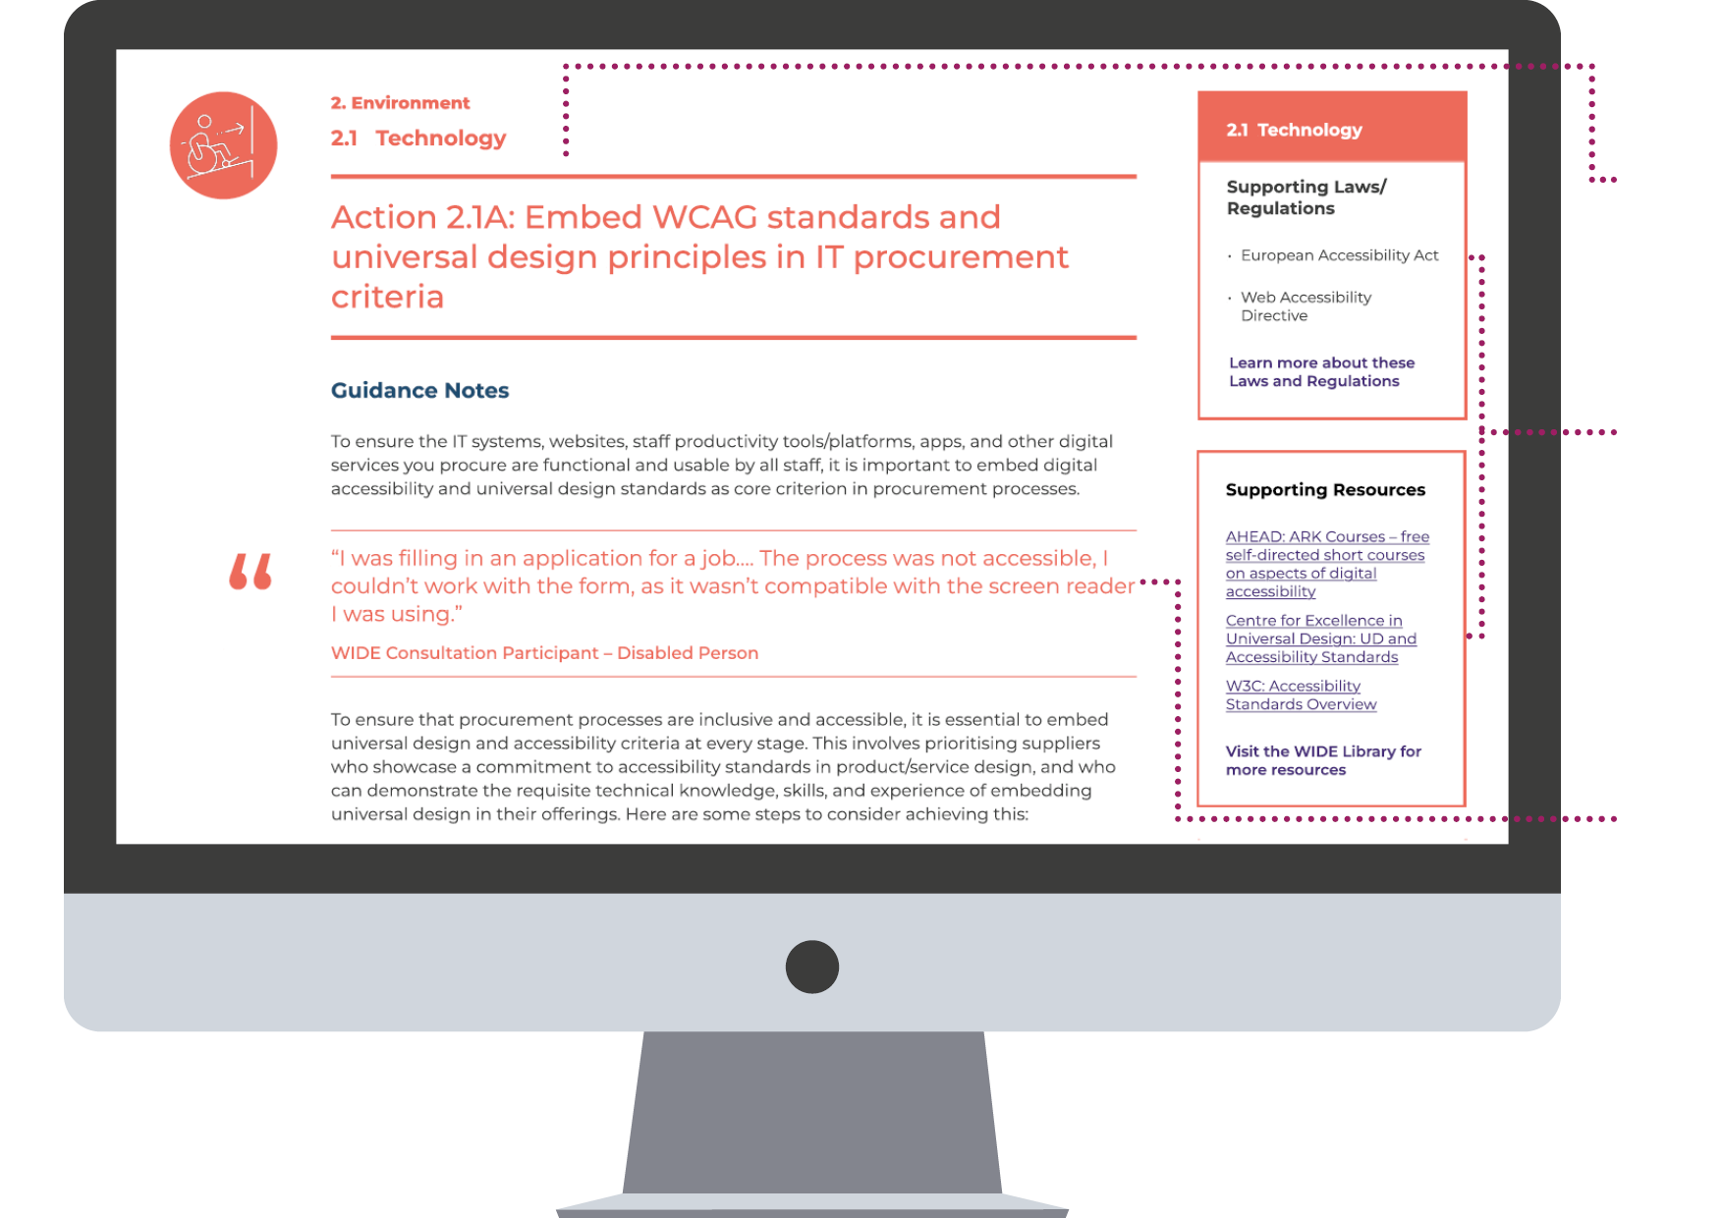
Action Pages
Evidence-based Guidance
Drawn from literature review and consultation process.
Point of Need Resources
Links to legislation and links to practical resources supporting implementation.
Real Voices
Quotes from consultation process bring the guidance to life.
Notes:
When you open an action, there are 4 keys elements on the page.
Firstly, the evidence-based guidance note
Every guidance note is informed directly from real voices, and these quotes from the consultations are included bringing the guidance notes to life
Additionally, on the right of the page, there are two boxes. The first, on the top right includes links to and information about specific legislation or regulation that guidance note applies to
The second box found underneath, includes supporting resources. As mentioned, we have already sourced over 110 resources specifically organised for each guidance note.

Slide 48
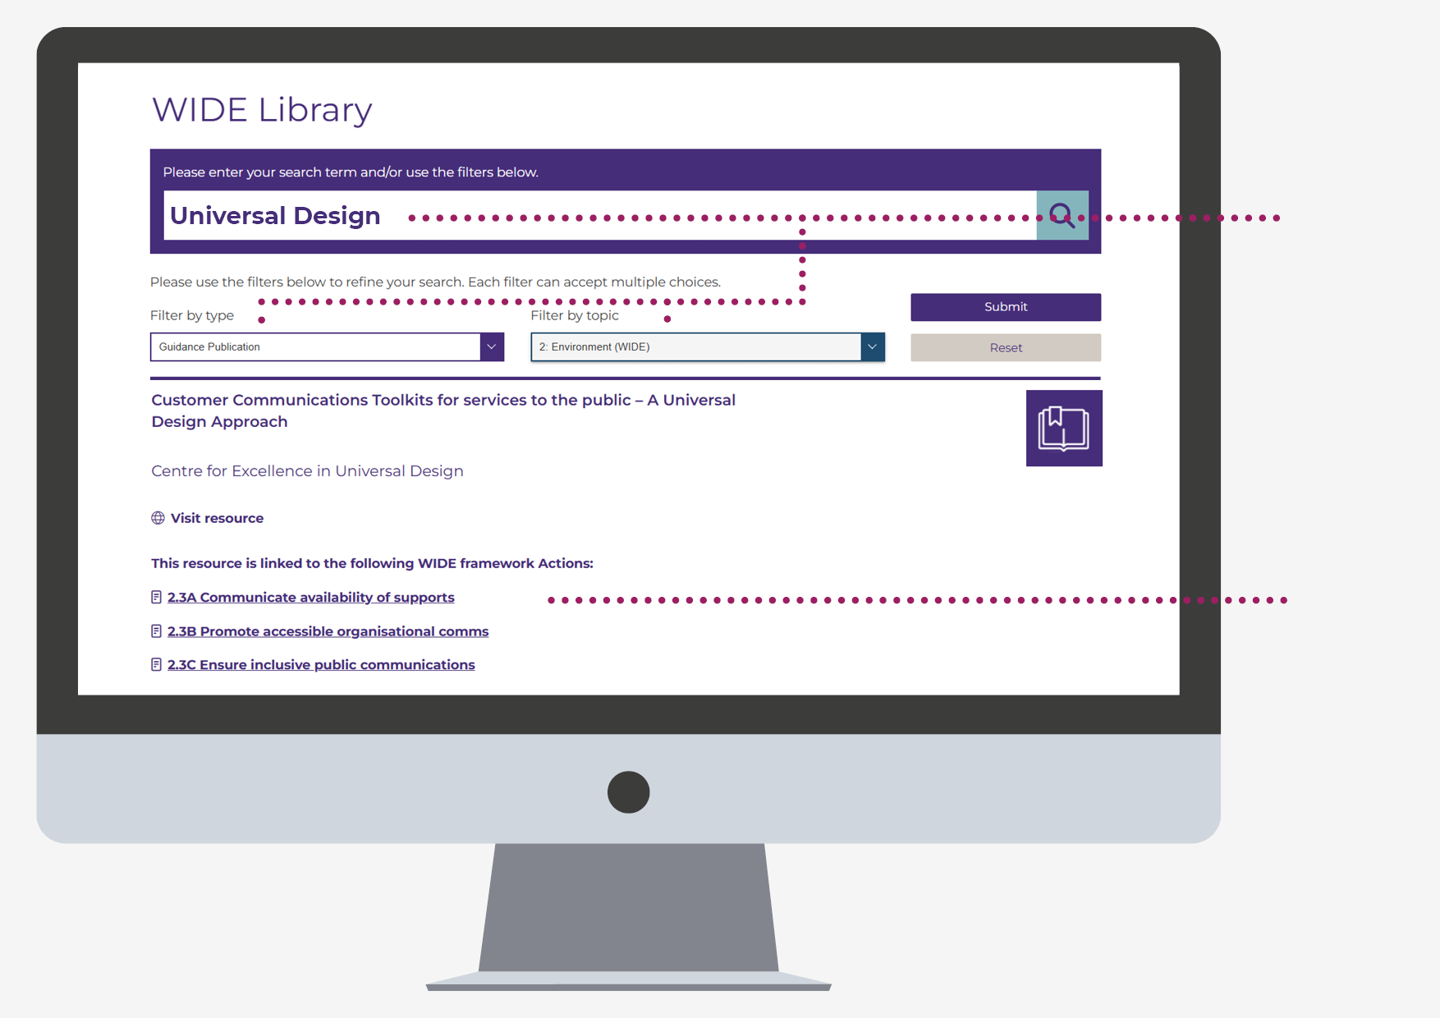
Resource Library
100+ External Resources
Search and filter by Topic or Resource Type to find just what you need.
Linked to Actions
Showing how these resources support WIDE implementation
Organisations can submit resources for consideration – 60 day review period
Notes:
Within the resource library you can search by filtering by type or topic, each resource is also linked to the actions is supports
The supplier directory is layout in a similar way and we hope that the WIDE framework platform will be the one stop shop where every resource and supplier can be found on the island of Ireland, eliminating endless searches.

Slide 49
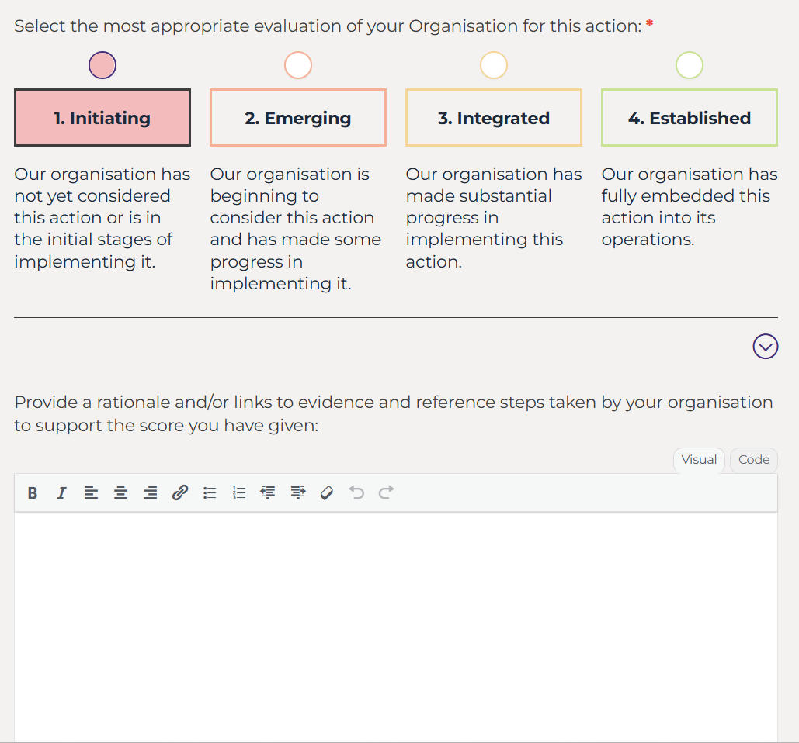
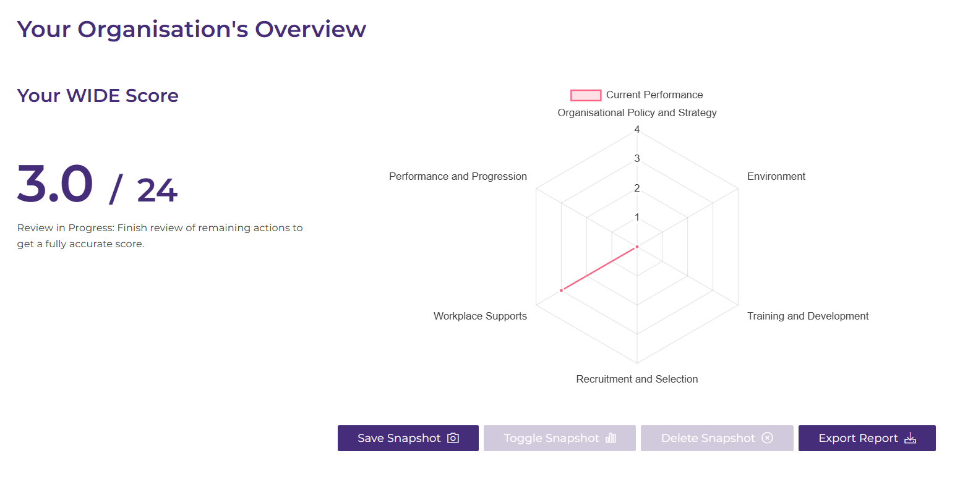
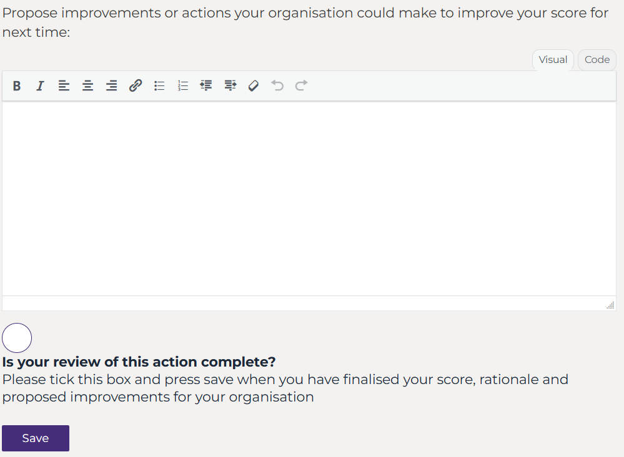
Self-Review Tool
Is available for organisations with an ROI or NI base
(free registration/login required)
Notes:
CM: For organisations with a base either in ROI or NI, you can access our free self-review tool by registering and logging in.

Slide 50
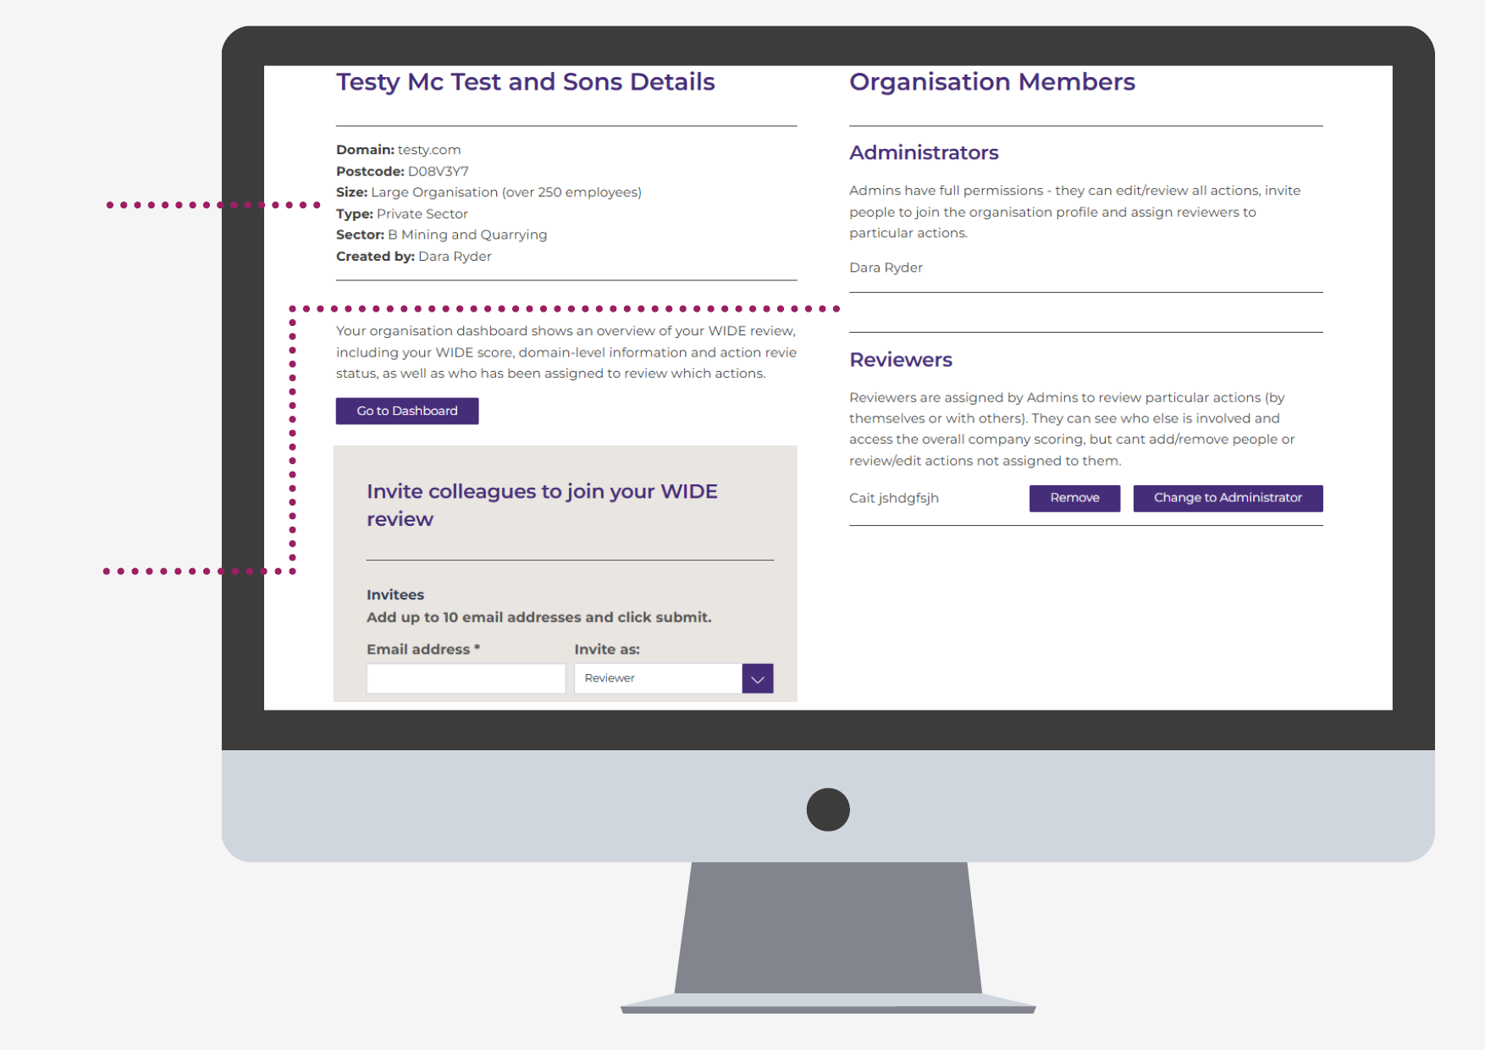
Organisational Profile
Create an individual account then and Organisation Profile
Invite Colleagues to Join: Everyone’s Business
Administrator and Reviewer Permission Levels Available
Notes:
Once you have made an individual and then organisational profile, of which you will automatically be an administer with full access, you can see an example on the screen, Testy McTest and Sons
You are able to invite colleagues to join your organisational profile either as other administers or reviewers which has specific permissions to review specific actions only

Slide 51
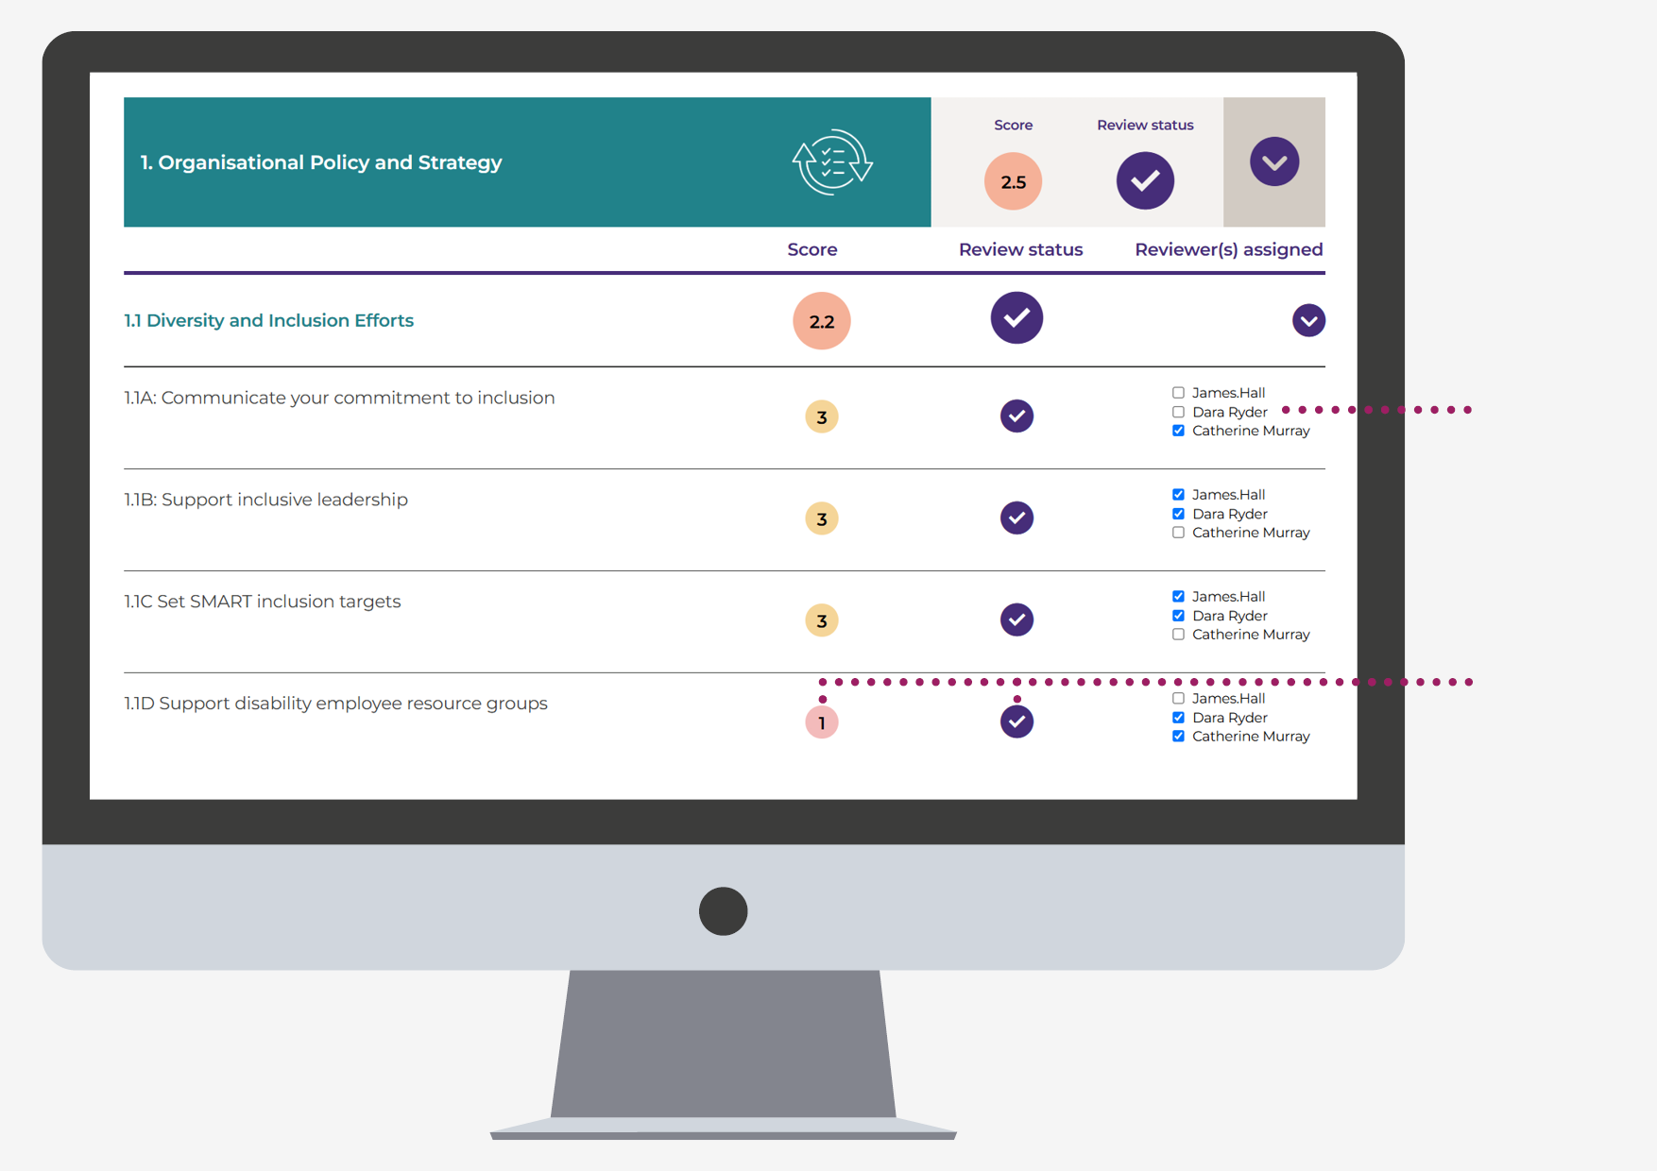
Dashboard –
Your Review Control Centre
Easy Review Assignment
Organisational admins can invite colleagues into the process and assign them to review specific actions.
Live Progress status
Easy to see where the review process is at and how your organisation is faring.
Notes:
An organisational profile means that you are able to review your organisational progress against each guidance note, you can award yourself a score (which I’ll explain shortly).

Slide 52
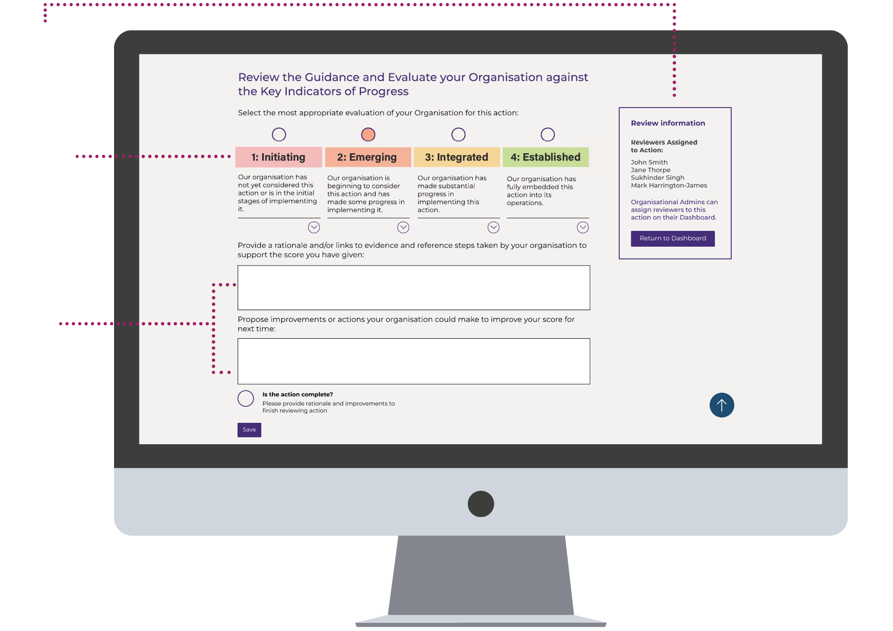
Action Review
Assigned reviewers listed
Maturity Model Approach
Guidance reviewed and progress measured
Evidence-Recorded, Improvements Planned
Rationale for the score recorded for transparency.
Notes:
When logged in, you are also able to see the maturity model which is found at the bottom of every guidance note page.
If you assigned a reviewer to that guidance note, you or you and colleagues also assigned to review that particular guidance note, select where you organisational is faring either 1 point for initiating, 2 points for emerging, 3 points for integrated or 4 points for established.
There are also two comment boxes where you provide rationale for the score, perhaps attachments or examples and then propose improvements

Slide 53
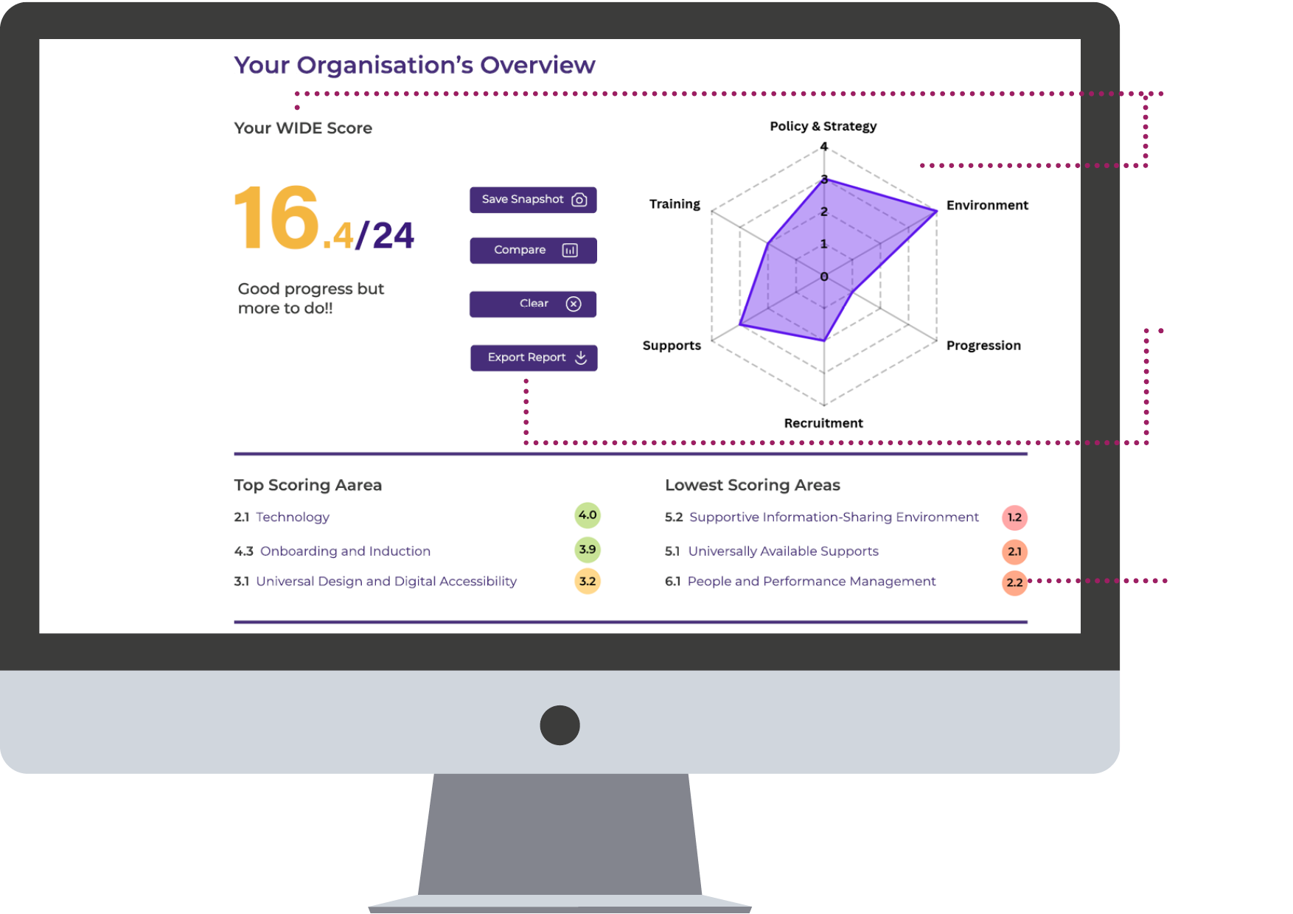
Dashboard:
Insights at a Glance
WIDE score and radar chart summarise performance.
Practical Features
Basic comparison tools and a summary exportable report.
Strengths and Areas for Improvement Highlighted
Links to legislation and links to practical resources supporting implementation.
Notes:
As you work through the WIDE framework and score yourself against the maturity model, you are able to see an overview of how the organisation is performing in relation to the 6 domains, visually shown on a radar chart.
Your top 3 scoring areas and lowest 3 scoring areas are also highlighted.
Some key features of the dashboard over are that
You can save a snapshot in time, perhaps today and then again in 6 months time and compare your progress
You can also export a report, useful for funding applications, board reports and business improvement planning

Slide 54
4) Getting Started –
Your Next Steps
Explore the Platform – Share with Colleagues
Consider a Review
  Read the User Guide – Reach Out for Support!
  Establish Responsibility - Form Your WIDE Group
  Review Your Policy and Practice Against the Framework
  Develop an Improvement Plan
Notes:
DR

Slide 55
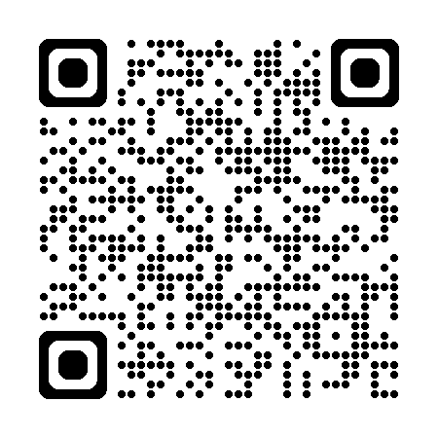
Thank You
Visit the Framework:
wide.employersforchange.ie
Contact Us:
Training and inclusive workplace support: info@employersforchange.ie
Support with using the WIDE Framework in your org: wide@ahead.ie

Slide 56
References
Aryani, R., & Widodo, W. (2020). The Determinant of Organizational Culture and Its Impact on Organization: A Conceptual Framework. The International Journal of Higher Education, 9, 64-70. https://doi.org/10.5430/ijhe.v9n3p64
Bavardi, A. (2025). Values-Based Leadership: The Role of Organizational Culture in Business Success. International Journal of Social Science Research and Review. https://doi.org/10.47814/ijssrr.v8i7.2682
Bogale, A., & Debela, K. (2024). Organizational culture: a systematic review. Cogent Business & Management, 11. https://doi.org/10.1080/23311975.2024.2340129
Costa, R. (2025). Building a Strong Organizational Culture: Key Drivers and Best Practices. OTS Canadian Journal. https://doi.org/10.58840/dyqem182
Gordon, G. (1991). Industry Determinants of Organizational Culture. Academy of Management Review, 16, 396-415. https://doi.org/10.5465/amr.1991.4278959
Jaiyeola, O., Blessing, K., Ayuba, M., Jaiyeola, A., & Roland, E. (2025). The Impact of Leadership on Organizational Culture and Employee Well-Being. Advances in Social Sciences and Management. https://doi.org/10.63002/assm.305.1166
Khan, M., Husain, S., Minhaj, S., Ali, M., & Helmi, M. (2024). To explore the impact of corporate culture and leadership behaviour on work performance, mental health and job satisfaction of employees: An empirical study. Journal of Infrastructure, Policy and Development. https://doi.org/10.24294/jipd.v8i11.6417
Mehendale, S., & Hande, A. (2025). A Study Concerning the Impact of the Organizational Culture on Employee Performance: A Literature Review. INTERNATIONAL JOURNAL OF SCIENTIFIC RESEARCH IN ENGINEERING AND MANAGEMENT. https://doi.org/10.55041/ijsrem52184
Men, L., & Yue, C. (2019). Creating a positive emotional culture: Effect of internal communication and impact on employee supportive behaviours. Public Relations Review. https://doi.org/10.1016/j.pubrev.2019.03.001

Slide 57
References cont..
Michulek, J., Gajanova, L., Križanová, A., & Nadanyiova, M. (2023). Determinants of improving the relationship between corporate culture and work performance: Illusion or reality of serial mediation of leadership and work engagement in a crisis period?. Frontiers in Psychology, 14. https://doi.org/10.3389/fpsyg.2023.1135199
Obydiennova, T., Demianenko, T., & Shelest, O. (2025). FACTORS INFLUENCE ON THE FORMATION AND DEVELOPMENT OF CORPORATE CULTURE OF AN ENTERPRISE. Market Infrastructure. https://doi.org/10.32782/infrastruct83-39
Paais, M., & Pattiruhu, J. (2020). Effect of Motivation, Leadership, and Organizational Culture on Satisfaction and Employee Performance. The Journal of Asian Finance, Economics and Business. https://doi.org/10.13106/jafeb.2020.vol7.no8.577
S, P., & Arunprakash, R. (2025). A STUDY ON ORGANISATIONAL CULTURE AND IT’S IMPACT ON EMPLOYEE BEHAVIOUR WITH REFERENCE TO FIBRECARE TECHNOLOGIES. Juni Khyat. https://doi.org/10.36893/jk.2025.v15i3.005
Shamsudin, S., & Velmurugan, V. (2023). A Study on the Drivers of Corporate Culture Impacting Employee Performance in it Industry. International Journal of Professional Business Review. https://doi.org/10.26668/businessreview/2023.v8i2.1023
Szczepańska, K., & Kosiorek, D. (2017). Factors influencing organizational culture. **, 2017, 457-468. https://doi.org/10.29119/1641-3466.2017.100.34
Warrick, D. (2017). What leaders need to know about organizational culture. Business Horizons, 60, 395-404. https://doi.org/10.1016/j.bushor.2017.01.011

Slide 58
Group discussion instructions
Breakout Sessions – As a group discuss the following:
1. What insights or learnings did you gain about the topic of culture from the speakers this morning?
2. What specific steps or actions can you and / or company take to create a cultural shift in your workplace which fosters inclusion, diversity and belonging (Short, Medium, Long term)
*During the discussion, please feel free to share examples of effective practices from your own organisation which others may learn from.

Slide 59
Q&A, Closing Remarks
Closing Remarks
DCEE - Oonagh Buckley - Secretary General
AHEAD

Slide 60

Q&A, Closing Remarks
Scan QR Code
Event Evaluation
https://www.surveymonkey.com/r/CultureInBloom

