Slide 1

Work smarter, not harder: using technology to support return to higher education and employment
Marie Cox, Senior Speech & Language Therapist
Sharon Leahy, Senior Occupational Therapist

Slide 2




Outline
AT Clinic overview
Outpatient service overview
Case Studies
Questions

Slide 3
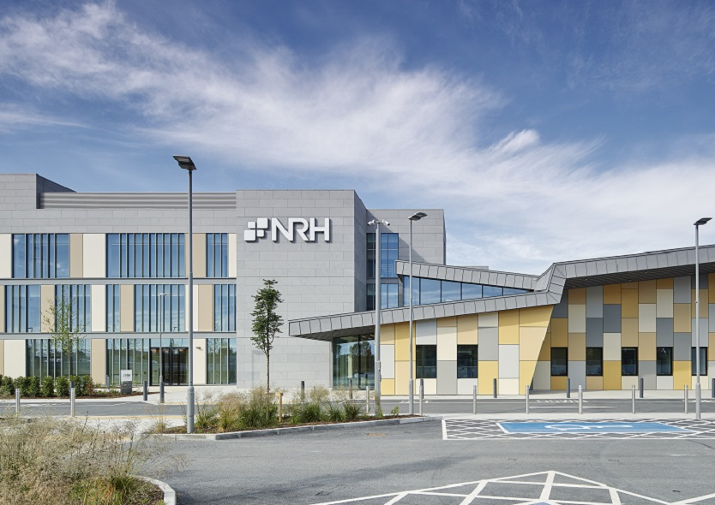
National Rehabilitation Hospital
National specialist complex neurorehabilitation service
New hospital building located in Dun Laoghaire
Brain injury programme; Spinal Cord service; POLAR (Prosthetics, Orthotics and Limb Absence Rehabilitation); Paediatrics
Inpatient (120 beds) & Outpatient services

Slide 4
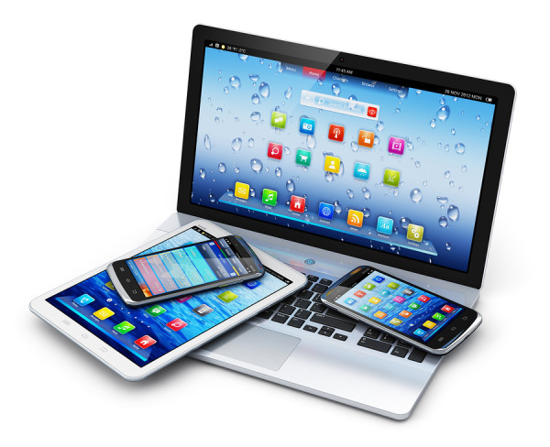
NRH Assistive Technology Clinic
IDT clinic (OT & SLT)
Staffing: OT 0.5 WTE, SLT 0.3 WTE, 0.1 Staff grade OT, Therapy assistant 1 WTE.
Volunteers x 2
Increased capacity for follow up of complex inpatients
Outpatient, Outreach & Vocational service (BI, SCSC, POLAR, Paediatrics) established in 2021
Telehealth for outpatients/vocational
Notes:
In 2021, the service expanded to cater to outpatients and vocational patients. The AT outpatient/vocational service offers appointment-based consultations for patients to trial relevant AT to meet their specific goals, particularly for higher education or returning to work.

Slide 5
Outpatient & Vocational service update and overview
Commenced in November 2021
NRH outpatients and vocational service only
Referrals from NRH OPD OT/SLT/PT
Service Delivery:
  1.5 hour consultation appointment +/- referring therapist in attendance
  Report and recommendations provided
Reflections:
  Patient readiness for engagement with service
  Follow up sessions may be beneficial for BI patients
  Family members in attendance
  Relevant goals
  Opportunities for technology use and practice e.g. phone

Slide 6
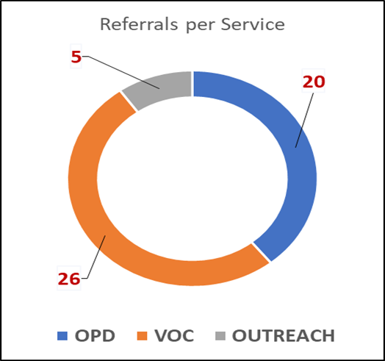
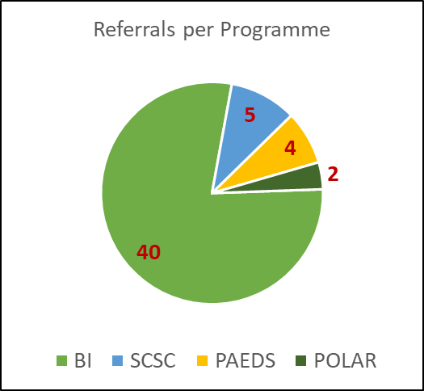
Outpatient AT Clinic – Year 1
Notes:
Total of 51 referrals to the OPD AT Clinic service in year 1 with the majority being from Vocational and BIP.

Slide 7
Patient Feedback
“I very much enjoyed meeting Sharon and Marie at the NRH on Wednesday. The session was both enjoyable and informative. I have had the opportunity trial a couple of the apps and am looking forward working with the others”.
“I am very satisfied with assistive technology clinic visit. All the members were very knowledgeable and genuinely trying to help me. Also they documented what we discussed and shared with me which I thought was really beneficial for people like me who is weak in remembering things”
“Providing information on assisted technology should also consider the legal implications of such technologies. To use ATs the patient may have to obtain approval from their employer involving, for example, HR, and there could be a significant delay in deploying ATs as HR must provide approval e.g., for recording work meetings”.
“Perhaps some communication in advance of the actual meeting might be worthwhile”.

Slide 8

Case studies

Slide 9

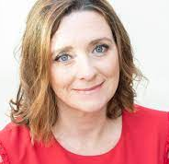
Case Study – Jennifer
51 year old; works in media
Diagnosis: Spontaneous intracerebellar haemorrhage
Referral from Vocational OPD team
Main difficulties – cognitive fatigue, reduced information processing speed and capacity; managing complex written information.
Good physical recovery.
Describes her job as high pressure with deadlines to generate her creative ideas, Fatigues quickly at the computer now.

Slide 10




Goals for AT assessment - Jennifer
To explore speech-to-text options that could be used in a work context.
To explore text-to-speech that could be used in a work context.
To explore inbuilt accessibility features to minimize impact of cognitive fatigue.
To explore technologies to support note taking.
Notes:
These goals were addressed over 2 appointments – first in person and second via telehealth.
6-week gap which allowed for trial, practice and consolidation of new learning.
Highly motivated and insightful to the benefits of AT.

Slide 11
AT Intervention
Speech-to-text
  Phone: inbuilt on iOS keyboard
  Laptop: Inbuilt Dictation function on MacBook
  Supported access to text messaging, e-mails, Word documents.
Text-to-speech
  Inbuilt options on smartphone and MacBook
  Highlight Content
  Reduced speaking rate
Inbuilt Accessibility Features
  Reader View on Safari browser – declutters and simplifies web pages.
  Enlarged font size
Note Taking
  Otter AI – note taking software (audio recording, transcription and keyword summary capabilities)
  Live Scribe pen

Slide 12

Case Study 2 – Louise
24-year-old; Business Masters student; working part-time
Diagnosis: Meningioma; 8 months post-resection
Referral from Vocational OPD team
Main difficulties: Visual field cut and reduced scanning; reading is slowed; reduced accuracy when sending text messages and emails
Good physical recovery

Slide 13
Goals for AT assessment - Louise
To explore AT options to support proofreading written materials (emails, messages, Word documents)
To explore AT options to support reading and processing written information (e.g. journal articles, emails etc)
To explore options to support typing access
To explore AT options to support visual changes
To explore AT options to support with college note taking

Slide 14
AT Intervention - Jennifer
Reading & Proof Reading
  Inbuilt text-to-speech function on phone
  Highlight spoken content
  Reader View on Safari browser
  Immersive Reader in Microsoft Outlook
  Read Aloud function in pdf documents
Writing emails etc
  Phone: Inbuilt speech-to-text
  Laptop:
    Inbuilt Dictation in Office365
    Email templates within Microsoft Outlook
    Keyboard shortcuts
    Show text suggestions as I type
Note Taking
  Glean software – audio notes and transcription
Vision
  Phone: Dark mode; Enlarged font and bold font
  Laptop: Enlarged mouse cursor in high contrast colour

Slide 15

Any Questions

